Slide 1



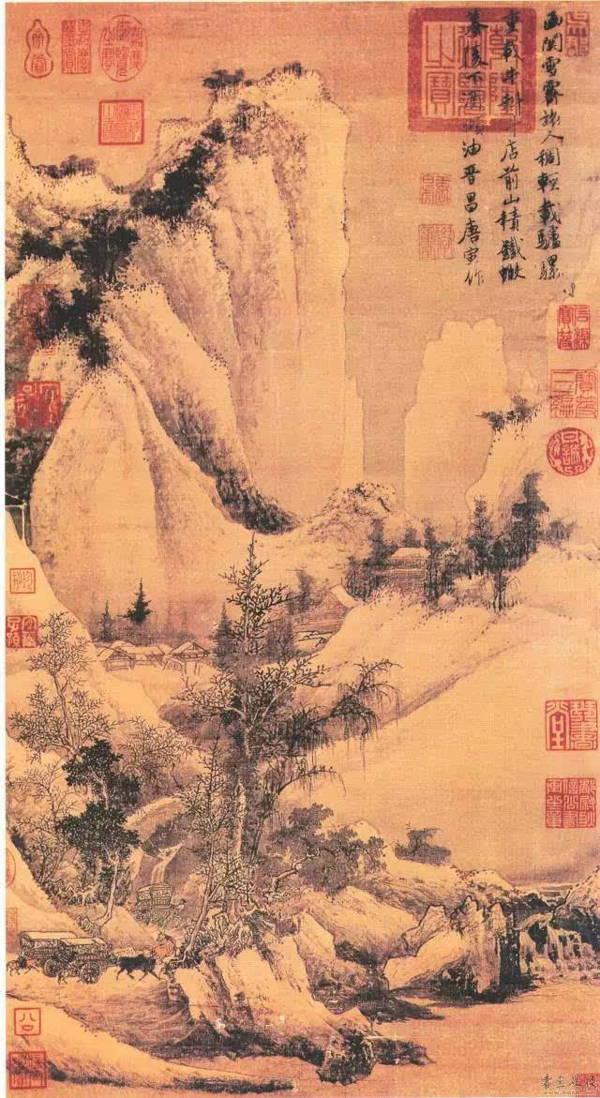

Unit 1 Art
Reading for writing

Slide 2
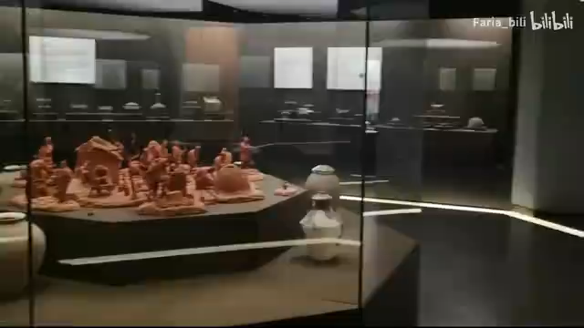
What Chinese art have you seen in the video?

Slide 3
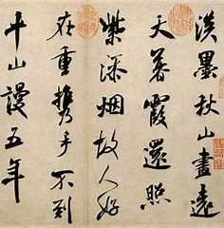
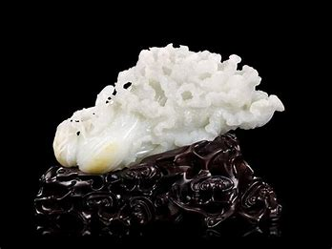
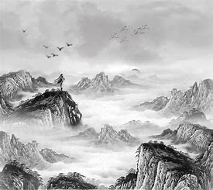
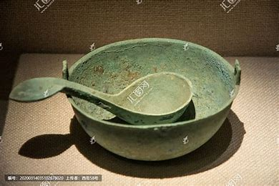
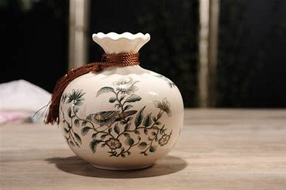
What Chinese art have you ever seen in the museum?
calligraphy
jade sculptures
Chinese Art
ink wash paintings
bronze bowls
ceramic vases

Slide 4
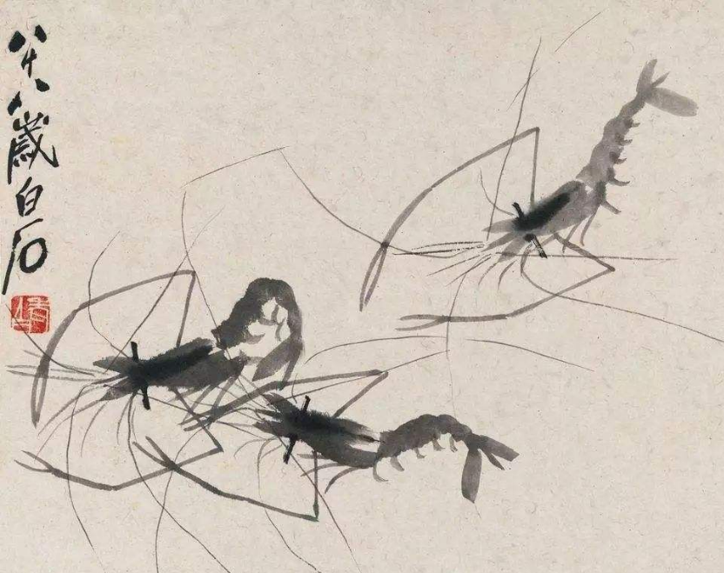
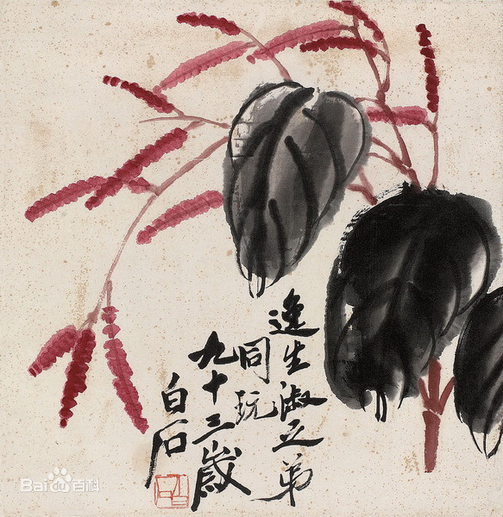
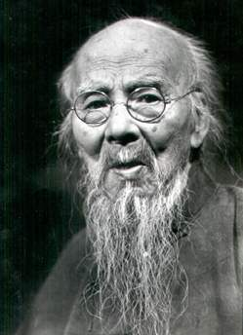
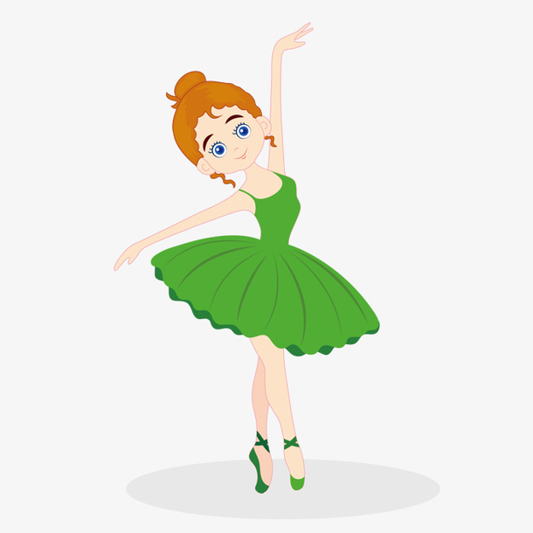
As for painting, which Chinese artists do you know?
Qi Baishi (1864 — 1957) is recognized for his very careful and beautiful way of painting common images.

Slide 5
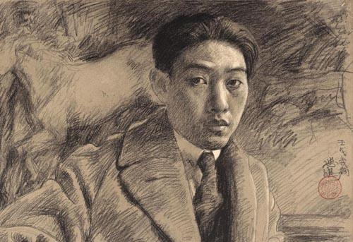
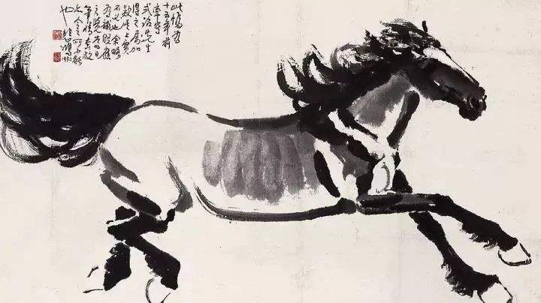
As for painting, which Chinese artists do you know?
Xu Beihong (1895 — 1953) is one of the most celebrated painters in modern China. He loves painting horses.

Slide 6
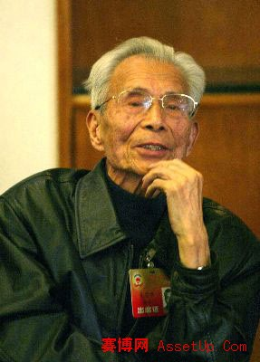
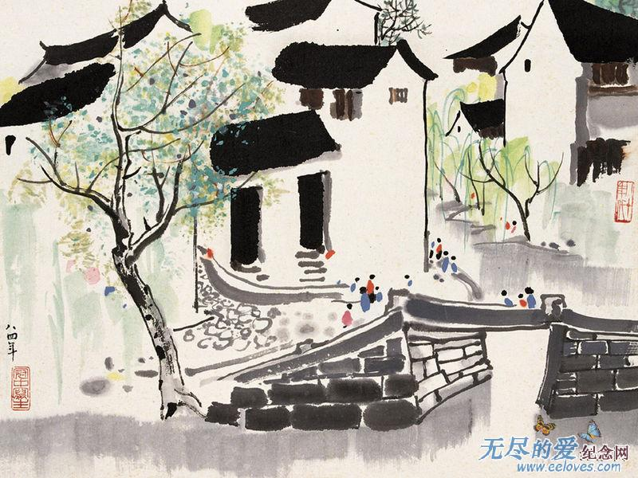
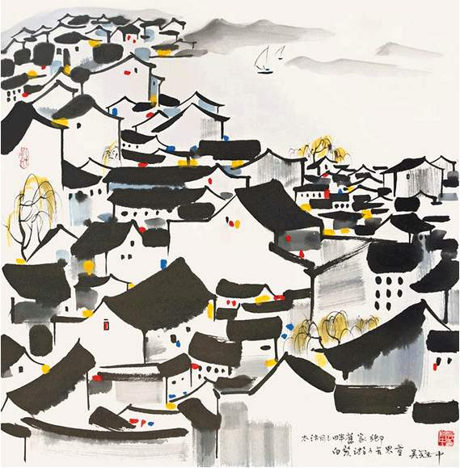
As for painting, which Chinese artists do you know?
Wu Guanzhong (1919 — 2010) is a contemporary Chinese painter. His distinctive painting style is both Chinese in outlook and modern in conception.

Slide 7
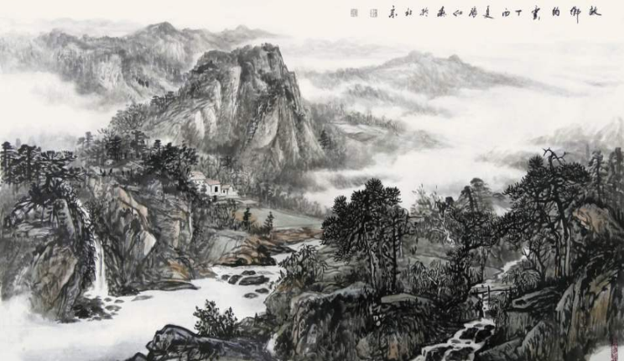
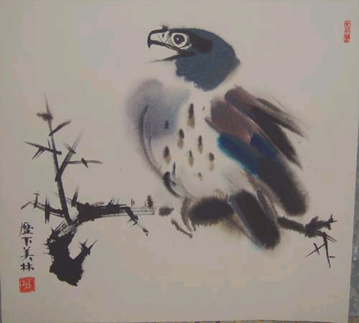
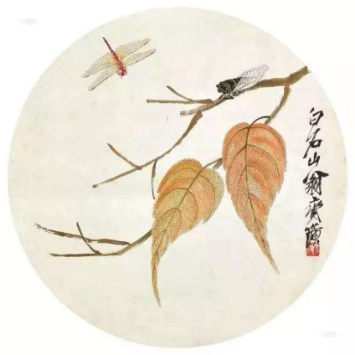
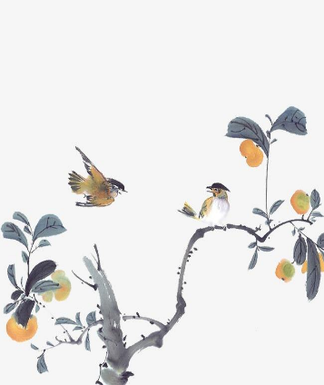
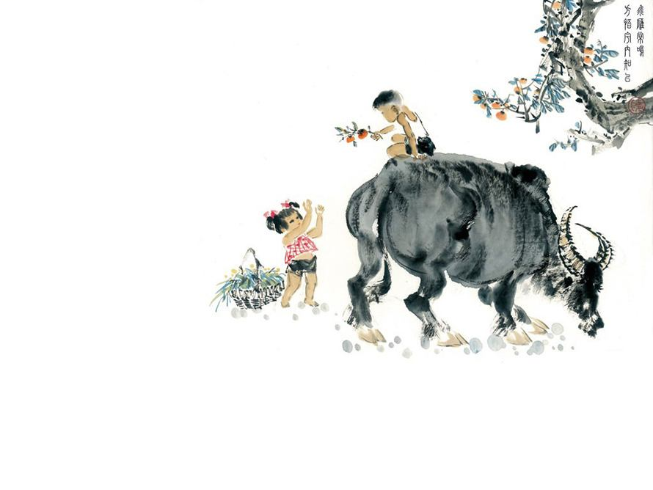
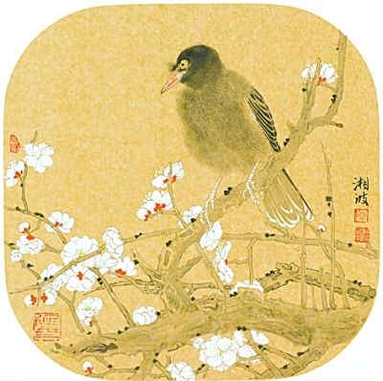
Features of Chinese painting
Chinese painting is often about nature. It has the symbol of harmony and peace.

Slide 8
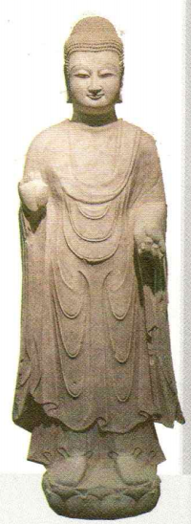
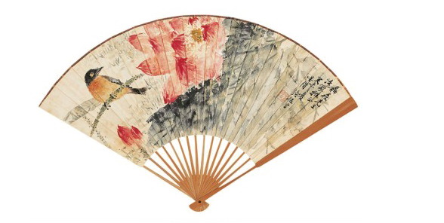
Where can you read the text?
What is the text type of the passage?
?
Advertising leaflets(宣传册) or newspaper
A. Narration(记叙文).
B. Argumentative Essay(议论文).
C. Expository Writing(说明文).
D. Practical Writing(应用文).

Slide 9
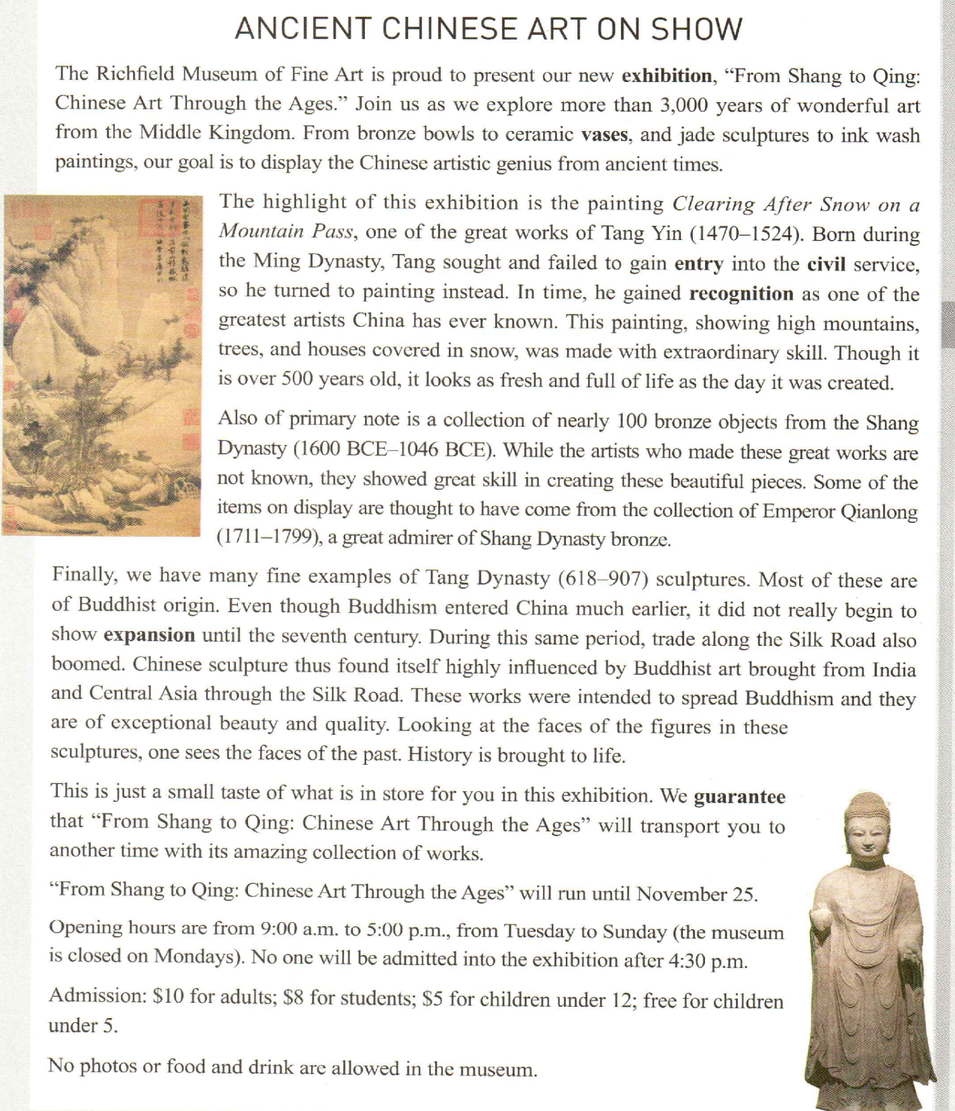
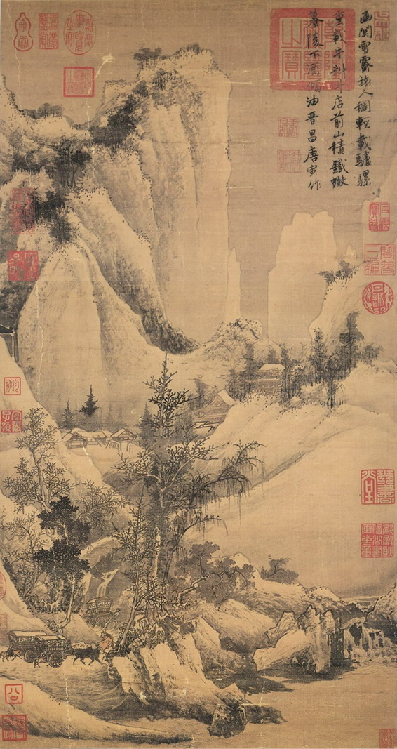

Para1: ____________________to the art exhibition
Ancient Chinese Art On Show
General introduction
1. What kind of article is this?
2.Who are the intended readers?
3.How many parts can this text
be divided into?
An announcement
Lovers of art.
Para2-4: ______________ of the exhibition
The highlights
the significance
Para5: _____________ of the exhibition
Tang Dynasty sculpture
唐代雕塑
Attentions
Clearing After Snow on a Mountain Pass
《函关雪霁图》
Para6-9: _____________ of the exhibition

Slide 10
https://www.bilibili.com/video/BV1TLaGzCEpY/?spm_id_from=333.337.search-card.all.click

Slide 11
An exhibition at the Jushi Art Museum in Shanghai is featuring artwork inspired by Go, or weiqi in Chinese, 56.______ originated in China more than 4,000 years ago.
Go is one of 57.______ earliest binary-based (基于二元的) games. The movements of the black and white pieces reflect the basic ideas of Eastern philosophy, according to Tu Ningning, who is in charge of the exhibition.
“The exhibition brings together Go culture, cutting-edge technology and contemporary art,” says Tu. “We hope 58.______(present) the rather abstract Go game and AI in a visual context, and initiate dialogues with minimalist art, conceptual art and expressionism.”
“In a Go game, each move should serve a long-term goal. You try to lead the opponent into your trap and force them to follow your ‘59.______(guide)’ till they lose,” explains Wang Wei, a Go player among the visitors to the exhibition.
“The players’ personalities 60.______(reveal) during the game, and one’s weaknesses are exposed to the opponent,” she adds. “A decent winner always 61. ______(try) to beat the opponent 62.______ no more than one or two points as a gesture (姿态) of respect for the other side.”
Tu says that the balance between the black and white pieces, the beauty in the 63.______(strategy) placement of the pieces, 64. ______the energy flow following each move inspired artists to create oil paintings, sculptures, 65.______(digital) generated pictures and silk-screen prints for the exhibition.

Slide 12
which,
the,
to present,
guidance,
are revealed,
tries,
by,
strategic/stratecial,
and ,
digitally

Slide 13
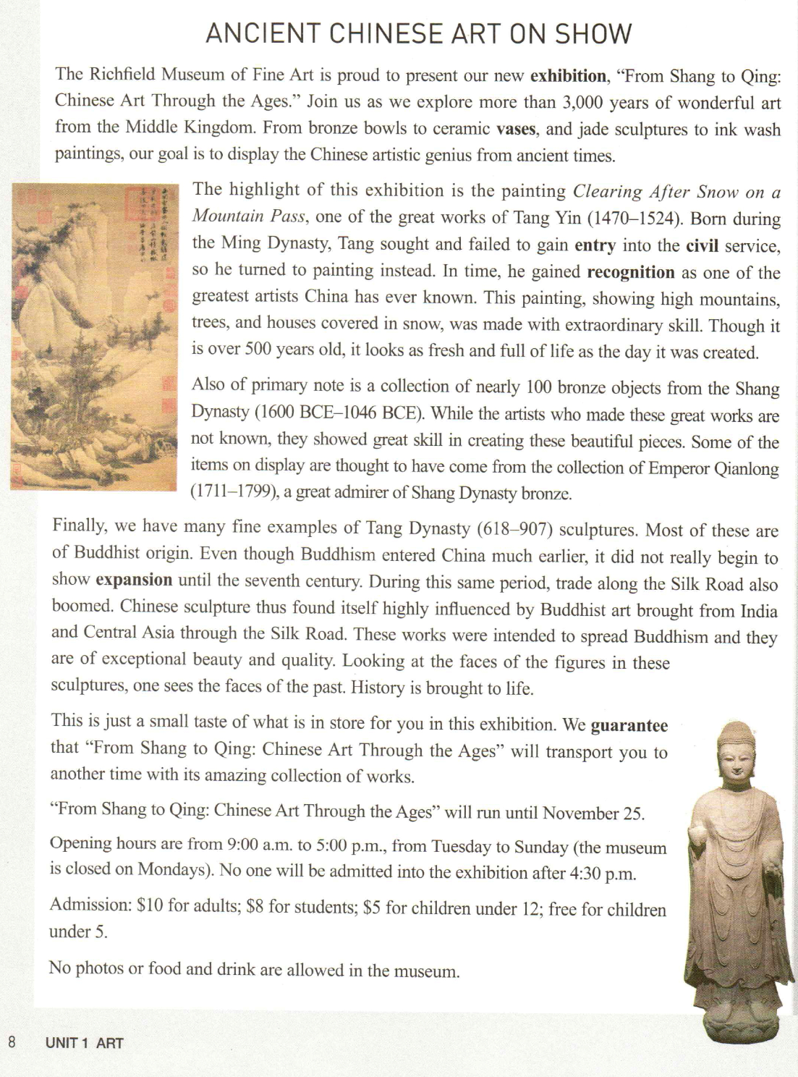
Read the text carefully and find the basic information.
?
Theme
Items on display
Purpose
Highlights
Possible emotions
Date
Details
Opening hours
Ticket price
Rules

Slide 14
Theme
From Shang to Qing: Chinese Art Through the Ages
Items on display
Bronze bowls, ceramic vases, jade sculptures and ink wash paintings
Purpose
To display the Chinese artistic genius from ancient times
?
Ancient Chinese Art on Show
The painting called Clearing After Snow on a Mountain Pass.
Highlights
A collection of nearly 100 bronze objects.
Many fine examples of Tang Dynasty sculptures
Possible emotions
amazed, thrilled and fascinated
It runs until November 25
Date
Opening hours
9:00 a.m. - 5:00 p.m. (Tuesday to Sunday)
Details
Ticket price
Adults: $10, students: $8, children uder12: $5,
Rules
Photos or food and drink are prohibited.

Slide 15
Detailed reading (para2-4)：Complete the form.
Item | Dynasty | Artist | Reason for showing
The painting
Ming Dynasty
Tang Yin
(1470-1524)
Made with extraordinary skills,
Fresh and full of life
a collection of bronze objects
Shang Dynasty
(1600BCE-1046BCE)
Show great skill.
Some may come from the collection of Emperor Qianlong
Not known
Buddhist origin,
be of exceptional beauty and quality,
Bring history to life
The sculpture
Tang Dynasty
(618-907)

Slide 16
Reading for details : complete the advertising leaflet below.
NEW EXHIBITION
From Shang to Qing: Chinese Art Through the Ages
“_______________________________________________”
More than of wonderful art from China on display.
3,000 years
Highlights:
The painting Clearing After Snow on a Mountain Pass, by .
A collection of nearly 100 .
Many fine examples of .
Tang Yin
bronze objects
Tang Dynasty sculptures
You will .
Date: Now until .
Opening hours: a.m. to p.m.
Museum is closed on .
Tickets: Adults $ , Students $ ,
Children under 12 $5, Children under 5 free.
No photos or food and drink allowed in museum.
be transported to another time with its amazing collection of works
November 25
9:00
5:00
Mondays
10
8

Slide 17
Words and Expressions

Slide 18
The Richfield Museum of Fine Art is proud to present our new exhibition, “from Shang to Qing: Chinese Art Through the Ages.” Join us as we explore more than 3,000 years of wonderful art from the Middle Kingdom.
里奇菲尔德美术博物馆很荣幸为您介绍我们的新展览——“从商朝到清朝：历代中国艺术”。加入我们一起来探索来自中央王国（即中国）的具有3000多年历史的美妙艺术。
be proud to do 很荣幸/自豪做...
n. 展览，展出
历代中国艺术
as引导时间状语从句
历代；自古以来; 古往今来

Slide 19
n.陶瓷制品，陶瓷器
adj. 陶瓷的
From bronze bowls to ceramic vases, and jade sculptures to ink wash paintings, our goal is to display the Chinese artistic genius from ancient times.
从青铜碗到陶瓷花瓶，从玉雕到水墨画，我们的目标是展示中国古代的艺术才赋。
青铜碗
玉雕
水墨画
陶瓷花瓶
n. 天赋，天资；天才
to do作表语

Slide 20
n.最精彩的部分
v.强调
《函关雪霁图》
The highlight of this exhibition is the painting Clearing After Snow on a Mountain Pass, one of the great works of Tang Yin (1470-1524).
本次展览的亮点是唐寅（1470—1524）的杰作之一--《函关雪霁图》。
同位语
one + of + the + adj.最高级 + n. 复数

Slide 21
Born during the Ming Dynasty, Tang sought and failed to gain entry into the civil service, so he turned to painting instead. In time, he gained recognition as one of the greatest artists China has ever known.
唐寅出生在明朝，他曾试图考取文官，但失败了，所以他转而从事绘画。最终，他被公认为中国有史以来最伟大的艺术家之一。
V-ed作状语
seek to do 试图做...
fail to do 未能做...
进入，加入
公务员体制
转而，求助于
及时，最终
被公认/承认... ;因为...获得赞誉
one + of + the + adj.最高级 + n. 复数
定语从句，省略that，修饰artists

Slide 22
This painting, showing high mountains, trees, and houses covered in snow, was made with extraordinary skill. Though it is over 500 years old, it looks as fresh and full of life as the day it was created.
这幅画运用了非凡的技巧，展现了高山、树木和被雪覆盖的房屋。虽然它已经有500多年的历史了，但看起来清新且充满生机，就像刚被创作出来一样。
V-ing作后置定语
V-ed作后置定语
adj. 非凡的，卓越的
（1）关系副词 when 被省略通常见于先行词是 day, night, morning, afternoon, evening, week, month, year, time 等表示时间的“常见名词”。
（2）关系副词 where 被省略通常见于先行词是 somewhere，anywhere，wherever，nowhere和place等表示地点的“常见名词”。
（3）关系副词 why 被省略通常见于先行词是 reason。
though引导让步状语从句
充满生机
定语从句，省略关系副词when，修饰the day

Slide 23
Also of primary note is a collection of nearly 100 bronze objects from the Shang Dynasty (1600BCE-1046 BCE). While the artists who made these great works are not known, they showed great skill in creating these beautiful pieces.
同样十分重要的（看点）是来自商代（公元前1600-公元前1046）的近百件青铜器藏品。虽然不清楚创作这些伟大作品的艺术家是谁，但他们在创作这些美丽的作品时表现出了高超的技艺。
全部倒装
显要的; 有名的
一群;一批；一堆
adj. 首要的；初级的
while引导让步状语从句
who引导定语从句，作主语，修饰artists
V-ing作宾语

Slide 24
Some of the items on display are thought to have come from the collection of Emperor Qianlong (1711-1799), a great admirer of Shang Dynasty bronze.
其中一些展品被认为是十分欣赏商朝的青铜器的乾隆皇帝（1711—1799）的收藏品。
在展出
be thought to被认为做...
同位语

Slide 25
Finally, we have many fine examples of Tang Dynasty (618-907) sculptures. Most of these are of Buddhist origin. Even though Buddhism entered China much earlier, it did not really begin to show expansion until the seventh century.
最后，我们还有许多唐代（618—907）的雕塑精品。 这些雕塑中大多数与佛教有关。虽然很早之前佛教便传入了中国，但直到公元7世纪它才真正开始传播开来。
be of + 抽象n. 具有...性质
even though引导让步状语从句
直到...才...

Slide 26
During this same period, trade along the Silk Road also boomed. Chinese sculpture thus found itself highly influenced by Buddhist art brought from India and Central Asia through the Silk Road.
与此同时，丝绸之路沿线的贸易也蓬勃发展。因此，中国雕塑深受经丝绸之路传来的印度和中亚佛教艺术的影响。
prep. 沿着，顺着
v. 迅速发展，繁荣
find + 宾语 + 宾补（done）
V-ed作后置定语

Slide 27
These works were intended to spread Buddhism and they are of exceptional beauty and quality. Looking at the faces of the figures in these sculptures, one sees the faces of the past. History is brought to life.
这些作品是为了传播佛教，而且它们外观精美、品质上乘。看着这些雕塑中人物的脸，你会看到过去的面孔。历史被赋予了生命。
打算做...；意在做...
be of + 抽象n. 具有...性质
V-ing作状语
bring...to life 赋予...生命

Slide 28
This is just a small taste of what is in store for you in this exhibition. We guarantee that “From Shang to Qing: Chinese Art Through the Ages” will transport you to another time with its amazing collection of works.
这只是本次展览供您参观的展品中的一小部分。我们保证“从商朝到清朝：历代中国艺术”展将凭借其令人惊叹的藏品让你穿越至另一个时代。
领略，感受
what引导宾语从句
v. 确保，保证；担保
即将发生...；等待着...
that宾语从句

Slide 29
“From Shang to Qing: Chinese Art Through the Ages” will run until November25.
“从商朝到清朝：历代中国艺术”展将持续到11月25日。
v. 持续，延续

Slide 30
Opening hours are from 9: 00 a.m. to 5:00 p.m., from Tuesday to Sunday (the museum is closed on Mondays). No one will be admitted into the exhibition after 4:30 p.m.
开放时间为星期二到星期日的上午9点到下午5点（博物馆星期一闭馆）。下午四点半以后不准任何人进入展馆。
被允许进入

Slide 31
Admission: $10 for adults; $8 for students; $5 for children under 12; free for children under 5.
No photos or food and drink are allowed in the museum.
门票：成人10美元；学生8美元；12岁以下儿童5美元；5岁以下儿童免费。
博物馆内禁止拍照和饮食。
n. 入场费

Slide 32
Writing

Slide 33
应用文分类
书信
通知
邀请函 道歉信
感谢信 申请信
投诉信 询问信
建议信 推荐信
书信
通知
书面通知
口头通知
应用文分类
报道
倡议
报道
倡议书
套路是关键
得体很重要

Slide 34
文体概述
通知是上级对下级、组织对成员或平行单位之间部署工作、传达事情或召开会议等所使用的应用文。常考的话题有活动、展览、比赛、讲座等事项通知。通知要求言简意赅、措辞得当、时间及时。
通知
书面通知
口头通知
标题：Notice
......
......
…….
the Students’ Union
Boys and girls, attention, please!
......
......
Thanks for listening!

Slide 35
口头通知
常用开头语：May I have your attention, please? 或Attention please. I have an announcement to make.
常用结束语：That's all. Thank you (for your attention).
如：请准时到校门口集合。
口头：
书面：
Casual v.s formal
please gather at the school gate on time.
Everyone is expected to gather at the school gate on time.
为避免命令之嫌，要求时书面通知中常采用被动语态

Slide 36
你校将要组织美国交换生参观中国美术馆(National Art Museum of China).请你根据下面提供的信息，口头通知活动安排。
集合的时间和地点：周六早上8:30，学校门口
交通方式：校车
活动内容：了解中国画家，欣赏著名画作
Hi! Everyone. Attention, please.
口头通知

Slide 37
假如你是李华，下周六你校将组织校内留学生参观在Art Museum举办的中国古代艺术品展，主题为 “From Shang to Qing”，请写一则通知发布在校园网上。内容包括：
1.展览的时间和地点；
2.展览内容；
3.参观时的注意事项。
书面通知

Slide 38
Write an art exhibition announcement
假如你是某个美术俱乐部的负责人李华，请你写一则通知，告知俱乐部成员要去参观一个美术展的事情。通知的内容需包含以下信息：
1.简介这个展览的内容：欣赏一些著名画家的作品；
2.最精彩部分就是唐寅的一幅画；
3.交代这个展览的开放时间等具体信息；
4.观看展览时的注意事项。
注意： 1.内容要包括以上提示，可适当增加细节，以使行文连贯。
2.标题已给出；An Art Exhibition Announcement

Slide 39
第一步 审题谋篇
[审题]
1.确定文体：这是一则通知。
2.主体时态：用一般将来时和一般现在时。
3.主体人称：以第三人称为主。
[谋篇]
第一段：介绍通知的目的。
第二段：简介这次展览的精彩部分以及注意事项。
第三段：最后表达祝愿。

Slide 40
第二步 遣词造句
[核心词汇]
1.展览
2.值得
3.尤其；特别
4.典型的；有代表性的
5.使与众不同
6.同时代的画家
exhibition
be worthy of
in particular
representative
set apart from
contemporary painters
_________
____________
____________
_____________
_____________
_____________________

Slide 41
7.承认……是
8.有很大影响力的
9.一流的
10.保证做某事
recognize...as
influential
of high rank
guarantee to do sth.
____________
__________
___________
__________________

Slide 42
介绍活动目的常用词汇
丰富课外生活
弘扬中国传统文化
促进文化交流
培养/激发对中国文化的兴趣
了解中国古代文化
展示中国传统文化之美
enrich after-class activities
promote traditional Chinese culture
promote cultural exchange
arouse the interest in Chinese culture
facilitate students’ understanding of Chinese civilization
display the beauty of traditional Chinese culture

Slide 43
介绍活动目的常用词汇
增强体魄
开阔视野
提高垃圾分类的意识
为急救演练做好准备
陶冶情操
培养对艺术的爱好
培养实践能力/创造力
增加对……的了解
build up our body
broaden our horizon
raise awareness of garbage classification
get better prepared for medical emergencies
cultivate one’s temperament
develop a taste for art
cultivate one’s practical ability/ creativity
further/deepen one’s understanding of...

Slide 44
介绍活动地点常用词汇
在会议室
在实验室
在报告厅
在体育场
在操场
在老师办公室
在学校大门口
在电影院
在二楼
在8号房
in the meeting room
in the lab
in the lecture hall
in the stadium
on the playground
in the teachers’ office
at the school gate
at the cinema
on the second floor
in Room 8

Slide 45
介绍活动时间常用词汇
2024年3月1日星期五上午9点
这周末
下周六
下周三晚上
下周二晚上8点
at 9:00 a.m. on Friday, March 1st, 2024
this weekend
next Saturday
next Wednesday evening
at 8:00 p.m. next Tuesday

Slide 46
1.介绍活动主题和目的常用句型
人作主语
物作主语
in order to/Aiming to/Aimed at/ with the purpose of doing sth
公式: In order to / Aiming to do sth., 组织者+ is going to /is scheduled to hold/ organize/launch a/an +活动名称+地点+时间, whose theme is...
为了增加我们的环保知识, 提高我们的英语口语水平, 学生会将于本周六早上8点~10点在学校礼堂举办一场英语演讲比赛, 主题是“保护环境,节约能源”。
Aiming to increase our knowledge about the environmental protection and improve our spoken English, the Students’ Union is going to organize/hold an English-speaking contest in the school lecture hall from 8:00 a.m. to 10:00 p.m this Saturday, whose theme is “Protect our environment and save our energy”.

Slide 47
1.介绍活动主题和目的常用句型
人作主语
物作主语
in order to/Aiming to/Aimed at/ with the purpose of doing sth
公式: Aimed at doing sth., 活动名称+ is going to /is scheduled to be held+地点+时间.
为了鼓励学生阅读更多的中国古典名著，学生会将会于5月30号下午3点~5点在学校礼堂举行一场学生中国名著朗诵比赛(Chinese Classics Reciting contest)。
Aimed at encouraging students to read more Chinese classics, a Chinese Classics Reciting contest among the students is scheduled to be held in the school lecture hall from 3 p.m to 5 p.m on 30th May by the Student Union.

Slide 48
2.介绍活动过程常用句型
1. ...offer you a fantastic / fabulous/ terrific opportunity to do sth/ Here comes your opportunity.
2. The highlight of... is ...
3. Also of primary note is ....
4. The best part of doing sth is that it enables sb to....
做某事最好的一点是可以让某人......
5. It's a wonderful / extraordinary experience for you to have a further knowledge of ....
6. It will not only develop/ enrich our knowledge, but also do us a favor to ...
7. I guarantee that you can gain knowledge that can't be acquired from books as well as develop your social skills.

Slide 49
3.介绍活动要求常用句型
1. Whoever is interested in it please join us. 任何感兴趣的人请加入我们。
2. All the students are expected/required /supposed to attend the lecture hall on time./All the students are welcome. 所有的学生都应准时在报告厅出席。/欢迎所有的学生。
3. Please keep in mind that... 请记住……。
4. Do be present on time. 请准时到达。
6. Don't miss the excellent chance/opportunity! And I hope you’ll have a nice time here! 不要错过这么棒的机会！
7. We'll gather at the school gate at eight tomorrow.
8. It is required/recommended that sb(should)....
9. If you have any problem, don’t hesitate to contact me at 电话号码／send your email at.../by WeChat.

Slide 50
[参考范文]
An Art Exhibition Announcement
Hello，everyone！We will go to see an exhibition next Sunday.The exhibition is about some paintings by several famous painters.
What makes the exhibition worthy of being visited is in particular one representative painting created by Tang Yin.Tang Yin’s excellent painting skills set him apart from his contemporary painters. Thus，he is recognized as one of the most influential artists China has ever known.
____________________________________________________________________________________________________________________
__________________________________________________________
____________________________________________________________________________________________________________________

Slide 51
While created more than 500 years ago，the painting still looks vivid and full of life.We will enjoy some other paintings，which are also of high rank.
Not only will no one be admitted into the exhibition after 4∶30 pm but also no photos or food and drink are allowed in the museum.To guarantee to get there as scheduled，please wait at the school gate at 7∶00 am next Sunday.Have fun！
____________________________________________________________________________________________________________________
__________________________________________________________
__________________________________________________________
__________________________________________________________
__________________________________________________________
__________________________________________________________

Slide 52
Thank You

