Slide 1

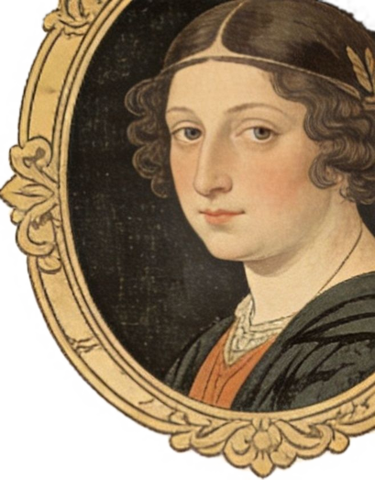
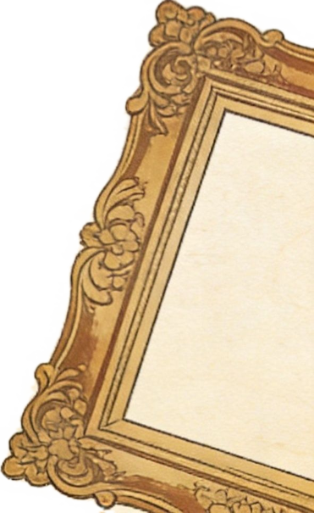
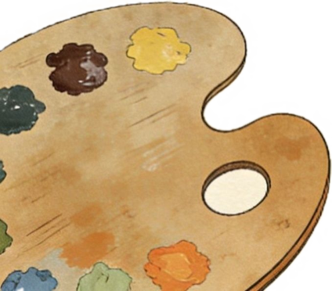
选择性必修三
Unit 1 Art
Reading and thinking
A Short History of Western Paintings

Slide 2


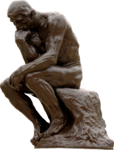


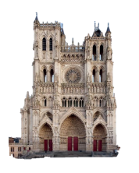
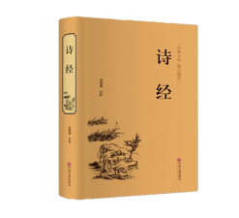

Lead in
What are the forms when it comes to art?
sculpture
雕塑

Slide 3
Lead in
What are the forms when it comes to art?
literature
文学

Slide 4
Lead in
What are the forms when it comes to art?
architecture
建筑

Slide 5

Lead in
What are the forms when it comes to art?
movie
影视

Slide 6
Lead in
What are the forms when it comes to art?
music&dance
音乐和舞蹈
Art is everywhere.
Learn art;
know art;
spread art.

Slide 7
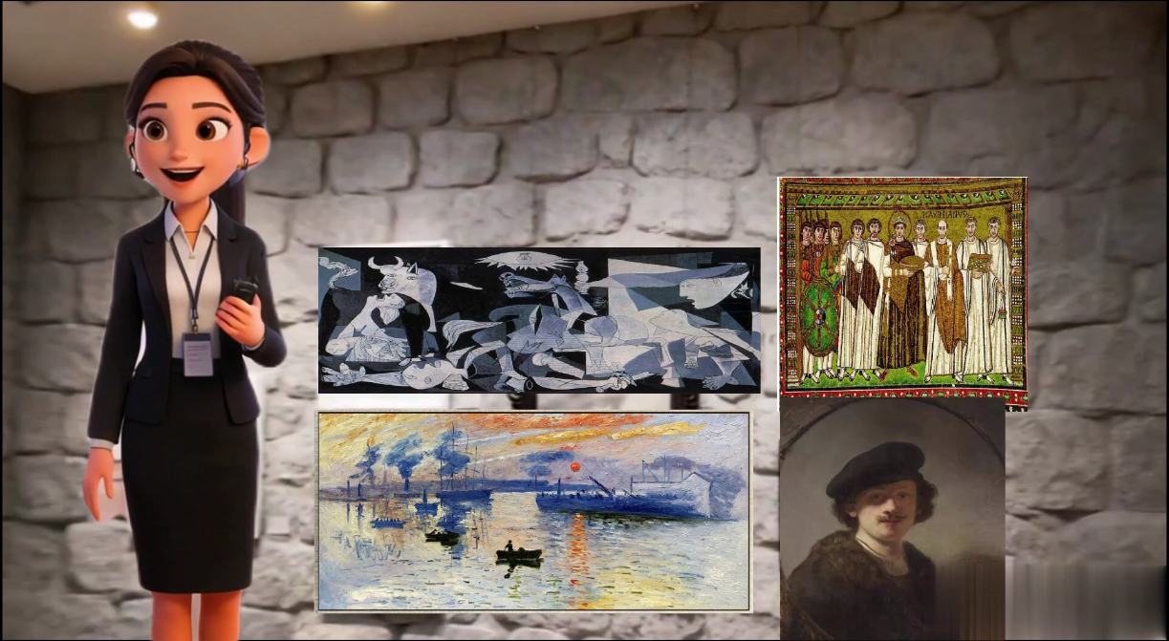
Lead in
Watch the video

Slide 8
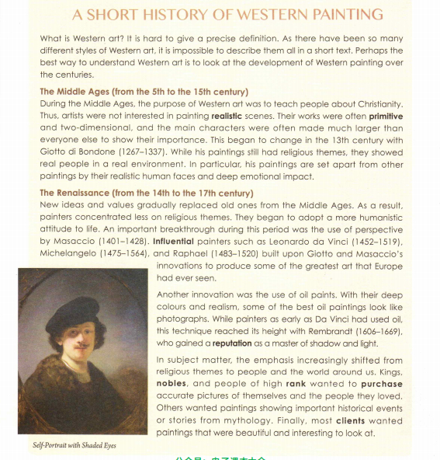
While-reading(skimming)
Find out the topic sentence of the text and four periods.
Topic sentence:
Perhaps the best way to understand Western art is to look at the development of Western painting over the centuries.

Slide 9
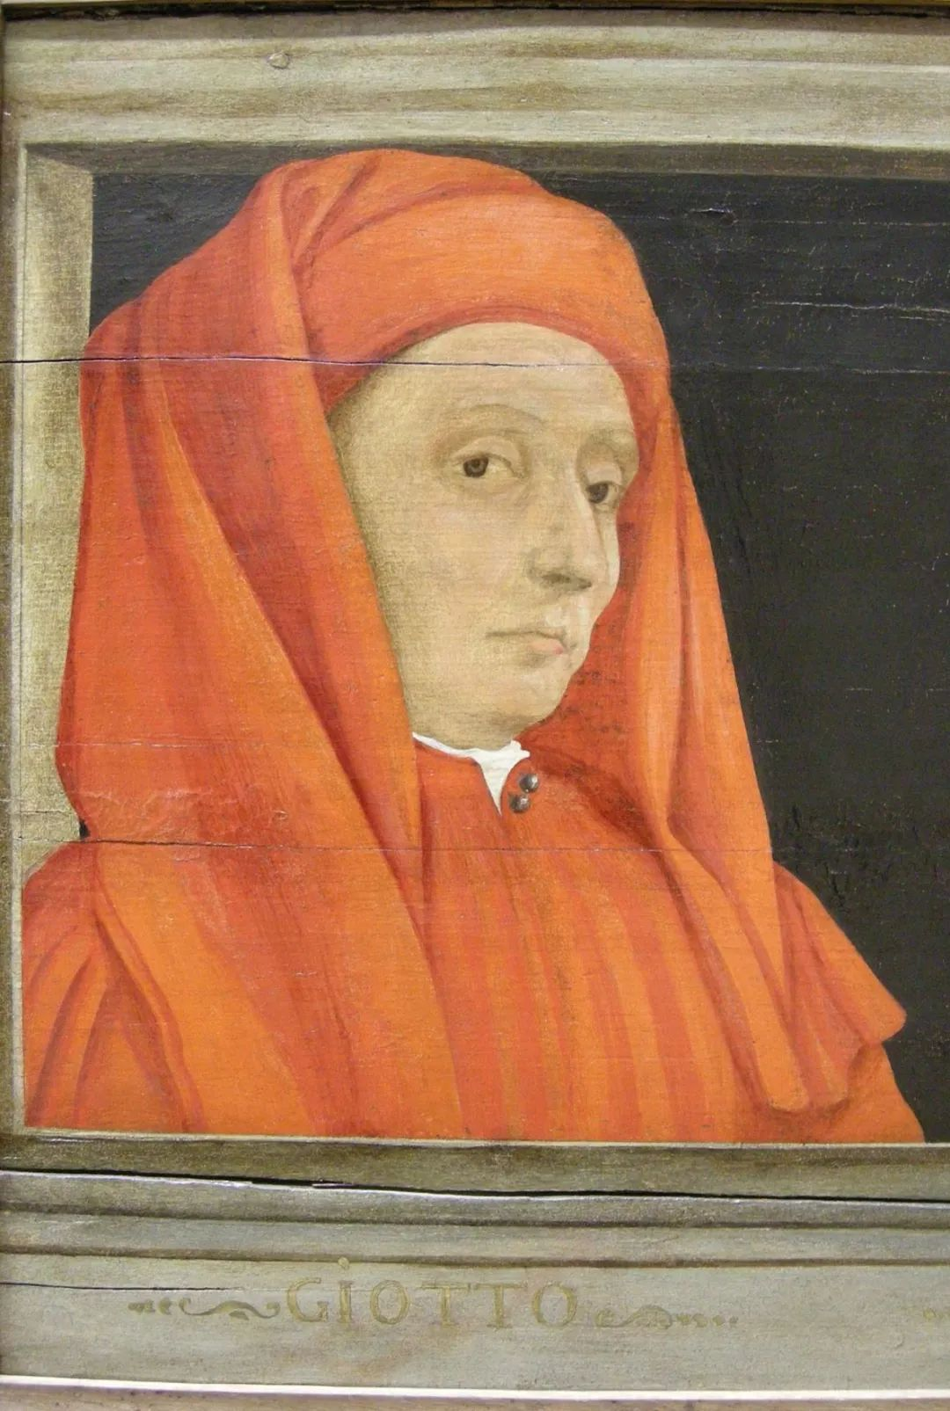

While-reading(scanning)
Period 1 | The Middle Ages (Para. 2)
Time
Purpose
Characteristics
Artists
From the 5th to the 15th century
To teach people about Christianity
From 5th to 13th century
From 13th to 15th century
Giotto di Bondone

Slide 10
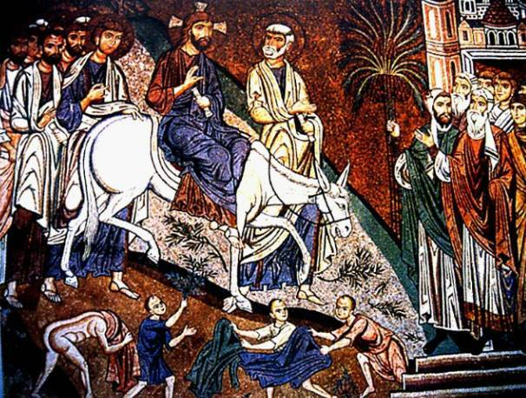
While-reading(scanning)
The Middle Ages (Para2.)
Characteristics
religious themes
primitive
two-dimensional
larger main characters
from the early Middle Ages

Slide 11
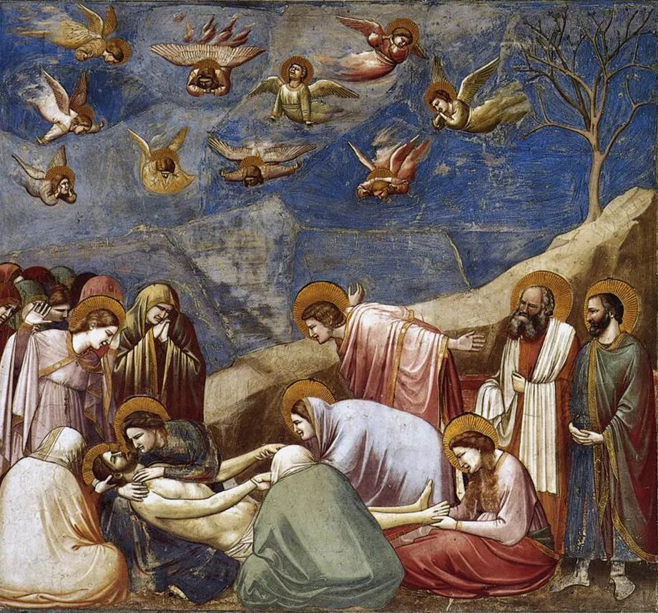
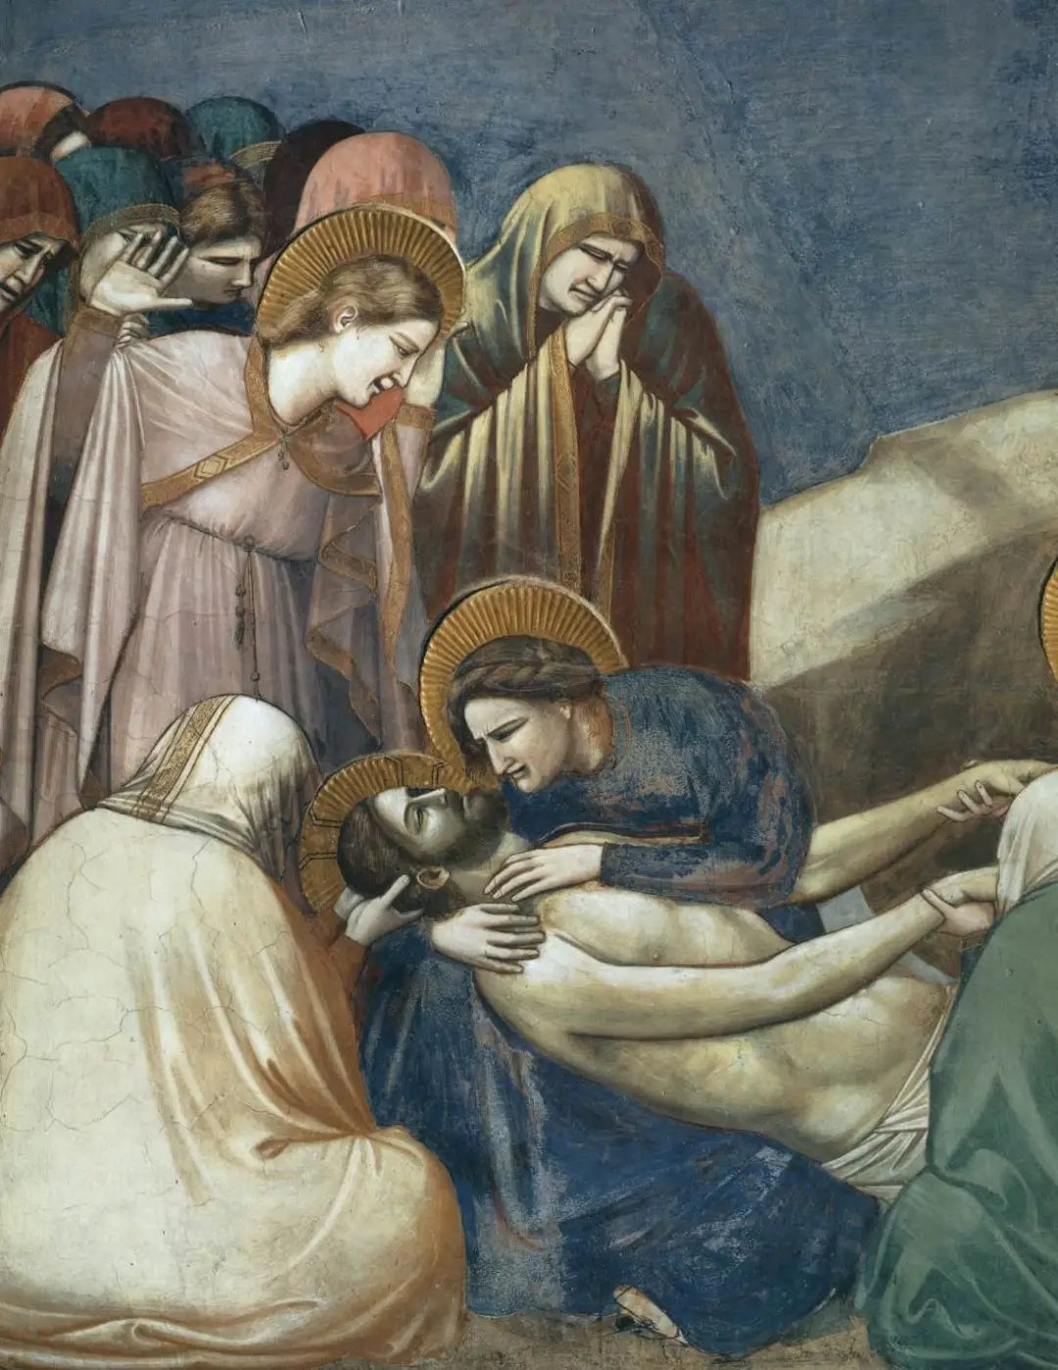
While-reading(scanning)
Period 1 | The Middle Ages (Para. 2)
Time
Purpose
Characteristics | From 5th to 13th century |  | From 13th to 15th century
Artists
From the 5th to the 15th century
To teach people about Christianity
real people in a real environment
realistic human faces
deep emotional impact
religious themes
primitive
two-dimensional
larger main characters
Giotto di Bondone

Slide 12
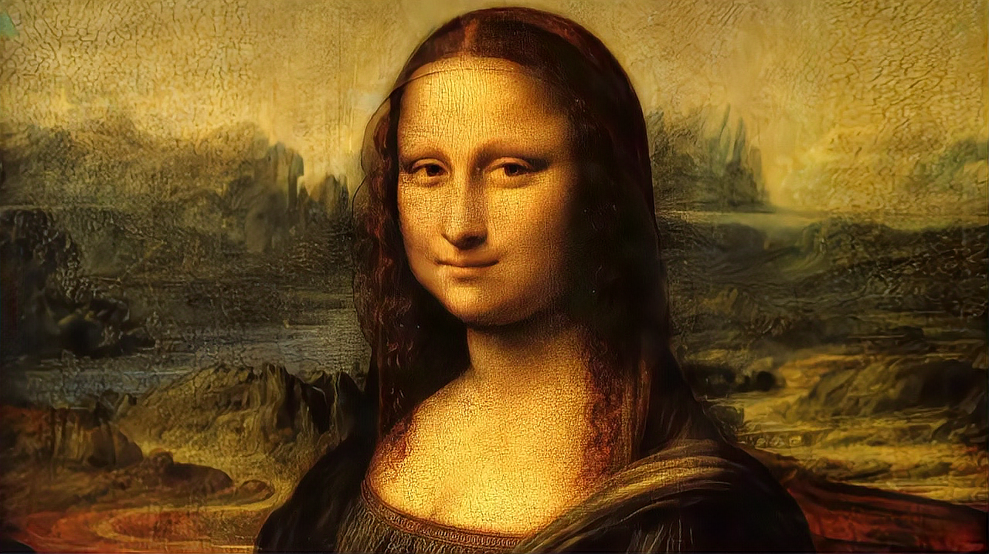

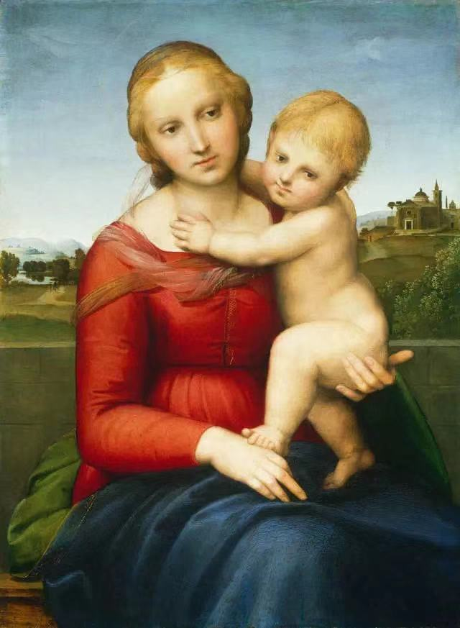

While-reading(scanning)
The Renaissance (Para.3-5)
Time
From the 14th to the 17th century
Characteristics(特征)
less religious themes
more humanistic attitude to life
use of perspective(透视)
use of oil paints
emphasis shifted to people and the world around us
innovations

Slide 13

Draw a painting
by using perspective
a house
or
two lines of trees

Slide 14
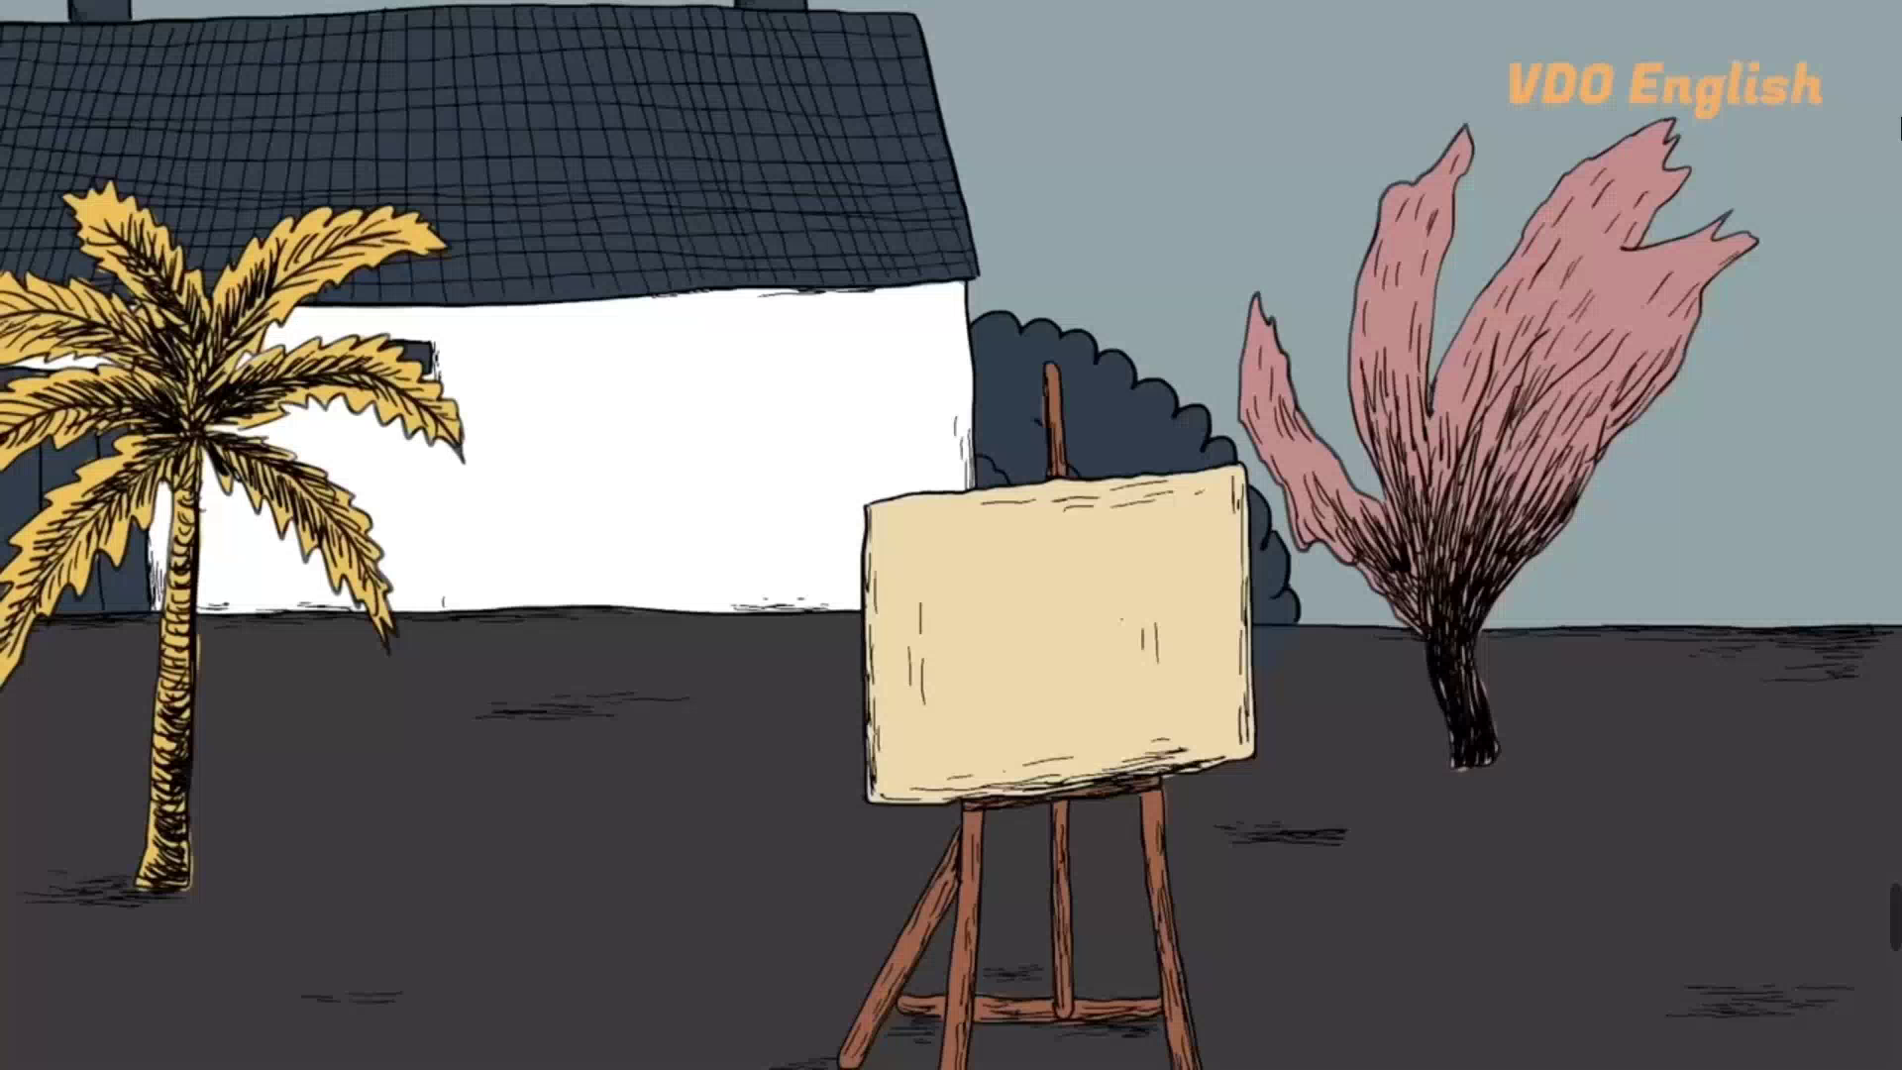
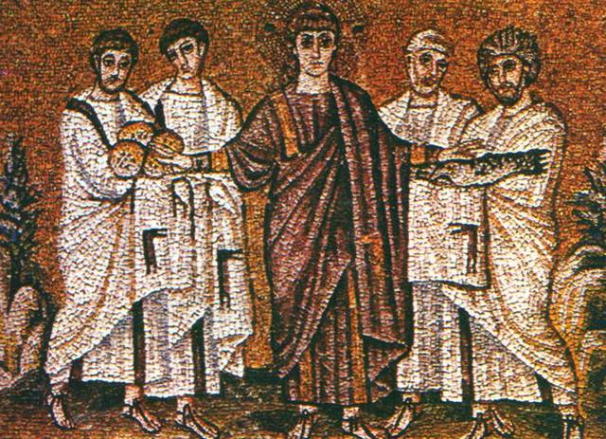
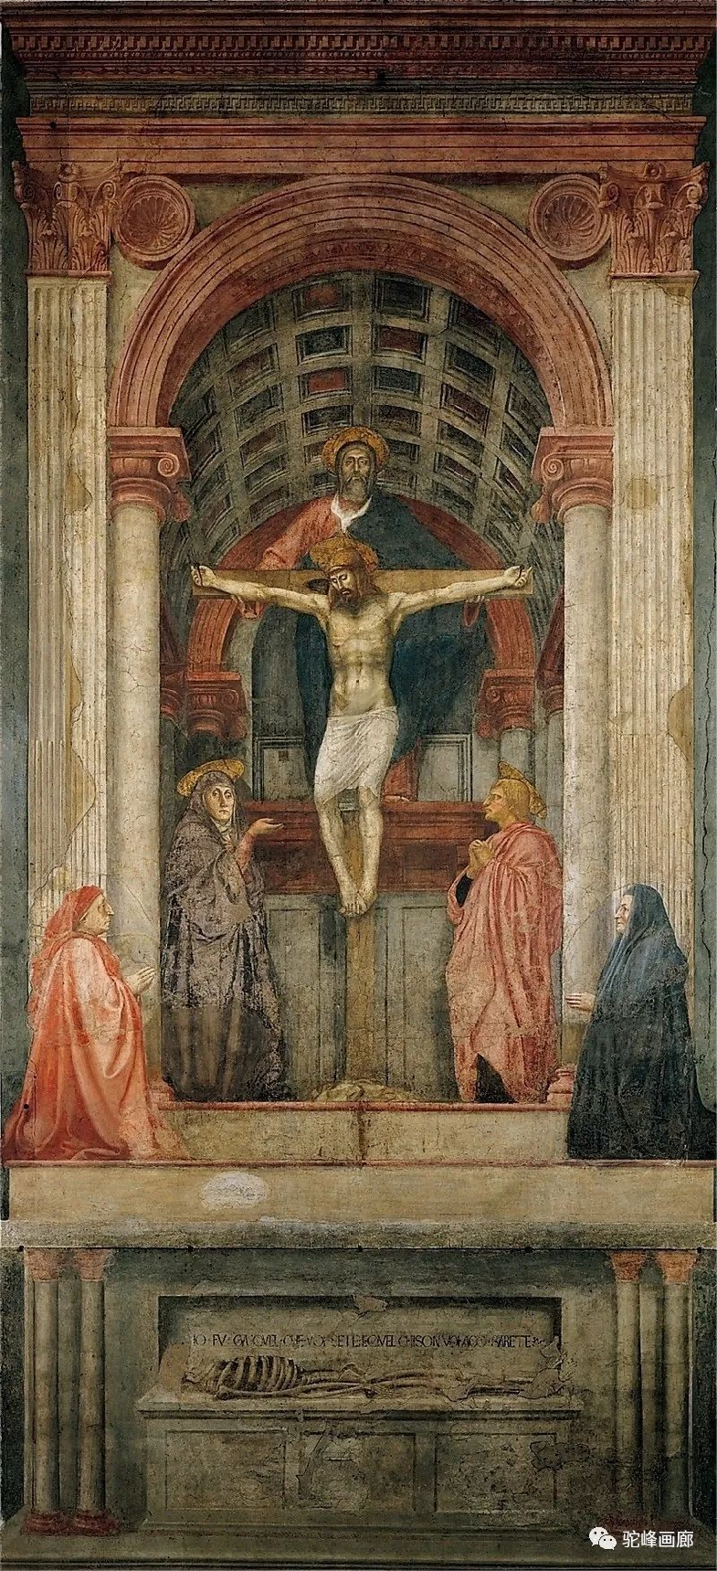

While-reading(scanning)
Which one uses perspective?
Holy Trinity 《圣三位一体》
by Masaccio 马萨乔

Slide 15
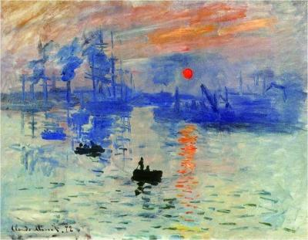

Is it clear and accurate?
No, it’s just an impression.
light
Monet’s aim: to convey the _______ and _______ in the scene——the ________ impression the scene gave him——but not a _______ record of the scene itself.
movement
subjective
Impression, Sunrise
《印象，日出》
by Monet 莫奈
detailed

Slide 16
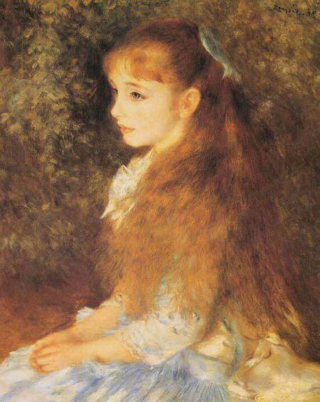
While-reading(scanning)
Is it beautiful?
Do you feel relaxed or warm?
Renoir’s paintings are full of _______, _______,_______and_______.He sought to show not just the ________ ________ of his subjects, but their _____ _____and ________ as well.
light
shadow
colour
life
outer
image
inner
warmth
humanity
Little Irene《小艾琳》
by Renoir 雷阿诺

Slide 17
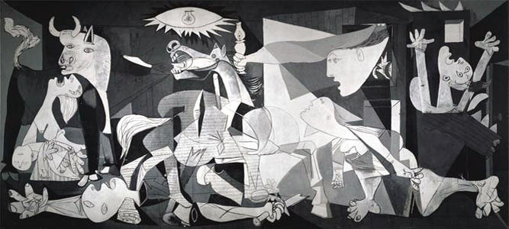
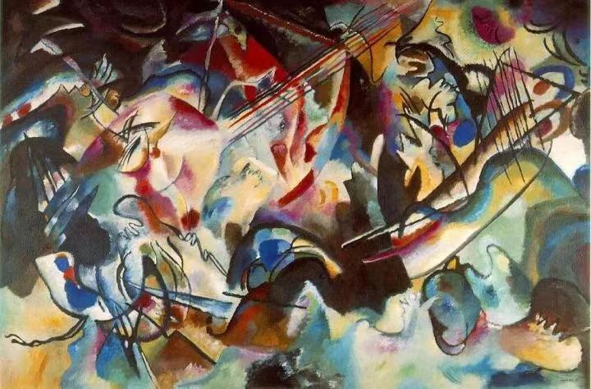
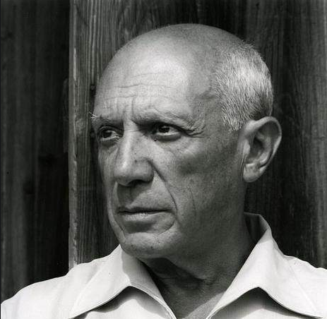
While-reading(scanning)
Period 4 | Modern Art (Para.8)
Time
Characteristics
Artists
from the 20th century to today
shapes
To analyse _________ of the natural world in a new way, with_________.
_________ art
Realistic but ___________ quality
Cubism
Abstract
dream-like
Picasso

Slide 18

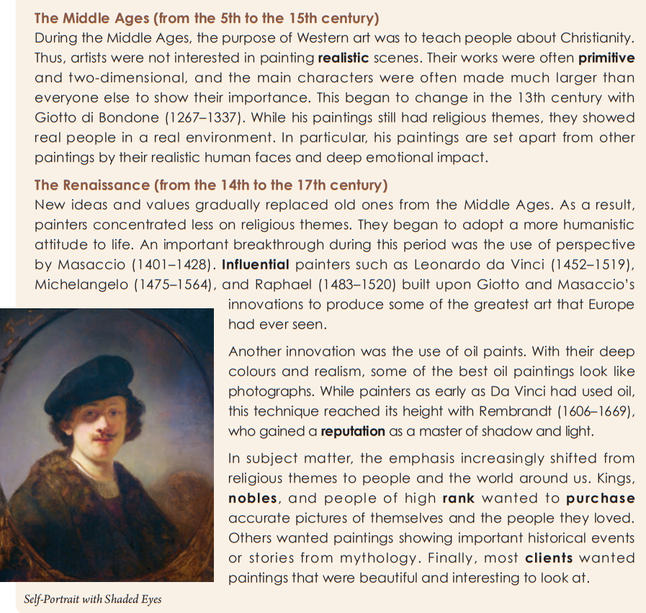
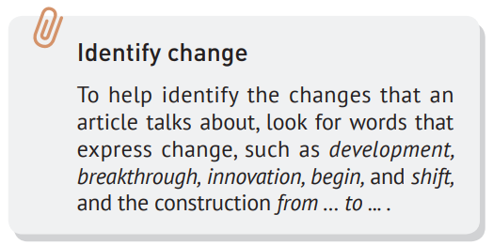
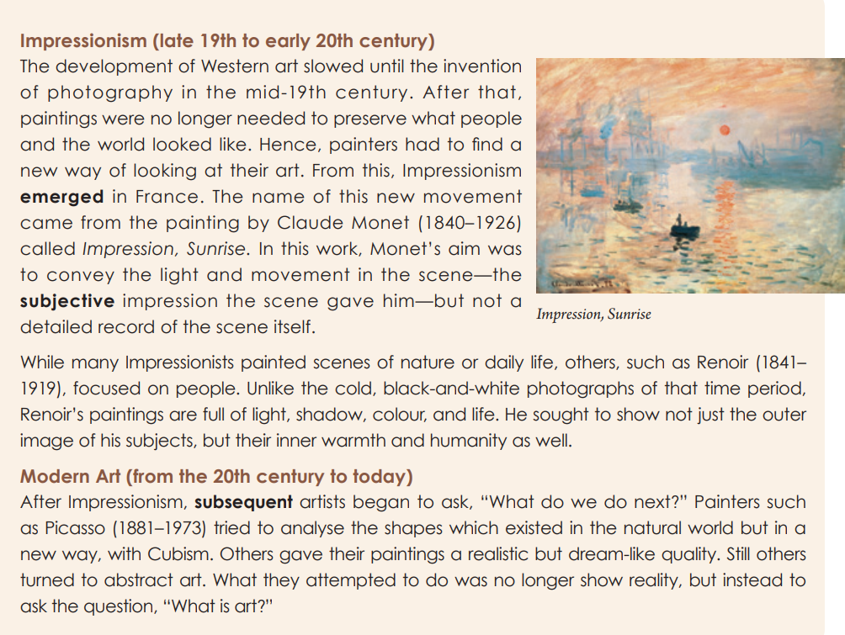
Post-reading(identify change)
Find the words that show changes.
Critical thinking
What are the factors that have influenced the changes in Western painting styles?

Slide 19
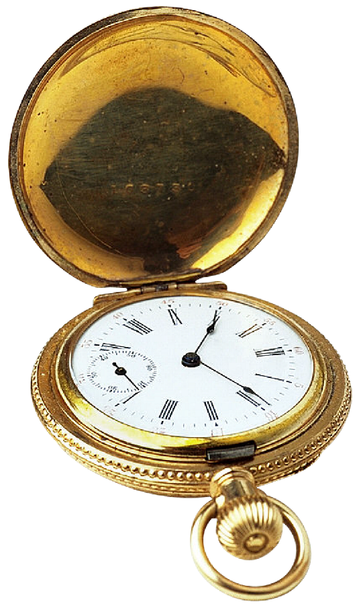
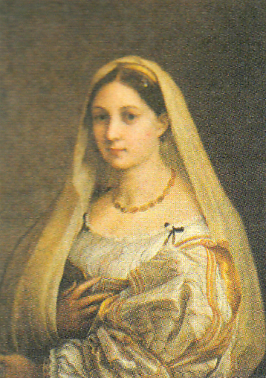
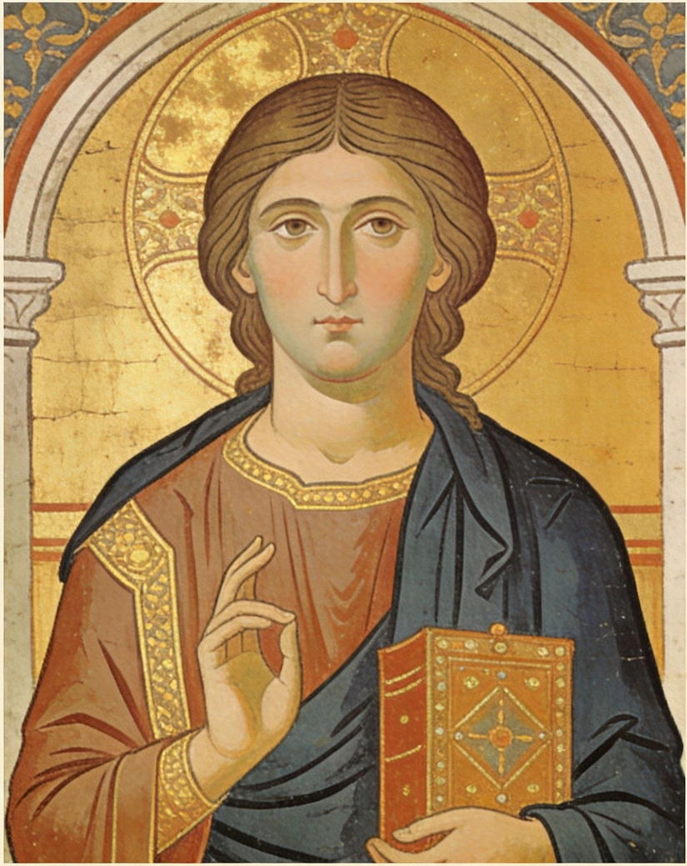
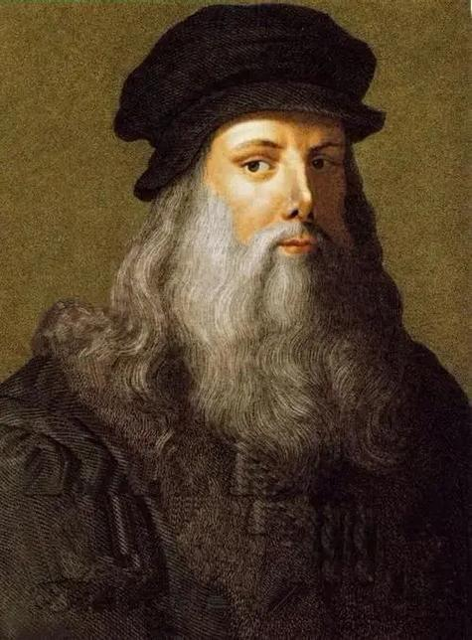
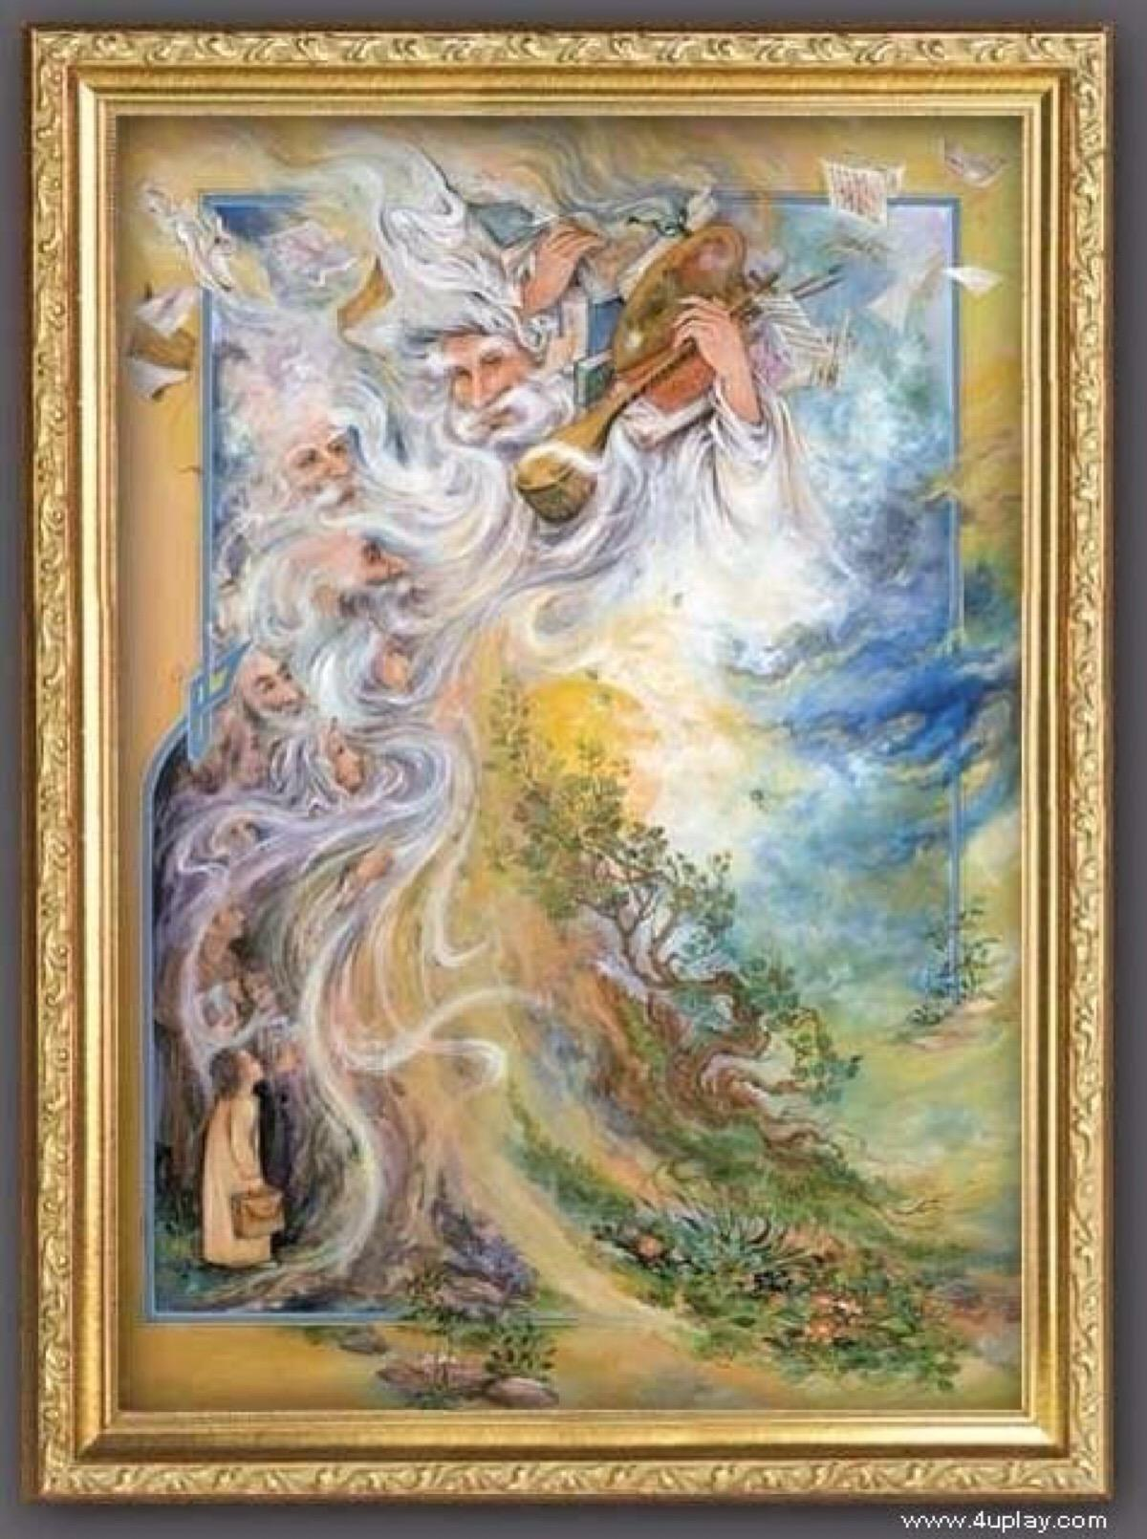
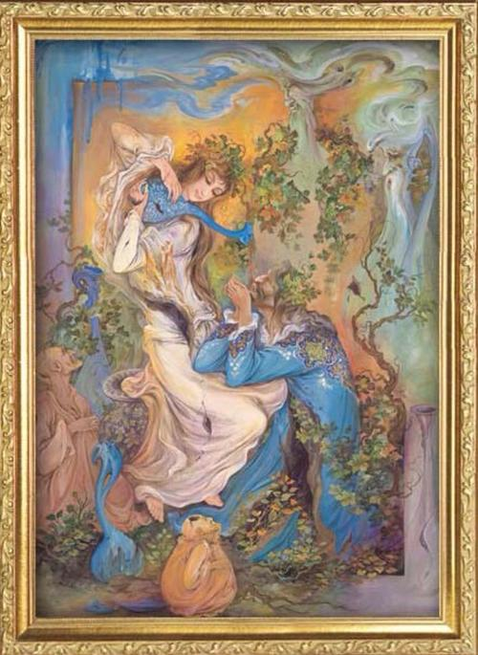
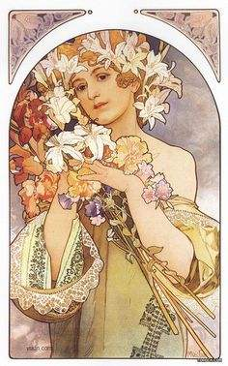
Post-reading
(factors for changes)
Critical thinking
What are the factors(因素) that have influenced the changes in Western painting styles?
At the beginning, ___________ played a key role in medieval(中世纪) Western art, because the main goal of art at that time was to teach people about Christianity.
Many different factors have influenced the changes in Western painting styles. To start with, ______________________gradually replaced old beliefs(信仰) from the Middle Ages, making painters focus less on religious themes and hold a more humanistic view of life.
Besides, the _____________________________ like perspective, oil paints and the invention of photography brought important breakthroughs and new possibilities to painting.
What’s more, great __________ such as Leonardo da Vinci and Picasso created new skills and styles, which greatly pushed the development of Western art.
Last but not least, artists’ __________ and understanding of art kept changing over time, leading to the birth of new art movements like Impressionism and Modern Art.
religion
new ideas and values
new tools/innovations/techniques
artists
attitudes

Slide 20
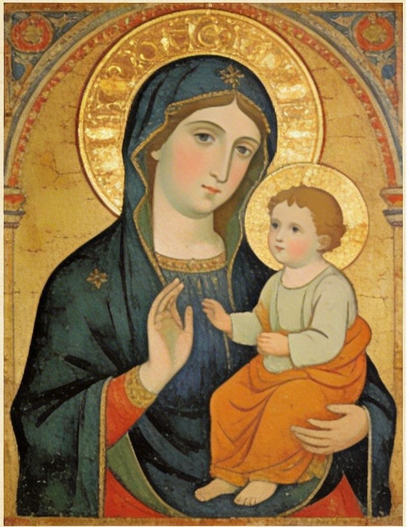
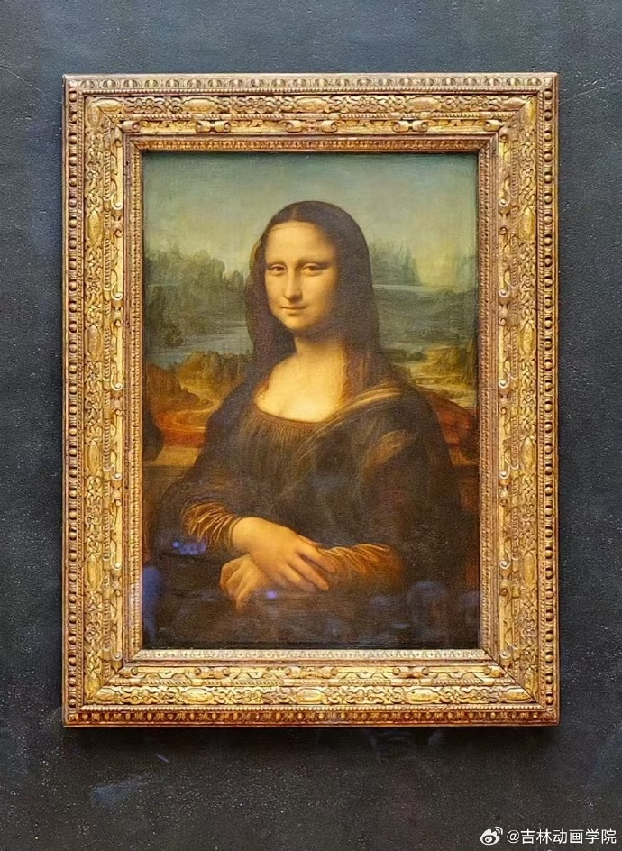
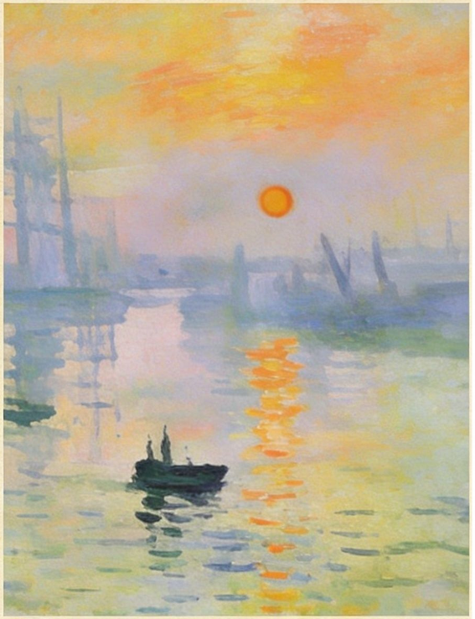
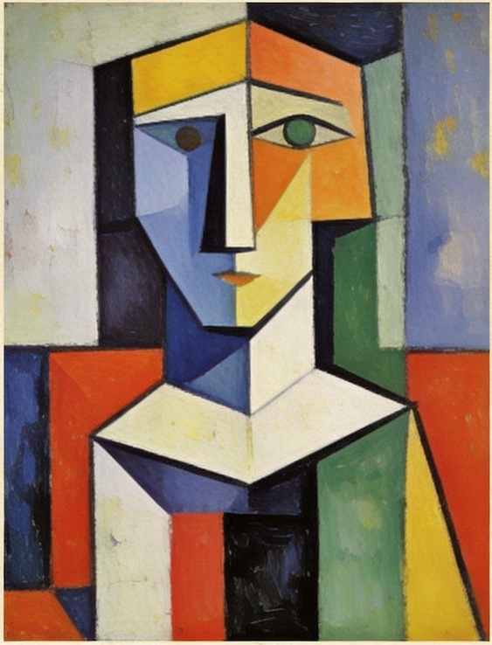
Post-reading
(presentation)
Art corner guide for Western painting
You are going to be a guide in school art corner(艺术角) to show students about western painting styles, which painting will you choose? Discuss in your group and give your presentation.
A
B
C
D
Question :
What is the theme and feature of the painting?
When/Why was the painting created?
How do you feel about the painting?

Slide 21
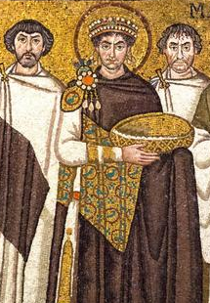
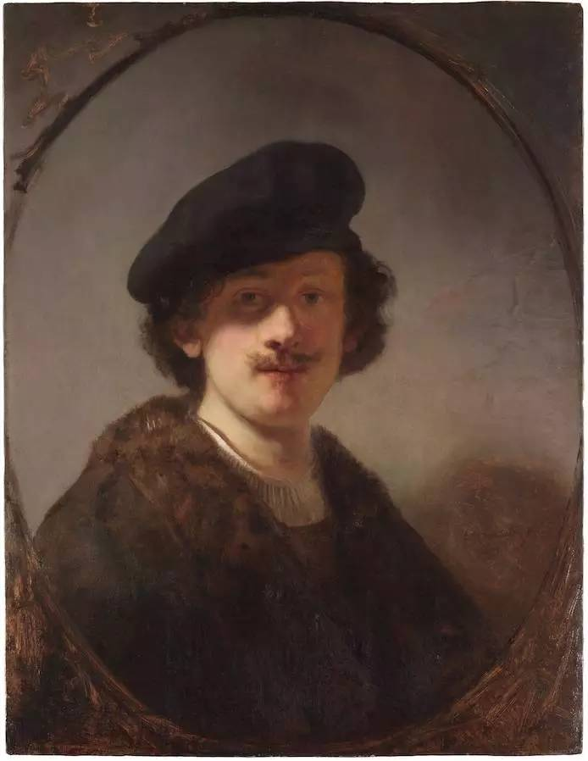
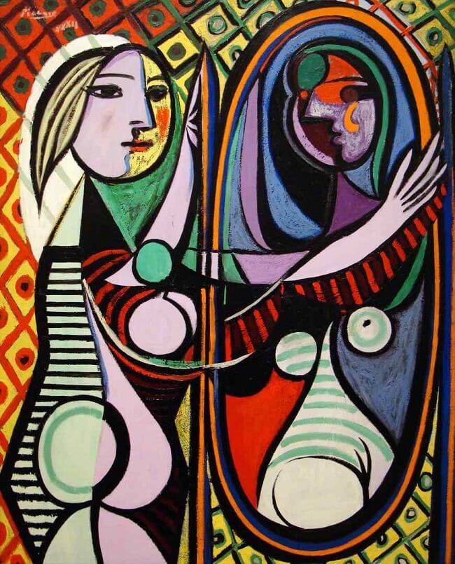
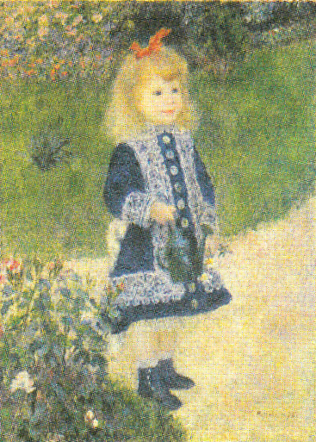


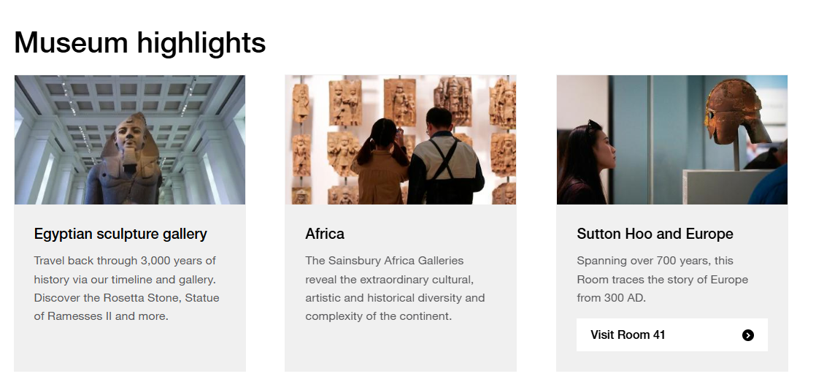
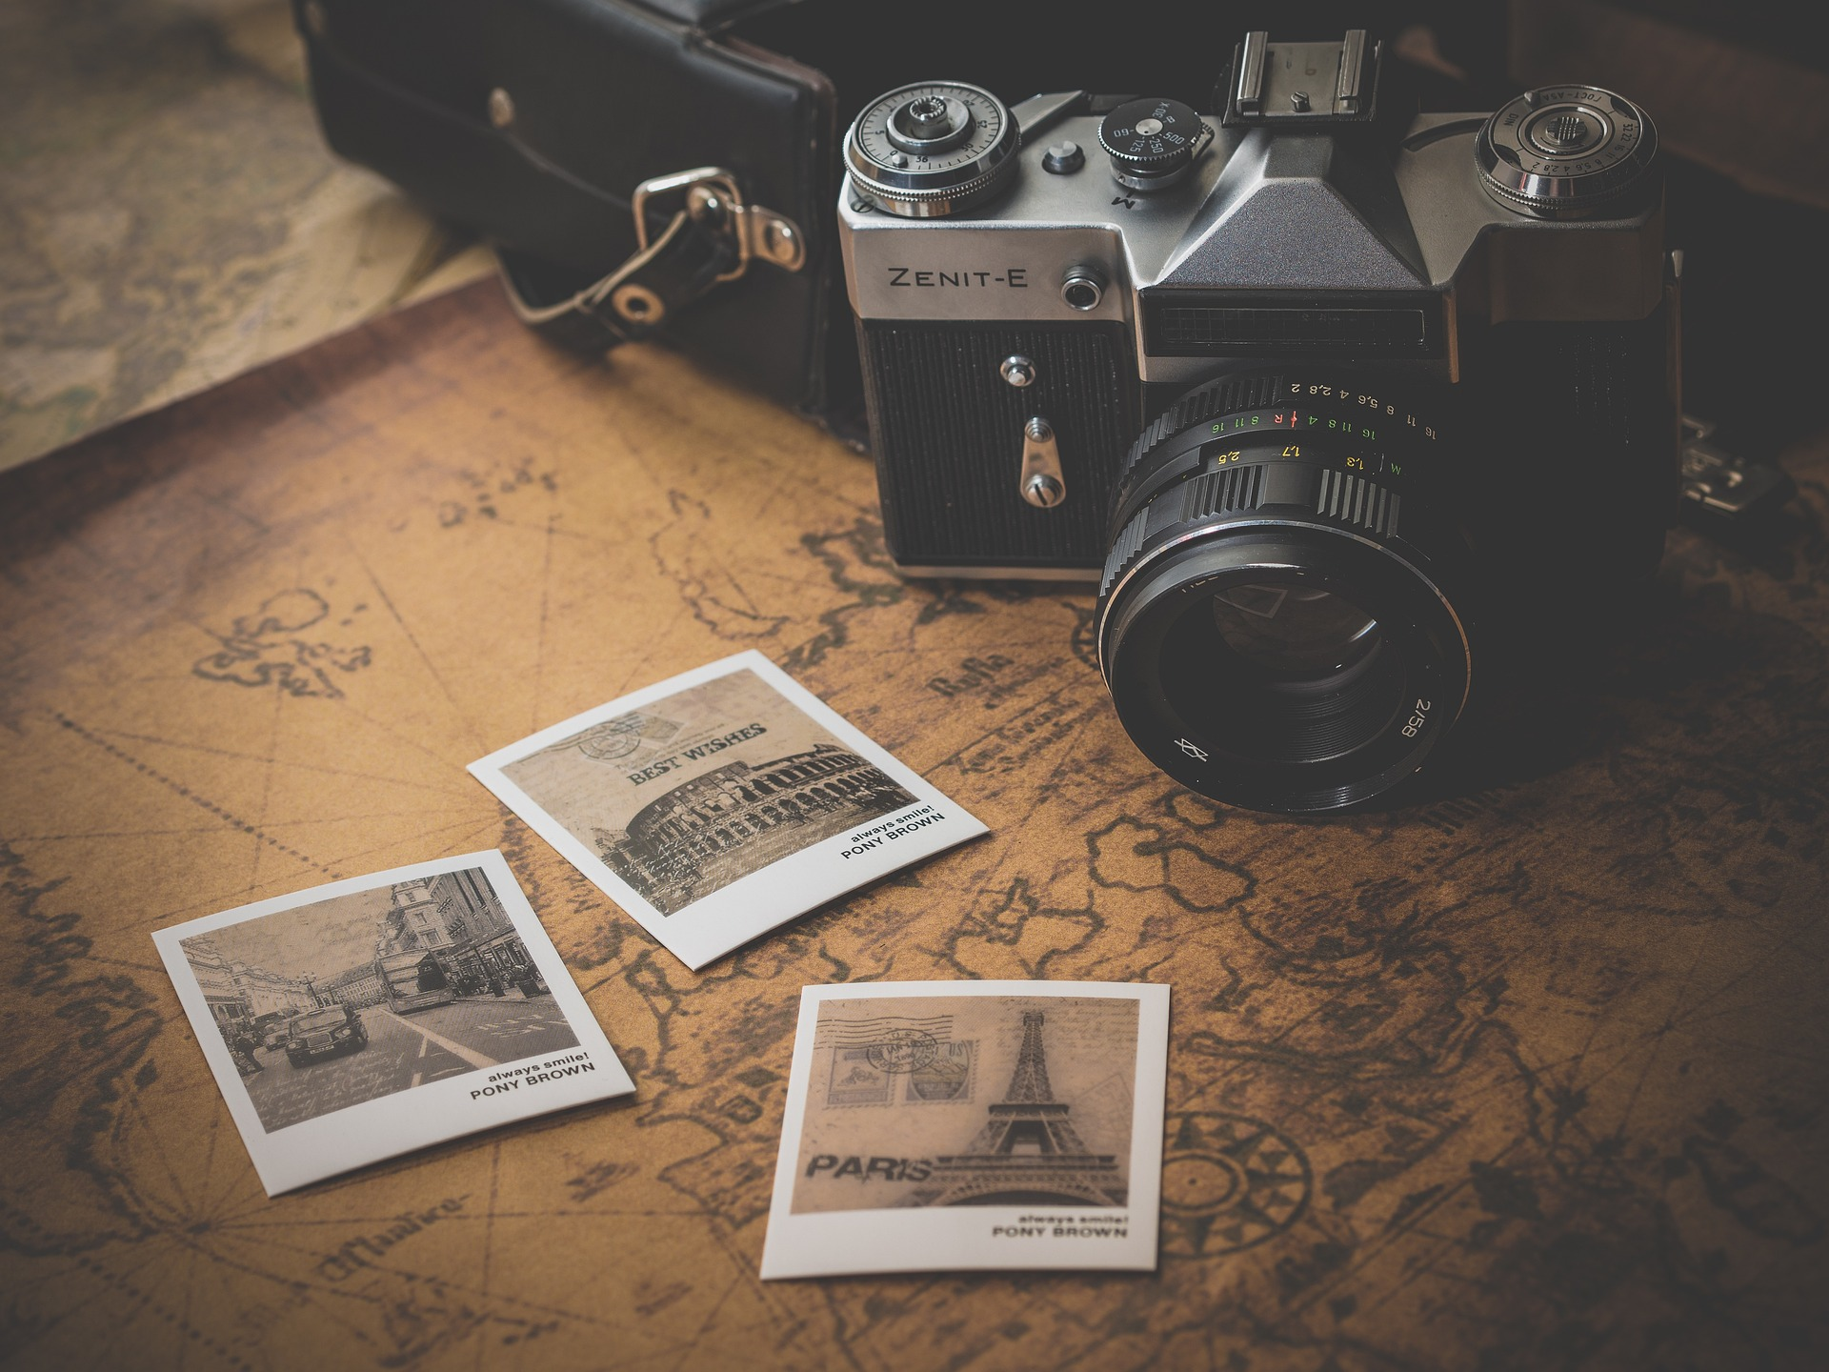
Homework
1.Search more information about western painting styles from http://www.britishmuseum.org/collection/galleries(大英博物馆).
2.How would you answer the question, “What is art?”
技术视角：art requires skill
表达视角：art conveys emotion/ideas
社会视角：art reflects its time
观众视角：art is what moves you
请结合课文内容，撰写100词短文表达自己的定义，并用文中例子支撑

Slide 22
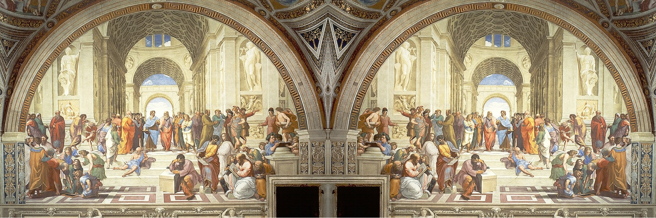

Art is the right hand of nature. The latter only gave us being, but the former made us men.‌
– Friedrich Schiller（德国诗人席勒）
艺术是自然的右手。自然只让我们存在，而艺术创造我们的人类。

Slide 23
Art is the mirror of society.
Art is not a mirror held up to reality but a hammer with which to shape it.
Art is an ever-changing process that always breaks traditions and freeing new minds.
Love of beauty is taste. The creation of beauty is art.
Art should comfort the disturbed and disturb the comfortable.
Art is the most intense mode of individualism that the world has known.
Art is something that no one can give a fixed definition.

