Slide 1
Unit 3 Food and Culture
Reading for Writing：
Healthy Eating

Slide 2
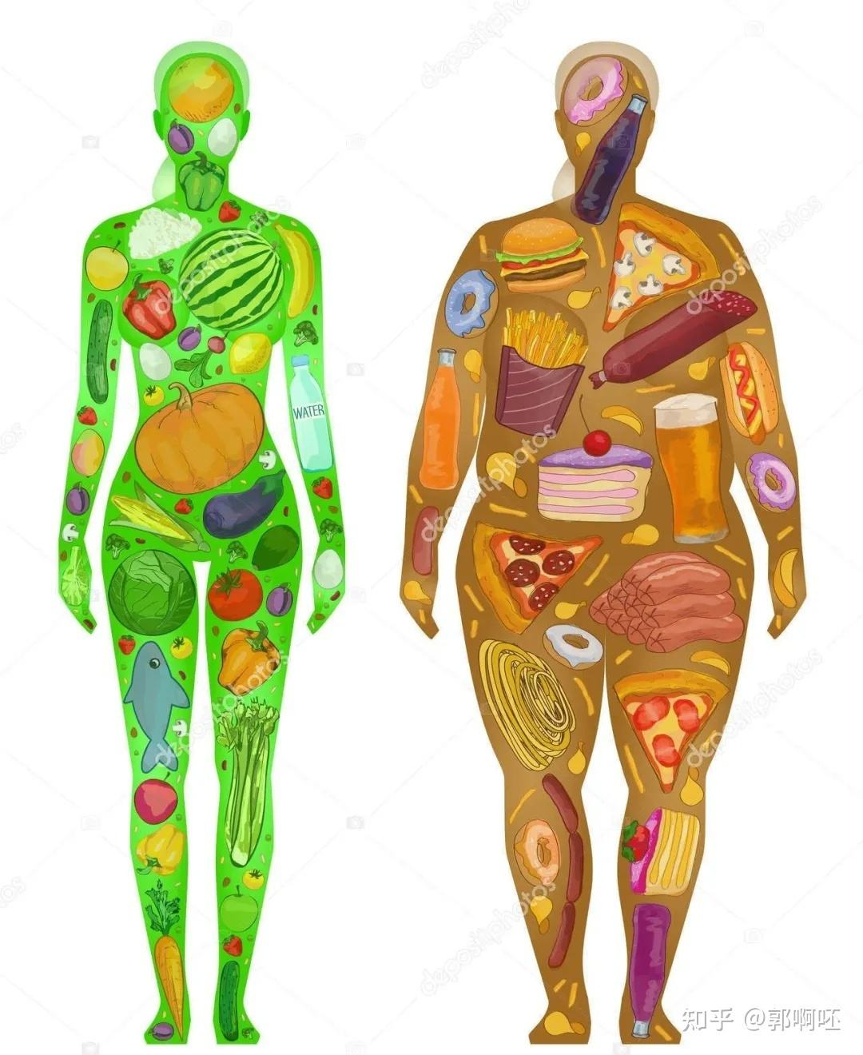
Recall what you have eaten and drunk in the past 3 days.

Slide 3
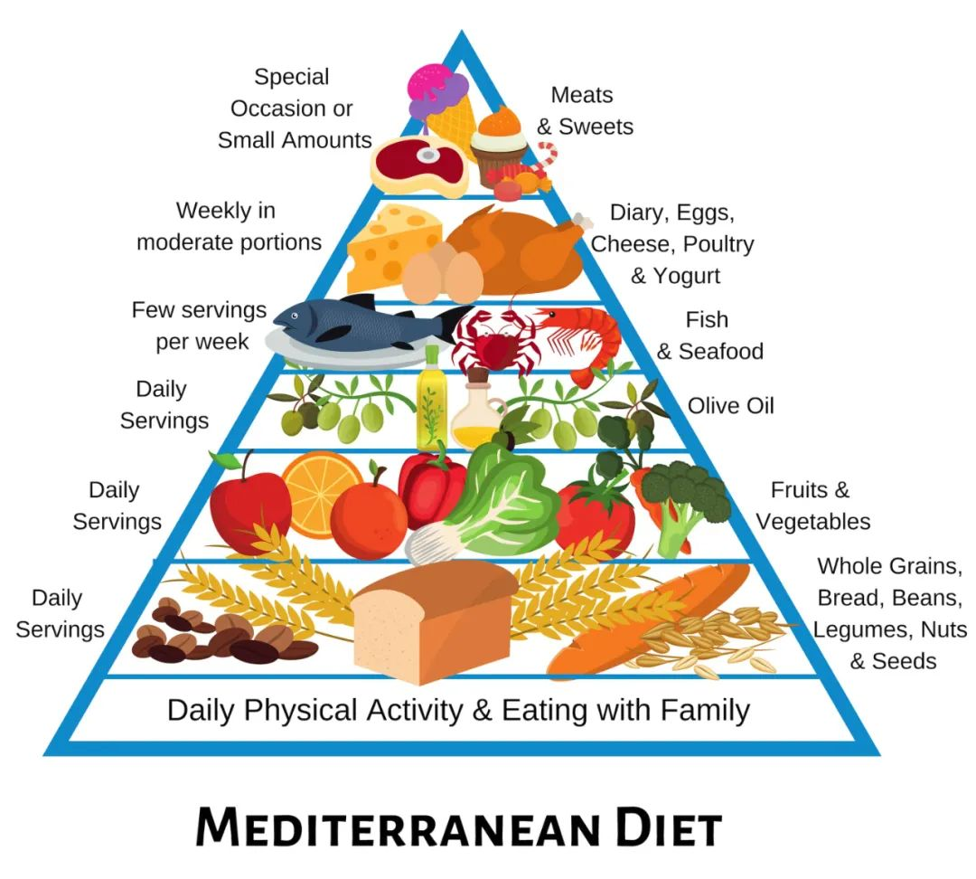
How to eat healthily?

Slide 4
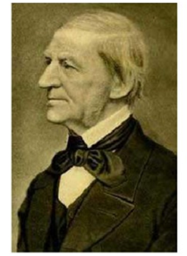
proverb
The first wealth is health.
By Ralph Waldo Emerson,
American thinker, writer and poet

Slide 5
Task 1: Divide the passage into different parts.
Para 1
The Real Killer is Sugar
What to eat
& not to eat
Para 2
Reducing Sweets is Key
Para 3
Keep it Fresh and Balanced
How to eat
Para 4
Slow Eating is Good
Attitude
Para 5
The Way You Look at Food is Most Important

Slide 6
Task 2: How does the writer support his idea?
(writing techniques)

Slide 7
Summary: Writing techniques
providing data
making contrast
listing reasons (give explanations)
1. Points + supporting details
2. Linking words
put more simply, in other words, what this means is that
however, while, rather than, rather
beyond this, besides this, also, in addition
for example

Slide 8
1. Why does the author mention the recommendation of the American Heart Association?
To show that the sugar contained in one can of sweet drink or a single candy bar has exceeded the recommended daily limit, thus emphasizing the necessity of cutting out sweet drinks and cutting down on desserts.
2. What does the author suggest about processed foods?
They usually have high sugar, salt and fat.
3. What does the author imply by putting forward the question “Do I eat to live, or live to eat?” in the last paragraph?
The author implies that a healthy attitude towards food is fundamental to healthy eating; people should take food mainly for nutrition rather than taking food as the center of their life.
4.What is the author’s purpose in writing this text?
To tell readers the real danger of sugar and offer practical tips on healthy eating, stressing that a balanced diet and a healthy attitude toward food are very important.

Slide 9
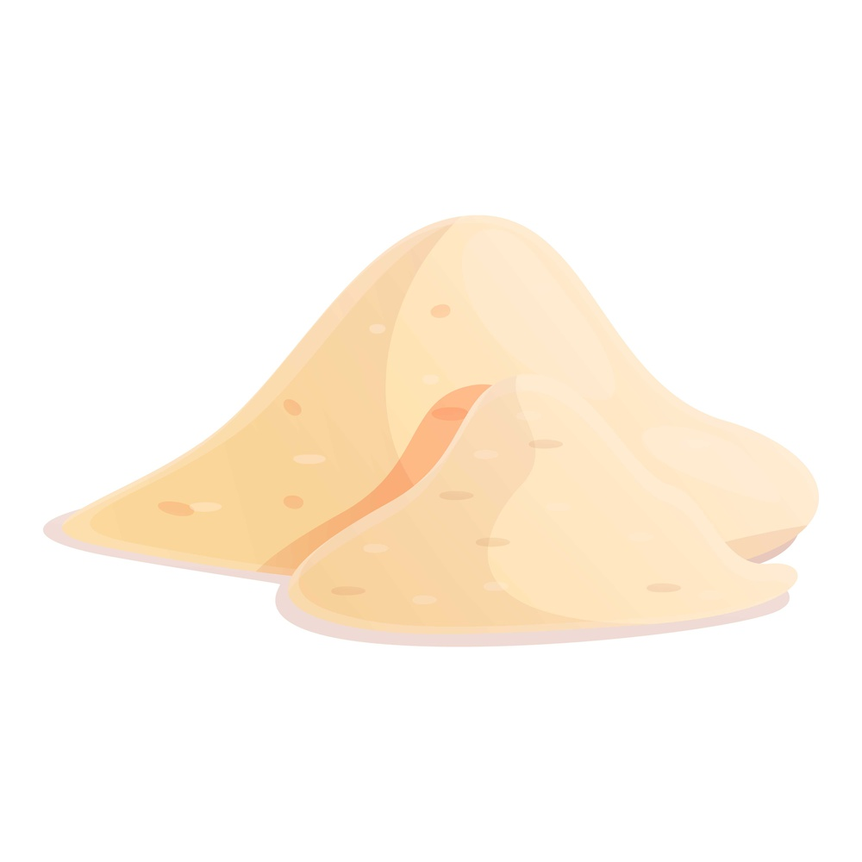

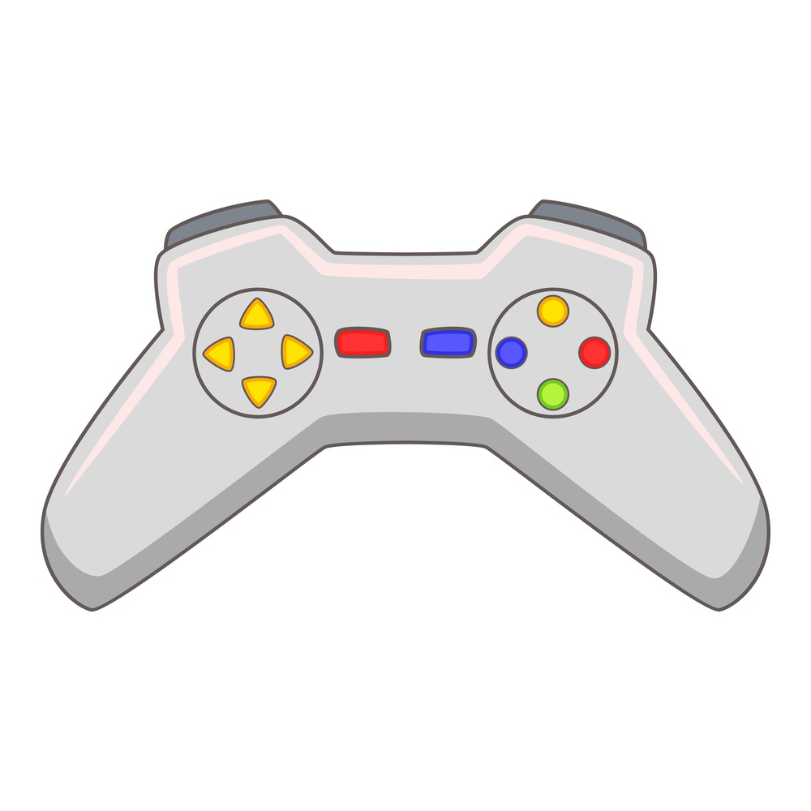

Analogy: Sugar vs. Electronic Temptations
Sugar
Electronic Temptations
Short-term pleasure, long-term harm
Short-term pleasure, long-term harm
Key Insight
Excessive indulgence in short videos can lead to decreased attention and insufficient sleep, similar to how sugar impacts health.
Notes:
We can compare sugar to electronic temptations such as video games and short videos. Both can bring short-term pleasure, but long-term indulgence can bring harm. Just as sugar can damage health, excessive indulgence in electronic products can lead to decreased attention and insufficient sleep.

Slide 10
Task 1: Divide the passage into different parts.
Para 1
The Real Killer is _____
What to do
& not to do
Para 2
Reducing______is Key
Para 3
Keep your life ____________
How to do
Para 4
________ is Good
Attitude
Para 5
The Way You Look at _____ is Most Important

Slide 11
P1
开篇：争议 + 观点？
However, there is increasing evidence that（同位语从句）the real driver of poor health is not so much ..., as it is (与其说...不如说...) ....
There is much debate nowadays as to （关于）what makes a balanced student lifestyle. For example, many have blamed tiredness on late homework for years. However, there is increasing evidence that the real driver of poor study and health is not so much heavy homework, as it is excessive use of electronic devices.

Slide 12
P1
数据论证
people who...are twice as likely to die as people who....
Mental health and focus problems are top threats to teenagers. And students who spend 4 hours or more daily on games and short videos are twice as likely to suffer anxiety and poor sleep as those who spend less than 1 hour a day (CDC, 2025). This is true regardless of how healthy the rest of their schedule might be.

Slide 13
P1
简单总结
Put more simply (简单来说）, while people continue to argue over whether or not..., we already know that ... is a killer.
Put more simply, while people continue to argue over whether or not schoolwork is too heavy, we already know that uncontrolled screen time is a real killer of teen health and grades.

Slide 14
P2
来源 + 建议
The ...recommends that we ..., which is less than what ....
Much of this extra screen time comes from games and short-video apps. The average teen gets most of their daily screen time from these two alone. The WHO recommends that we limit entertainment screen time to less than 1–1.5 hours a day, which is less than what many students spend in one evening. In other words, if you want a balanced life, you have to cut down on game time, and cut out endless short-video scrolling altogether.

Slide 15
P3
均衡适度的生活方式
Beyond this（除此之外）, you can ..., especially ..., rather than ....
Beyond this, you can stay healthy and focused by following a balanced schedule, especially enough sleep, regular exercise and face-to-face communication, rather than staying up late on screens. As with（正如） everything in life, moderation/a modest amount is key. The ideal lifestyle is a balanced one, without too much or too little of any one thing.

Slide 16
Key expressions
1. modest 适中的
He charged a relatively modest fee.
2.较小的/朴素的/谦虚的 modesty n.
modest improvements
a modest little house
be modest about sth
1. moderate 适度的，合理的
a moderate drinker moderate amounts of drug
2. moderate 中等的，指身高或体型为平均水平
a man of moderate/ medium height/build

Slide 17
P4
习惯建议?
Finally, a fundamental key to a balanced lifestyle is active time management and self-discipline. Your mind and efficiency need clear plans to stay organized and work at their best. What it means is that students who waste time and lack self-control will end up feeling stressed and achieve little every day.

Slide 18
7. 态度升华
One question you can ask yourself is, “Do I...or ...?”
There is no one trick to a balanced lifestyle. Rather, a healthy lifestyle starts with a healthy attitude toward time. One question you can ask yourself is, “Do I use screens to relax, or let screens control my life?” It is up to you to make the right decisions about your daily routine.

Slide 19
Lexical Chunks
1. 构成健康的饮食
2.不管不顾
3.少吃/戒掉甜点
4. 吃不同种类的新鲜食品
5. 加工食品
6. 乳制品
1.make up a healthy diet
2.regardless of
3.cut down on /cut out desserts
4.consume different categories of fresh foods
5.processed foods
6.dairy products

Slide 20
Lexical Chunks
7. 新鲜的食材
8. 均衡的饮食
9. 健康饮食的基本要点
10. 一致的饮食习惯
11. 适量的
12. 方向正确，做得对
7.fresh ingredients
8. a balanced diet
9.fundamental key to healthy eating
10.consistent eating habits
11.a modest amount of
12. on the right track

Slide 21
Translation
比赛前（prior to)，许多人都充满（consume)恐惧。诀窍(trick)是一种由练习和自信构成(consist of)的方法。
与长期成功相关(associated with)的稳定的生活方式也值得坚持。
这个观点与专家常说的一致(be consistent with）。
尽管(despite/regardless of)你会遇到很多困难，你仍可以坚持下去。因为真正的成长在于(consist) 过程而不是结果。
Prior to the competition, many people are consumed with fear.The trick is a method consisting of /comprising/ made up of practice and confidence.
A steady lifestyle, associated with long-term success, is also worth keeping.
This idea is consistent with what experts always say.
Despite / Despite the fact that you may encounter difficulties, you can keep going/forge ahead/press on. Because true growth consist in / lies in the journey rather than the outcome.

Slide 22
Writing
假定你是李华，你的美国网友Jack来信说他的家人都很喜欢吃中餐，向你请教如何在中餐馆选择健康的中餐。请你用英语给他写一封回信，内容主要包括：
1．分量适当，避免浪费；
2．蔬菜为主，少油少盐；
3．蒸、煮为佳，不加味精(MSG)。
注意：可以适当增加细节，以使行文连贯。

Slide 23
审题
主题 | 饮食文化 | 体裁 | 应用文
人称 | 以第二人称为主 | 时态 | 一般现在时
Para.2 布局 | 第一部分：选择适量的饭菜； 第二部分：选择中餐时饭菜的种类及注意事项。

Slide 24
Sample
Dear Jack,
I’m delighted to hear that your family enjoy Chinese cuisine! When dining at a Chinese restaurant, there are a few tips that might help you make healthier choices.
Firstly, portion control is key. Chinese restaurants often serve large portions, so it’s advisable to order smaller portions to avoid overeating and reduce food waste. In addition, focus on dishes that feature vegetables, and ask for less oil and salt to be used in cooking. By opting for dishes that are rich in vegetables, you can enjoy a balanced meal while minimizing unnecessary fats and sodium. Lastly, choose steaming and boiling methods over frying, as they preserve the natural nutrients in the ingredients. It’s also a good idea to avoid dishes with MSG, especially if you’re sensitive to it.
I hope these suggestions help you and your family have a healthier Chinese dining experience. Have a good appetite and stay healthy.
Best regards,
Li Hua

