Slide 1

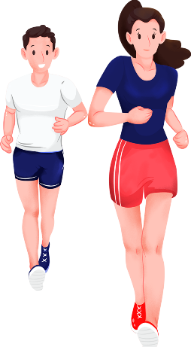
U2 Healthy Lifestyle
Reading for Writing
unit 2
HEALTHY LIFESTYLE

Slide 2
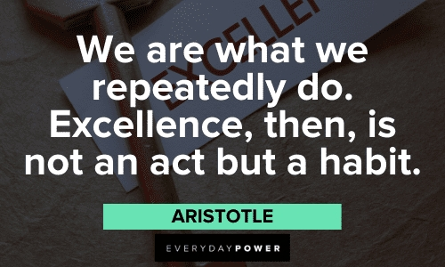
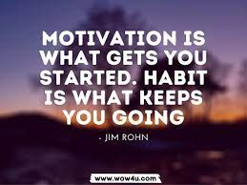

Slide 3

A lifelong motto to live by
Watch your thoughts,
they become words.
积思成言
watch your words ,
they become actions.
积言成行
watch your actions,
they become habits.
积行成习
watch your habits，
they become character.
积习成性
watch your character,
it becomes your destiny.
积性成命

Slide 4
Find out highlights & useful expressions
if left unchecked, sth could lead to ...
to prevent sth from dominating one’s life
Choice will become automatic and form a habit.
act as a signal
A routine is the regular action you take in response to the cue.
to facilitate a positive change
First examine our bad habit cycles and then adapt them.
show some discipline and repeatedly take small steps
There is no magic pill or delete button
decide on some positive changes
1.倘若放任不管，可能会引发……
2. 避免其主宰自己的生活
3.选择会变成下意识行为，进而形成习惯。
4.起提示作用
5.惯例就是你受诱因驱使而做出的固定行为。
6.助力促成正向改变
7.先梳理坏习惯的循环规律，再对其做出调整。
8.严于律己且循序渐进
9.世上没有特效药，也没有一键删除的捷径
10.敲定几项正向改变方案

Slide 5
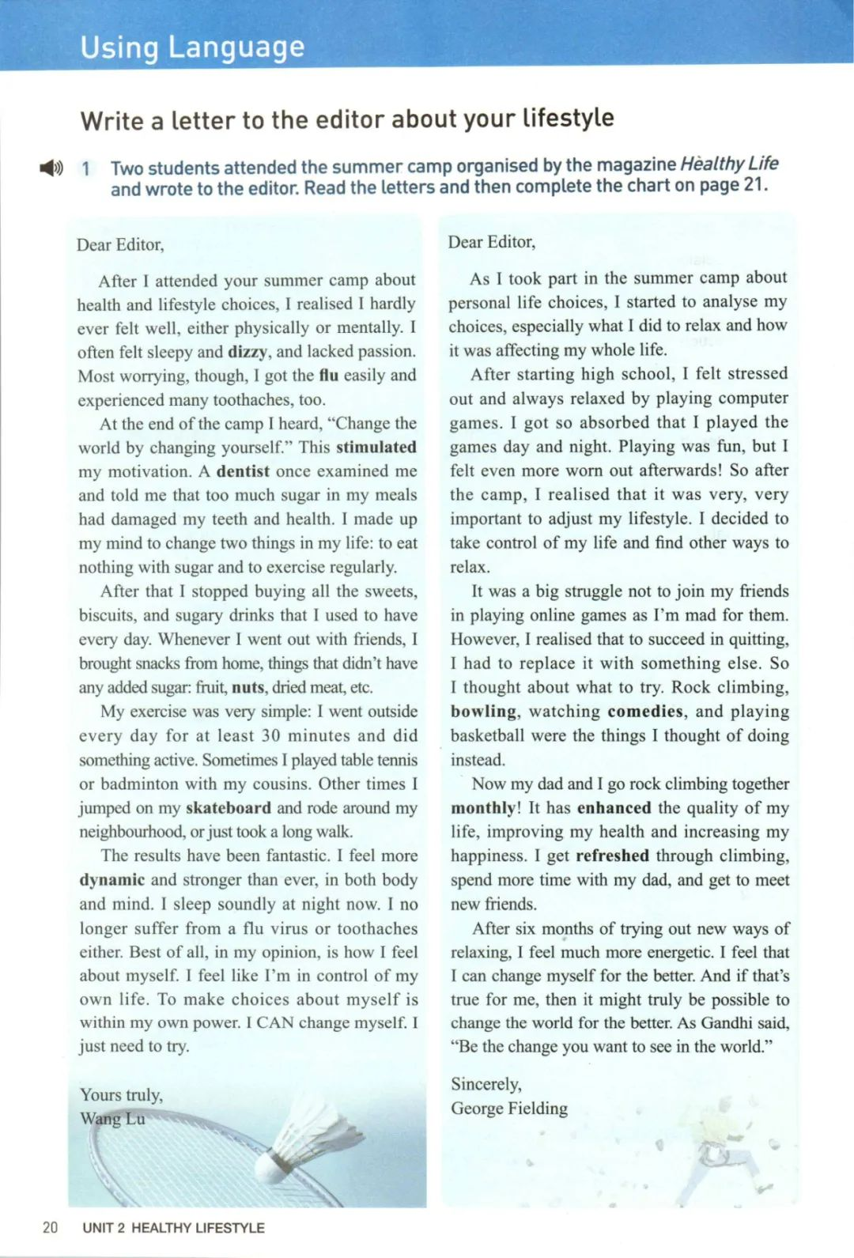


Two students, a gril named and a boy named , who have bad habits attended a summer camp organised by the magazine Healthy Life, and wrote to the editors. Let’s listen and fill in the blanks.
Wang Lu
George Fielding

Slide 6
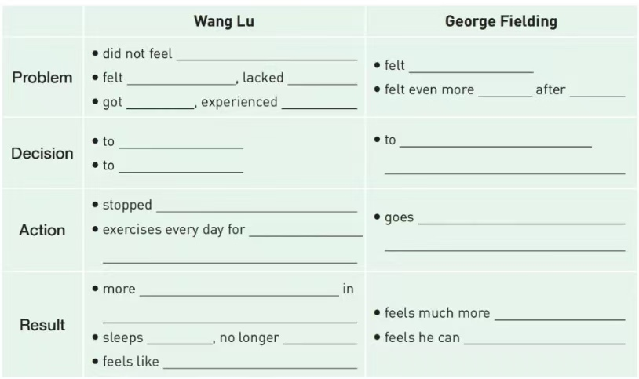
task 2
Read carefully to fill in the blanks

Slide 7
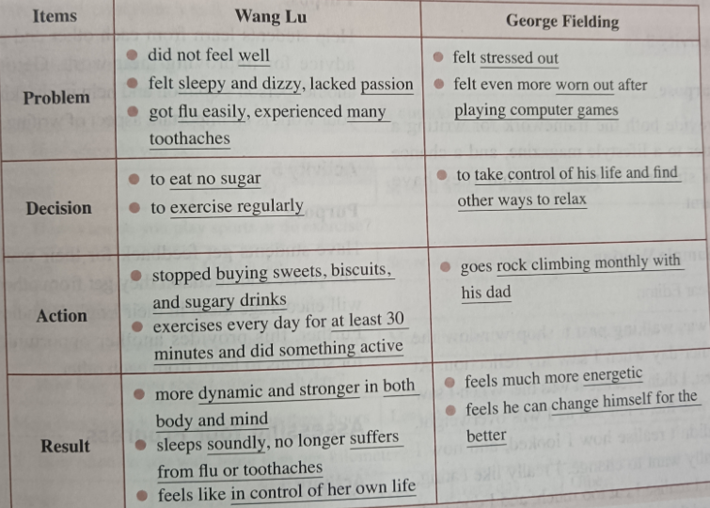


Slide 8
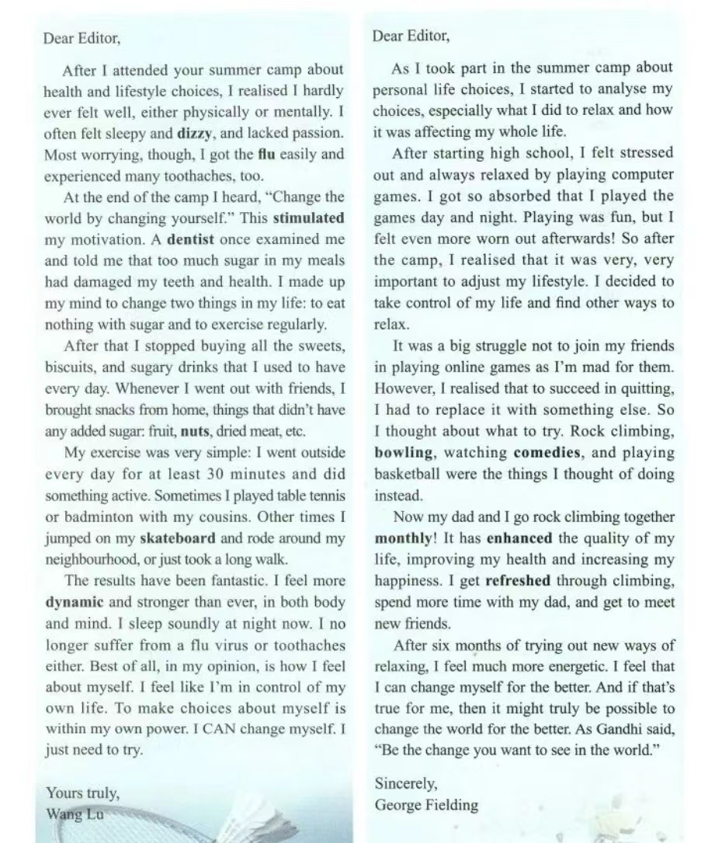
task 1
Read fast to find out main topics in each letter.
A
B
A identifying problem(s)
B considering what to do
C what he/she has done to change
D the results
C
D

Slide 9
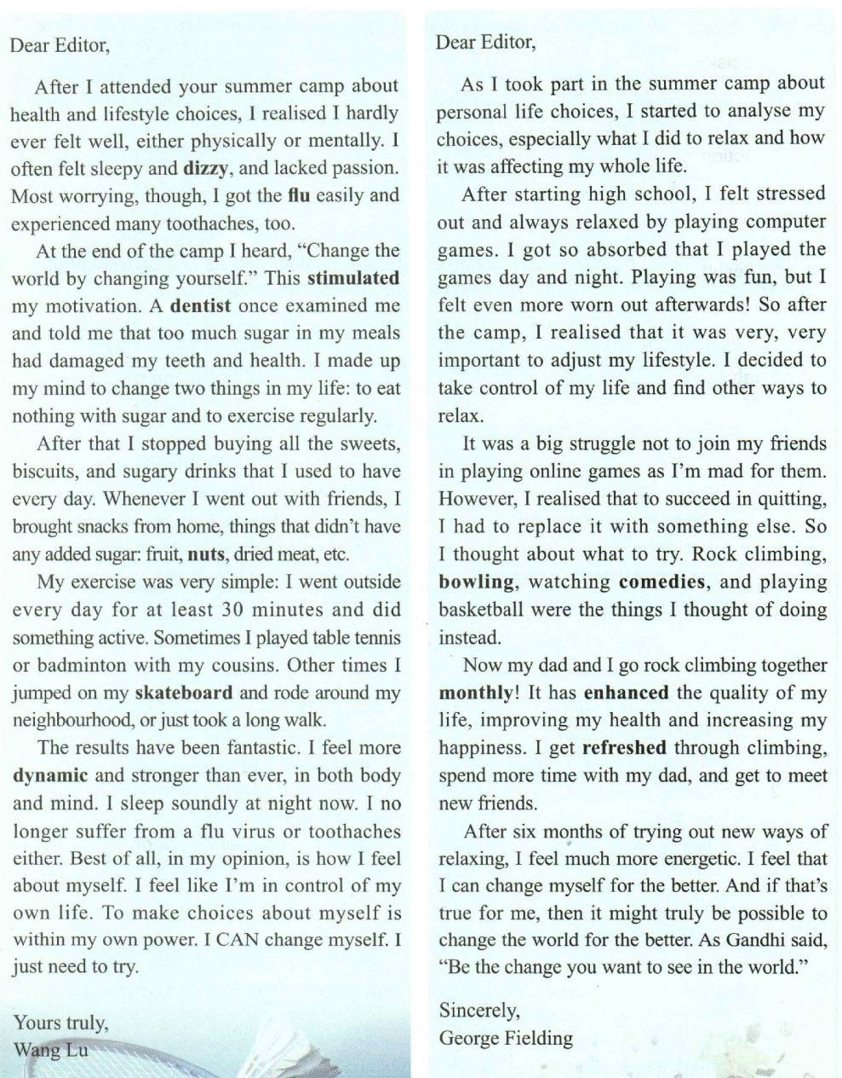
task 3
Analyse the tense of the letter.
Problem
past tense
Decision
Action
Result
present tense

Slide 10
A identifying problem(s)
well
did not feel ____________
felt _________________;
lacked _____________
sleepy and dizzy
passion
got _______________;
experienced _______________
flu easily
many toothaches
Problem
stressed out
felt _____________
worn out
felt even more ____________
after ______________________
palying computer games

Slide 11
task 4
Find out useful expressions
1. After I attended your ..., I realised...
2.I felt ... and lacked ...
3.As I took part in ..., I started to analyse...
Problem
1. ...stimulated my decision.
2. I made up my mind to ...
3. I decided to ...
Decision
1. Some times I... Other times I...
2.I get refreshed through doing A , B and C
Action
1. The results have been fantastic.
2. I no longer suffer from ...
3. I feel like I’m in control of own life.
Result

Slide 12
task 5
Revise the phreses
1.曾几何时There was a time when
2.更糟糕地是Worse still
3.依赖……做某事 rely on...to do sth.
4.决定；选定 decide on
5.约束自我discipline myself
6.下定决心做某事 make up one’s mind to do sth.
7.立即；马上 straight away
8.筋疲力尽的；疲惫的 be worn out
9.焦虑不安的；心力交瘁 stressed out
10.提高质量 enhance the quality of
11.恢复精力 get refreshed

Slide 13
Language Points: Important phrases
1 | 最令人担心的...
2 | 更有活力
3 | 睡得香
4 | 掌控自己的生活
5 | 压力山大
6 | 专注的
most worrying
more dynamic
sleep soundly
be in /take control of my life/ ...be within my power
be stressed out
be absorbed in ； absorption n.

Slide 14
Language Points: Important phrases (para.4)
7 | 调整生活方式
8
9
10 | 提高生活质量
11 | 感到精神振奋
12 | 尝试新的方法
13 | 把...变得更好
adjust my lifestyle
enhance/improve the quality of my life
get refreshed
try out new ways of...
change ...for the better

Slide 15
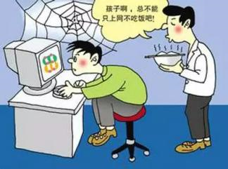


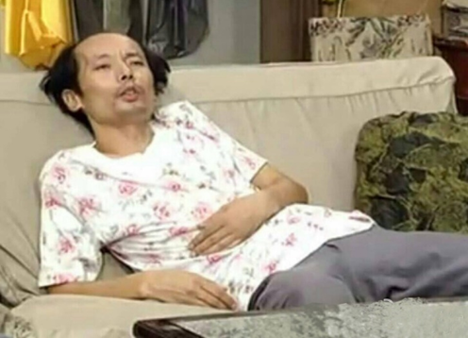

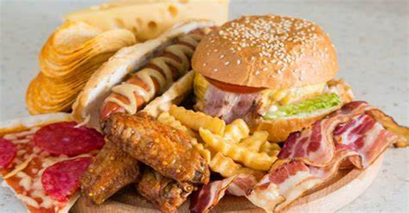
Discussion
It’s time to change our bad habits !
skip breakfast
digital addiction
smoking & drinking
rarely doing exercise
staying up late
eating junk food

Slide 16
Think about one lifestyle/ habit of yours or of others that you would like or suggest to change. The following information should be covered:
1.What lifestyle habit you would like to change
2. Why you want to change
3. How you plan to change
4. What result you hope to see

Slide 17
1.What lifestyle habit you would like to change
The undesirable habit I am eager to break/adapt/adjust is ...
It is the addiction to... that I’m longing to get rid of/abandon in the near future.
I..., which has brought me a negative effect physically and mentally.
2. Why you want to change
I am too ... to .... due to this bad habit.
I often can’t help feeling .... because of ....
What troubles me most is that ...
Without a healthy lifestyle, it would be impossible for me to...
3. How you plan to change
I’m supposed to/ I think it’s a good idea to set limit to/ step by step/ discipline...
Only by ... can I .....
4. What result you hope to see
What matters/what I expect most is ...
Hard as the adjustment might be, I’m convinced that...

Slide 18
给词根
beyond recognition
be in store
exhibit v.
civilized adj.
emergence n.
humanistic adj.
arched brows 挑起的眉毛
expension n.
criticism n.
subjective adj.
worthwhile adj.
subsequently adv.

Slide 19
rewarding adj. 值得做，有益的
compose oneself/one’s thoughts
the team composed of five doctors
refreshed adj.
absorbed adj. absorption n. 吸收，着迷
be worn out 破旧，疲惫

