Slide 1
读后续写技巧
Detailed description of feelings
细节描写之情绪描写基础

Slide 2


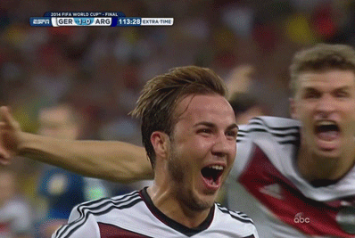
How does she/he feel?
Lead-in
moved/touched
excited/ thrilled
pleased/delighted

Slide 3

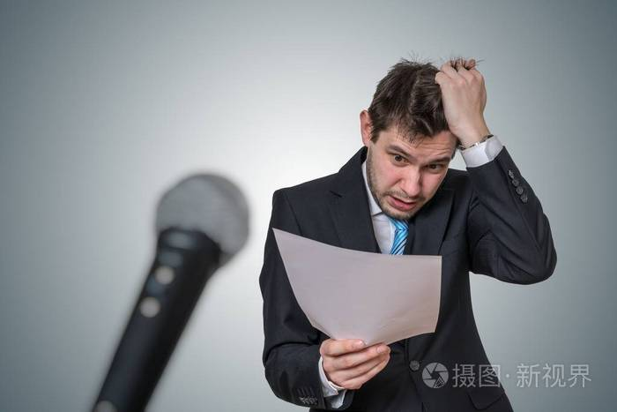



frightened/afriad
nervous/ anxious
surprised/shocked
upset/ sad/ worried
angry

Slide 4
more feeling words:
adj. |  | n.
satisfied |  |  | 满意
relaxed |  |  | 放松
proud |  |  | 自豪
confident |  |  | 自信
glad, happy |  |  | 快乐，乐趣
surprised/ shocked |  |  | 惊讶
hopeful |  |  | 希望
interested |  |  | 兴趣
curious |  |  | 好奇
excited |  |  | 激动
感到满意的
satisfaction
轻松的
relaxation
positive
自豪的
pride
自信的
confidence
happiness, joy,
高兴的
surprise, shock
惊讶的
充满希望的
hope
感兴趣的
interest
好奇的
curiosity
兴奋的
excitement

Slide 5
adj. |  | n.
guilty |  |  | 愧疚
sad/upset |  |  | 悲伤
lonely |  |  | 孤独
angry |  |  | 怒气
anxious |  |  | 焦虑
awkward |  |  | 尴尬
nervous |  |  | 紧张
frightened |  |  | 害怕
hopeless |  |  | 绝望
disappointed |  |  | 失望
tired |  |  | 疲惫
愧疚的
guilt
伤心的
sadness/upset
孤独的
loneliness
negative
生气的
anger
焦虑的
anxiety
尴尬的
awkwardness
紧张的
nervousness
害怕的
fright
绝望的
hopelessness
失望的
disappointment
疲劳的
tiredness

Slide 6

How to use adjectives to describe feelings?

Slide 7


Presentation：
eg.
Feeling tired, he went to bed early.
Feeling so embarrassed, the man’s face went red suddenly.
Feeling + (情绪)adj.
eg.
Tom was so happy that he felt as if he had been in heaven.
He was so nervous that he could not say a word.
Sb. was/felt so + (情绪)adj. + that sb. …

Slide 8

How to use nouns to describe feelings?

Slide 9

Presentation
eg.
To their relief, their son returned later that night safe and sound.
To my surprise , no one laughed at her.
To sb.‘s + (情绪)n 令某人。。。的是
eg. The letter wasn't addressed to me. But I opened it out of curiosity.
He leaved the house hurriedly out of fear.
Out of + (情绪)n 由于。。。

Slide 10
eg.
Hearing that his team won, his eyes were shining with joy and happiness.
I jumped up, filled with pleasure about the good news.
with + (情绪)n.

Slide 11
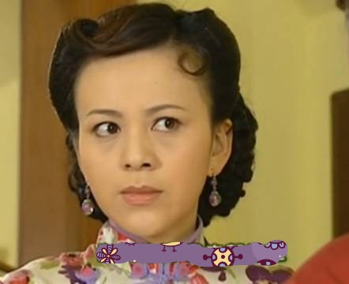
eg.
Unhappiness was written all over her face. It seemed that whatever I said or did was wrong in her eyes.
Anger was written all over his face as he saw the broken window of his car.
④(情绪)n.+ was written all over one’s face.
某人脸上挂满。。。的情绪

Slide 12
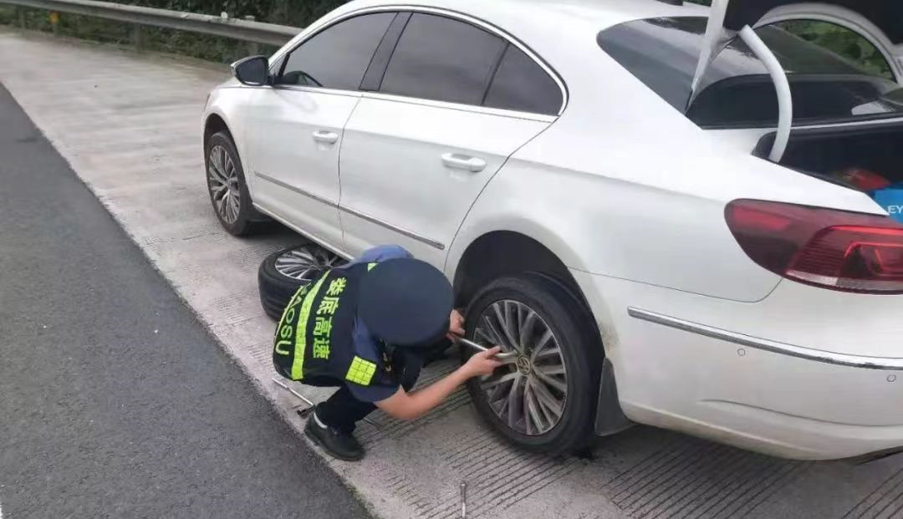
eg. I stood there watching the repairman finishing the whole job. A sense of respect and admiration welled up in my heart.
A sense of relief welled up in her heart when she finally heard the good news
⑤A sense of + (情绪)n. + welled up in sb's heart./
⑥Sb. felt a sense of + (情绪)n. + welling up in sb’s heart.
某人感觉一种...涌上心头/在某人心里

Slide 13
Fill in the blanks with proper words.
Practice:
1. Feeling ____________ , I could feel my face burning.
2. I was so_________ that my heart was in my mouth.
3. To our great ____________, it rained every day of the trip.
4. I was heartbroken because my best friend didn’t talk to me for a few days. To my__________, she smiled at me this morning.
embarrassed
nervous
disappointment
surprise

Slide 14

Practice:
Fill in the blanks with proper words.
5. The twins were filled with_____________ as they thought of the surprise they were planning for Mother’s Day.
6. Thinking of her rudeness(粗鲁) to the man, she felt a sense of _______welling up in her heart.
7. He stood up, and shouted at the black girl, “It is YOU who stole my wallet!”. _______was written all over his face.
excitement
guilt
Anger

Slide 15


Translation
Practice:
令所有人震惊的是，这对夫妇在女儿的葬礼（funeral）上激烈地争吵。
因为紧张，他的腿不停地抖。
他失望地望着最好的朋友。
感到欣喜若狂，她张开双臂抱住她最好的朋友分享这个美妙的消息
他感到如此悲伤以至于泪水顺着脸颊滑落
当我们十年后再次重逢的时候，脸上都挂满了喜悦。
当医生告诉她她患有癌症(cancer)，她感到一丝绝望在心里。

Slide 16

1. 令所有人震惊的是，这对夫妇在女儿的葬礼上激烈地争吵。
To everyone’s shock, the couple quarreled violently at the funeral of their daughter.
因为紧张，他的腿一直在抖。
His legs were trembling out of nervousness.
他失望地望着他最好的朋友。
He looked at his best friend with diappointment.

Slide 17

4. 感到欣喜若狂，她张开双臂抱住她最好的朋友分享这个美妙的消息。
Feeling overjoyed, she threw her arms around her best friend to share the wonderful news.
5.他感到如此悲伤以至于泪水顺着脸颊滑落
He felt so sad that tears streamed down his face.

Slide 18

6. 当我们十年后再次重逢的时候，脸上都挂满了喜悦。
When we reunited ten years later, happiness was written on both of our faces.
当医生告诉她她患有癌症，她感到一丝绝望在心里.
When the doctor told her that she had a cancer, she felt a sense of hopelessness welling up in her heart.

Slide 19
Summary
情绪描写的一些结构：
Feeling +adj.
Sb. was/feel so +adj. +that sb.
To one’s +n.
Out of +n.
With +n.
N. was written all over one’s face
A sense of n. welled up in sb.’s heart
Sb. felt a sense of n. welling up in sb.’s heart

