Slide 1

读后续写之情绪描写
Ways of Describing Emotions
in Continuation Writing

Slide 2
He was excited.
He was curious.
He was nervous.
……
Rely too much on telling!!!
过度依赖陈述

Slide 3
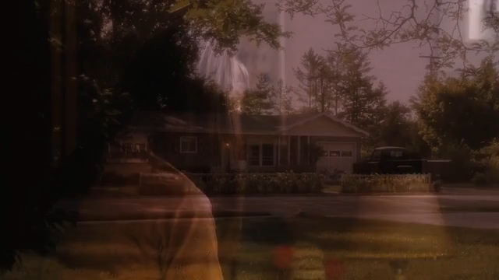

Slide 4
Show！√
Tell！×
She is in love
Invite your readers into the house
Shut your readers out of the house

Slide 5
VOICE
“He’s planting a tree?” “I’d help him, but he says he has to do this himself." I whispered. "Is it a…" The words stuck in my throat, and the next thing l know he's holding my hand, looking right into my eyes.
My heart stopped. It just stopped beating. And for the first time in my life, I had that feeling. Like the world is moving all around you, all beneath you, all inside you, and you're floating. Floating in midair. And the only thing keeping you from drifting away is the other person's eyes. They're connected to yours by some invisible physical force, and they hold you fast while the rest of the world swirls and twirls and falls completely away.
BODY
ENVIRONMENT
FACE

Slide 6
Show！
Don't tell！
Step 1
Face+Body+Voice+Environment
Have a clear and vivid picture in your mind.
A face in fear

Slide 7
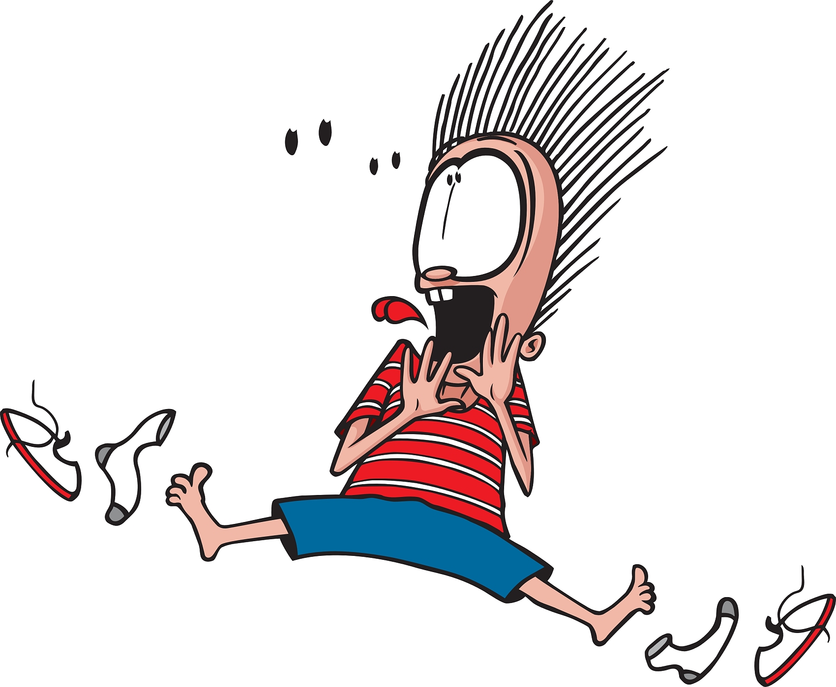
FACE: Draw his face
恐惧让他毛发直竖(make one’s hair stand on end)
The fear made his hair stand on end.
他惊恐地瞪大了(wide)双眼。
He opened his eyes wide in panic
他脸色变得苍白(pale/white)。
His face turned pale.

Slide 8

BODY: Make your body move
他全身止不住的颤抖
He trembled uncontrollably.
他感到双腿发软
He felt his legs turned to jelly.

Slide 9

VOICE: Make some noise.
“什么？”他发出(let out)一声恐怖(terror)的尖叫(scream)。
“Whattttt?!” he let out a scream of terror.
I felt so scared that my knees felt weak.

Slide 10
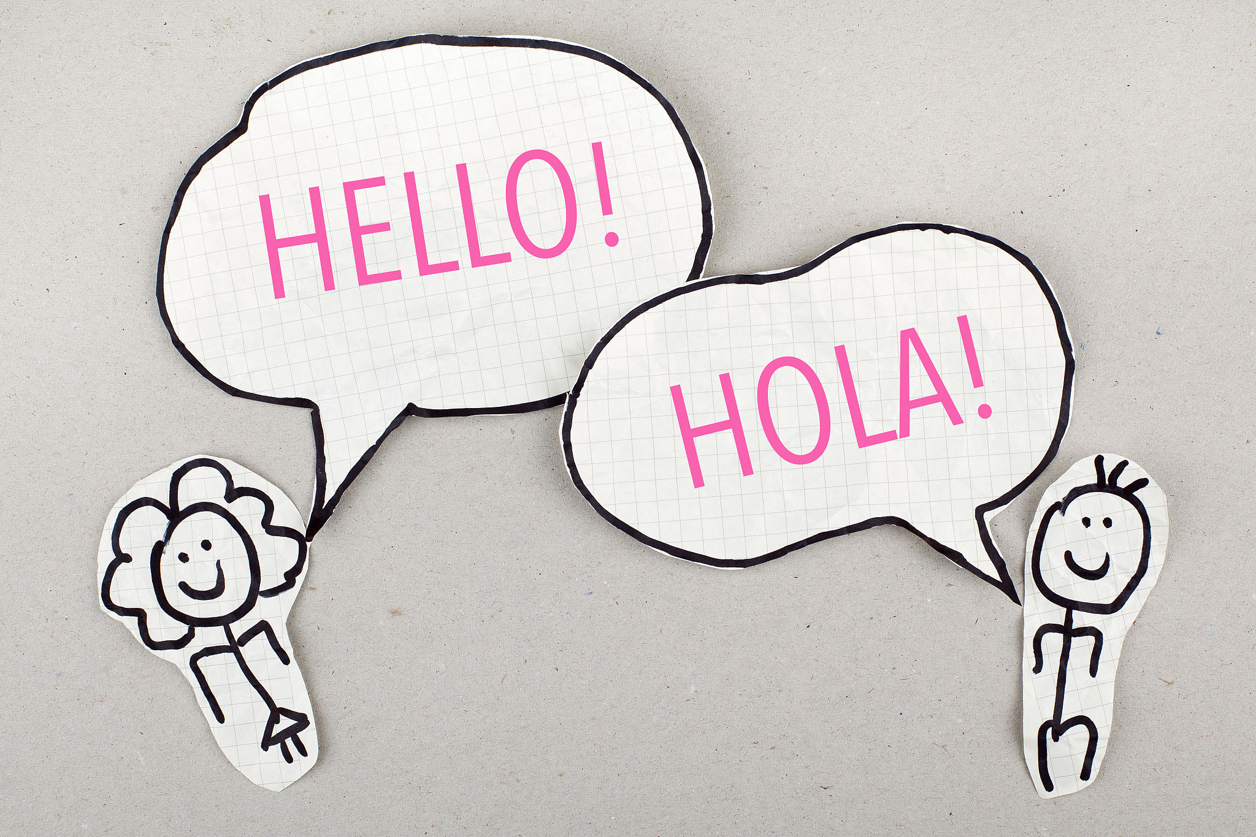
Environment: Give it a setting(背景)
老师让我们挨个上去自我介绍
The teacher asked us to introduce ourselves one by one.
I felt so scared that my knees felt weak.

Slide 11

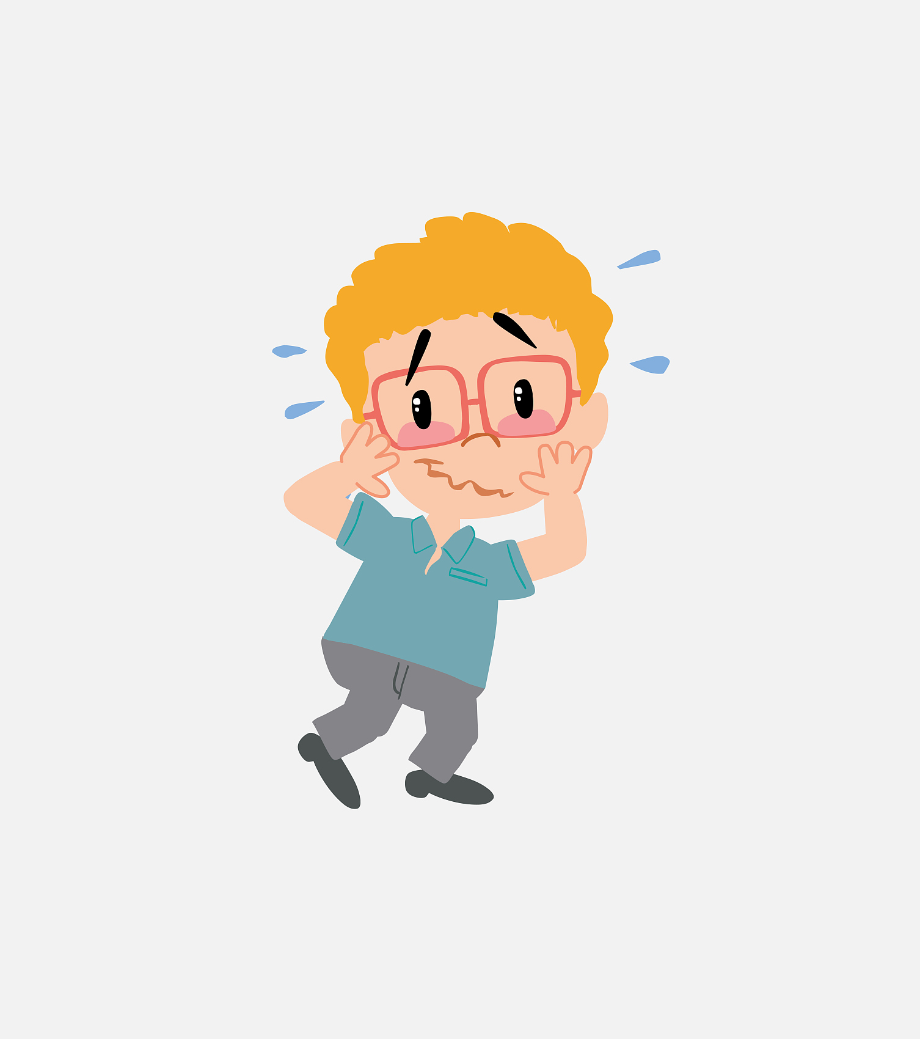
Show the picture!
make his hair stand on end/open his eyes wide/face turned pale.
FACE
His legs turned to jelly/He trembled
BODY
let out a scream of terror
VOICE
The teacher asked us to introduce ourselves
ENVIRONMENT

Slide 12
观察例句，总结句型
I was so afraid that I lowered my head
句式1:sb be so+情绪adj+that 从句 某人如此...以至于...
我太害怕了以至于我发出恐怖的尖叫声。
I was so frightened that I let out a scream of terror.
let out a scream of terror

Slide 13
观察例句，总结句型
Scared and nervous, he let out a scream of terror.
句式2:形容词1+形容词2, sb did sth. (感到)...和...,某人做了某事。
当老师叫我们挨个上去自我介绍时，我感到紧张和恐惧不受控制的颤抖着。(Body+Enviroment)
his legs turned to jelly/He trembled
Scared and nervous, I trembled uncontrollably when the teacher asked us to introduce ourselves one by one.
The teacher asked us to introduce ourselves

Slide 14
观察例句，总结句型
Scared and nervous，he let out a scream of terror with tears running down his face uncontrollably.
技巧3:with+n/代+Ving，sb did sth. 有……, 某人做了某事
感到紧张和恐惧，我不受控制的颤抖着，汗毛直立。(Body+Face)
make his hair stand on end/open his eyes wide/face turned pale.
Scared and nervous, I trembled uncontrollably with my hair standing on end.
his legs turned to jelly/He trembled

Slide 15
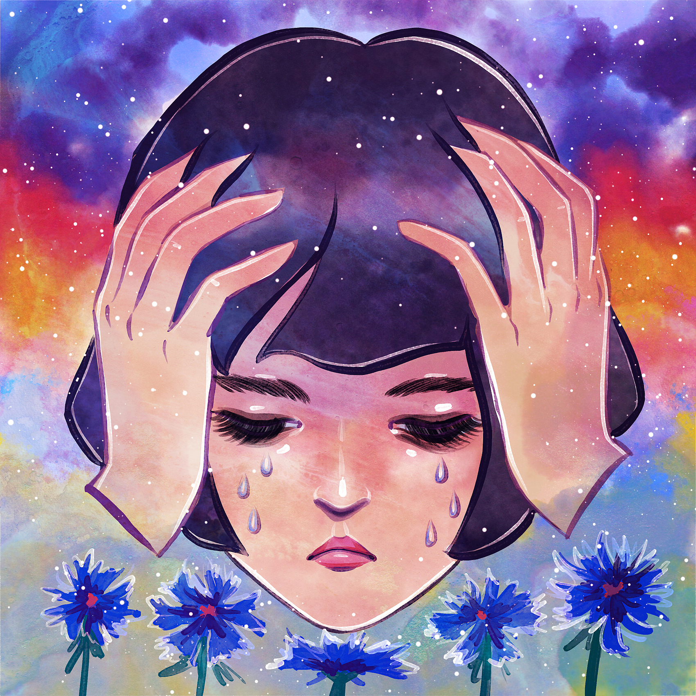
句式3:with+n/代+Ving/Ved/to do/介词短语，sb did sth.
有……, 某人做了某事
我的脸变得惨白，全身止不住的颤抖，我感觉我双腿发软。
With my face turning pale, I trembled uncontrollably and I felt my legs turning to jelly.

Slide 16
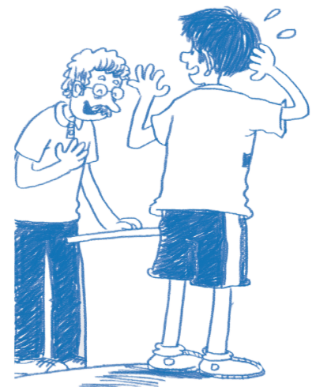
(Voice) “Noooo!” I let out a scream of terror (Environment) as we were asked to introduce ourselves one by one. (Face) With my face turning pale, (Body) I trembled uncontrollably and I felt my legs turned to jelly.

Slide 17
No
Yes
(Voice) “Noooo!” I let out a scream of terror (Environment) as we were asked to introduce ourselves one by one. (Face) With my face turning pale, (Body) I was so scared that I trembled uncontrollably and I felt my legs turning to jelly.
I felt nervous

Slide 18
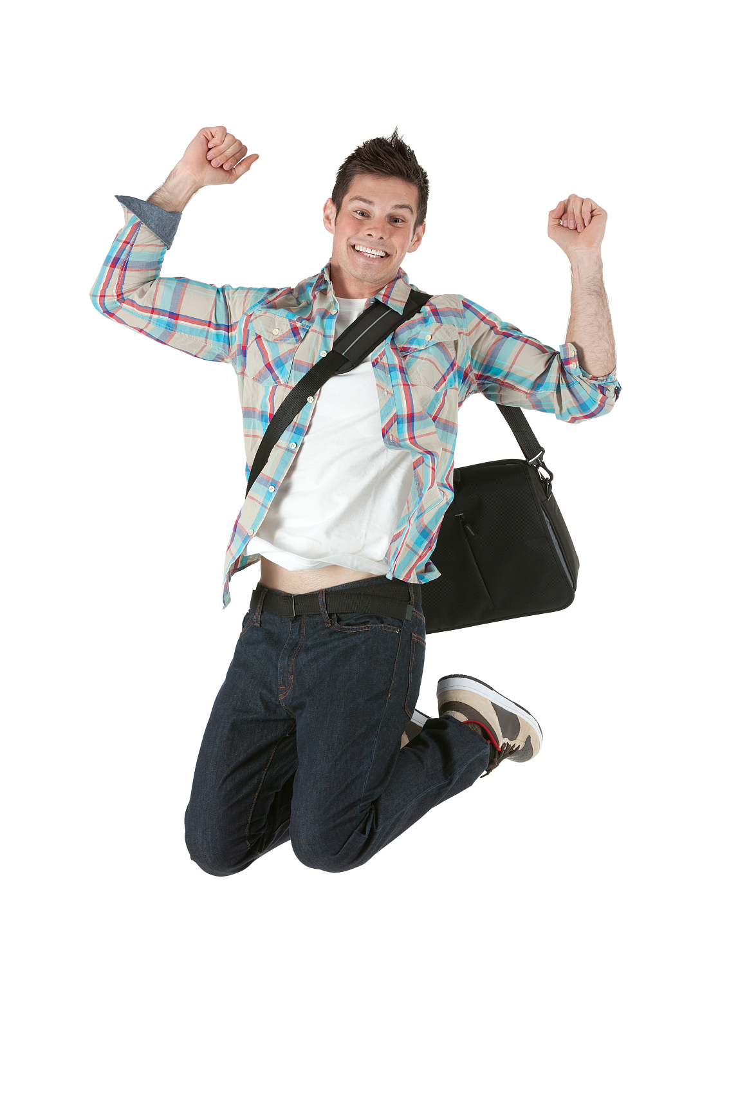
Practice: He was excited.
FACE
VOICE
BODY
ENVIRONMENT

Slide 19
Expressions and grammar you can use
语言素材：Face
眼睛--light up 亮起来
嘴巴--smile from ear to ear
咧嘴笑
语言素材：Body
jump to one’s feet 跳起来
punch the air 举拳欢呼
语言素材：Voice
let out a cry of joy
发出喜悦的欢呼
语法结构：
with+n+doing;
adj and adj,SVO;
so…that...

Slide 20
Practice: He was excited
With my eyes lighting up with delight (face), I jumped to my feet, punching the air with fists (body) as all day’s classes have been finished. (enviroment) “Yeah!!!” I let out a cry of joy at the top of my lungs (voice). A big toothy smile spread across my face, broadening from ear to ear. (face)

Slide 21
Summary: 4 steps to show one’s feelings.
FACE
VOICE
BODY
ENVIRONMENT

