Slide 1
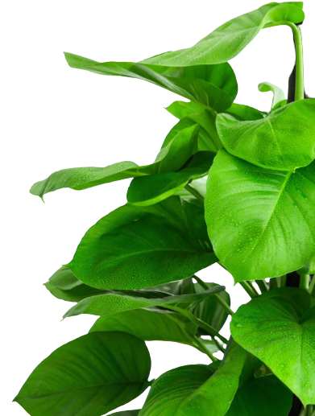
应用文写作

Slide 2


推荐信
假如你是李华，你的加拿大朋友Peter想在春节来中国旅游，让你为他推荐一个城市。请根据以下提示给他写一封邮件，内容包括：
1. 推荐城市；
2. 推荐的原因。
注意：
1. 写作词数应为80左右；
2. 可适当增加细节，使行文连贯。

Slide 3
【任务分析】
1) 篇章布局（三段式写作）
Para 1: background(想来中国旅游)+writing purpose (推荐城市)；
Para 2: reasons for your recommendation(what to recommend)；
Para 3: open ending(祝愿和希望/ 愿意提供更多帮助或信息)。
完成背景信息和要点1
完成要点2(注意层次性和逻辑性，详略得当)

Slide 4
2) 句子结构--
P1-background+writing purpose
非谓语开篇/情感式开篇：Hearing that...., I'm writing .../ Delighted and excited to know..., I can't wait to...
P2-reasons for recommendation
地位/景点(典型景点)/收获好处：高级句型：非谓语/强调句/定语从句/ 名词性从句/倒装句/ withOC等.
P3-open ending
祝福希望：Wish.../ I do hope.../

Slide 5
P1-背景信息+写作目的
PARA 1: 情感导入式
非谓语导入式
高兴且兴奋地知道你计划在春节期间来中国旅游，我迫不及待向你推荐西安作为理想的目的地。
听说你计划在春节期间来中国旅游，我带着激动的心情，写信向你推荐西安作为你理想的旅游目的地。
__________________ to know that you want to visit China during Spring Festival, I _________ ________recommend Xi’an as your ideal destination.
_________ that you want to visit China during Spring Festival, I_________________________ to recommend Xi’an as your ideal destination.
Delighted and excited
Knowing
can hardly
am writing with excitement
wait to

Slide 6
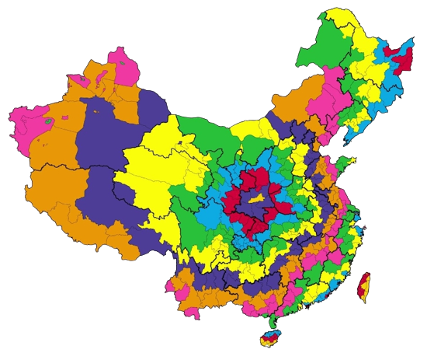


PARA 2: 推荐原因
【地理位置+中心句】位于中国中心，西安在国内外游客中享有极高的欢迎度，有着很多吸引人的风景点。
非谓语动词表达地理位置：Located in the center of China
_________ in the central China, Xi’an enjoys great popularity among tourists __________ ________ with __________ attractive sights.
located
at home and
abroad
numerous

Slide 7
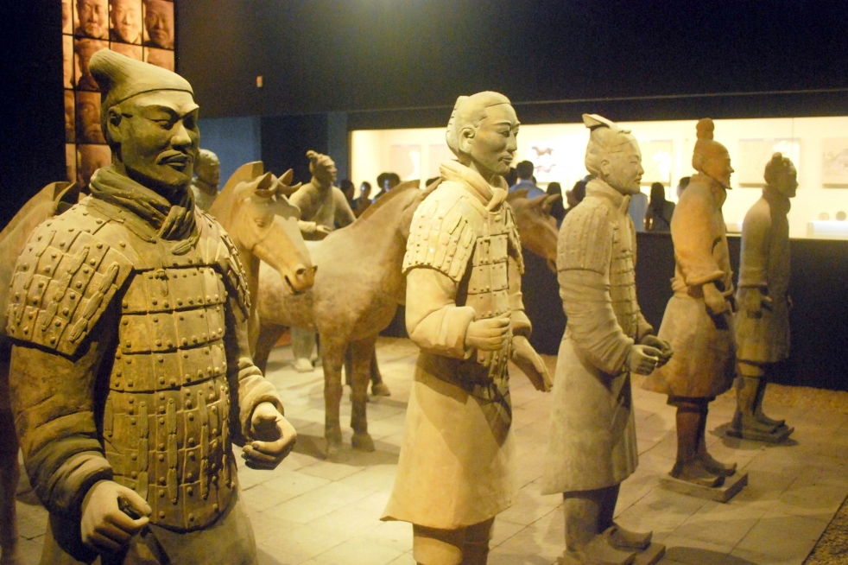
PARA 2: 推荐原因(值得推荐的兵马俑)
【兵马俑介绍】尤其令人惊喜的是兵马俑。追溯到公元前3世纪，兵马俑由8000多个像真人士兵的复制品一样的雕塑组成。直到20世纪70年代，现代人类才知道它们。
完全倒装句
Especially amazing is the Terracotta Amry.
Dating back to the third century BCE, the Terracotta Army is made up of over 8,000 statues as copies of real soldiers.
非谓语动词
Not unitil the 1970s did people in modern times know about it.
倒装句
It was not until the 1970s that people in modern times knew about it.
强调句

Slide 8

PARA 2: 推荐内容
get a better understanding of its history.
当出现两个或者两个以上并列元素表达时，可采用：Not only...., but also...(倒装句)
deeply unearth the culture of this city.
have a great feast on local food...
【总结+收获】当旅行在西安，你不仅能对这个古都有深入了解，挖掘其内在文化，而且还能享受到西安特有的美味当地小吃。
非谓语+倒装句：When travelling in Xi’an, not only can you get a better understanding of this city but also enjoy delicious local snacks unique to Xi’an.

Slide 9
PARA 3:祝福结尾/ 期待回信
题目要求有祝福：
祝你拥有一个难忘且有意义的中国之行。
Wish you an unforgettable and meaningful trip in China.
Wish you have fun travelling in China.
如果你对我的推荐有任何疑问，不要犹豫/ 随时联系我哦。
题目没有要求祝福：
Don’t hesitate/ Feel free to contact me/ Drop me a line if you have any problems concerning this recommendation.

Slide 10
Dear Peter,
Learning from your last letter that you will travel to China during the Spring Festival and are eager to choose a city to visit, I am more than delighted to recommend Shenzhen to you.
Shenzhen, located in southern China, is a vibrant city with a high level of modernization. Here are some reasons why I think you would enjoy traveling here. Firstly, as one of the most innovative cities in China, Shenzhen boasts many distinctive scenic spots and modern landmarks, which will bring you a unique travel experience. Additionally, with a diverse and inclusive community, this modern city never fails to attract visitors from all over the world, thus probably making it easy for you to communicate and feel at home. Lastly, there exist many parks, beaches and mountains in this city, where you can immerse yourself in its striking natural beauty and enjoy various outdoor activities in your spare time during the festival.
I would appreciate it if you take my recommendation into account, and I do hope you will have a wonderful Spring Festival trip in China. Should you need any further information, please feel free to contact me.
Yours,
Li Hua
Firstly, shenzhen enjoys warm,mild weather with comfortable tempertatures around 15-20 degrees , you can explore the city without bulky winter coats.
Additionally, boasting a diverse and inclusive atmosphere, this modern city attracts countless global travelers with its rich and varied activities as well as an amazing selection of tasty food. No matter what your preference is, you are sure to find something that delights your taste buds.

Slide 11
Dear Bill,
Delighted to learn that you are keen on traveling to China, I can’t wait to recommend Chengdu, a city that I believe holds the promise of an unforgettable experience, as your first choice.
The reasons why I recommend Chengdu are as follows. Firstly, Chengdu, the capital city of Sichuan province, situated in the southeast of China, is a famous historical and cultural city with a history of over 3,000 years. Besides, there are plentiful places of interest in Chengdu, among which the majority like most is Chunxi Road. While strolling down the commercial pedestrian streets, you can find yourself surrounded by bustling constructions which are modeled on the style of modern architecture. What’s more, it is various traditional local foods that make Chengdu a paradise for a food lover like me. You just can’t miss them.
Welcome to slow-paced Chengdu, a city you are reluctant to leave once you pay a visit to. I am confident that with its unique blend of history, culture and cuisine, it will leave a lasting impression on you.

Slide 12
Dear Peter,
Knowing that you want to travel to China during the Spring Festival, I’d like to recommend Chengdu, a city full of charm and warmth.
Firstly, Chengdu is famous for its long history, leisurely lifestyle and cute giant pandas. Walking on the old streets or drinking tea in local teahouses will make you feel relaxed and peaceful. Besides, during the Spring Festival, Chengdu is filled with strong festive atmosphere. You can enjoy temple fairs, dragon dances, Sichuan Opera performances and beautiful lantern shows. What’s more, it is various traditional local foods that make Chengdu a paradise for a food lover like me. You just can’t miss the famous hot pot.When families sit together around, the passionate vibe warms your heart, just like the hot and spicy taste that fills the air.
The friendly locals and joyful holiday vibe will surely leave you a deep impression.

Slide 13
Dear Bill,
Excited to know you intend to travel in China during Spring Festival, I’m writing to recommend Xi’an as your ideal destination.
As an ancient capital of 14 dynasties, Xi’an is home to abundant cultural heritage. The Shaanxi History Museum, Known as treasure houses of Chinese civilization, is a must-see attraction that you will definately appreciate. Besides, the spectacular Terracotta Army, consisting of over 8,000 life-like soldier statues will surely take your breath away. Finally, the magnificent Xi’an City Wall will leave you in awe, for it stands as a testament to the city’s time-honored past. During the festival, the ancient City Wall is decorated with thousands of red lanterns, creating a stunning sea of light. I do believe this trip in Xi'an will offer you a profound insight into China’s brilliant civilization and unique traditions of the Spring Festival.
Wish you an unforgettable trip in China. I'm eagerly looking forward to receiving your photos and insights from your journey.
Yours,
Li Hua

Slide 14


