Slide 1

第9周英语早读
4月27、28日

Slide 2
1
4月28日
英语早读

Slide 3
1. 读后续写--情绪描写（齐读）
2. 复习U3,U4,U5
Tasks
3.自己复习读后续写学案

Slide 4
Part 1 恐惧、害怕
A flood/burst/wave/rush of fear/anxiety crowded into my mind. 一阵恐惧/焦虑涌上心头
Seeing/hearing/thinking/feeling/knowing/realizing......, sb... 看到/听到/想到/感到/得知.....，某人....
Scared and shocked, sb.... 既害怕又震惊，某人.....
heart beats violently 心脏剧烈跳动
1. At the sight of the ferocious tiger, I froze with terror, too scared to move an inch.
一看到那只凶猛的老虎，我吓呆了，不敢动弹。
2.At the sight of the ferocious tiger, I felt so scared that my throat tightened and my knees felt weak.
一看到那只凶猛的老虎, 我害怕得嗓子发紧，膝盖发软。
3. At the sight of the ferocious tiger, I was seized by a strong sense of horror and my palms were sweating.
一看到那只凶猛的老虎，我就被深深的恐惧感所控制，手心出汗。

Slide 5
Part 2 惊讶、震惊
raise the eyebrows扬起眉毛
be wide-eyed/ with sb’s eyes wide open瞪大眼睛
blink in surprise吃惊地眨眼
freeze/stand still/stop dead/ be numb with shock 因震惊、惊吓而呆住、动弹不得
1. On learning the truth, I was totally shocked. 得知真相后，我完全震惊了。
2. Hearing the bad news, Mary froze with shock, as if rooted on the ground.
听到这个坏消息，玛丽惊得僵住了，仿佛在地上生了根一般动弹不得。
3.She looked at me in amazement. 她惊讶地看着我。

Slide 6
Part 3 愤怒 、生气
stare at sb in anger/glare at sb 怒目而视
be red-cheeked with anger或go/turn red with anger
气得 满脸通红
sb's face falls/darkens 脸沉/黑了下来
with one's arms crossed 双臂交叉
stamp one's feet with anger 气得直跺脚
1. His face clouded with anger.他气得脸色阴沉。
2. He glared at me with burning eyes.他用灼热的目光怒视着我。

Slide 7
Part 4 焦虑、绝望
be thrown into a world of darkness.某人突然被投入黑暗世界
sink into hopelessness/ despair，fall into despair陷入绝望
throw up one’s hands in despair 彻底绝望；束手无策
abandon oneself to despair自暴自弃；陷入绝望；沉溺于绝望之中
1.John returned at night with hollow, pale face. 约翰夜里回来了，面色憔悴、苍白。
2.He gave up the attempt in despair. 他在绝望中放弃了尝试。
3.As the result of an accident, James was suddenly thrown into a world of darkness and sank into hopelessness. 由于一场意外，詹姆斯骤然坠入黑暗的世界，陷入了绝望。

Slide 8
Ⅰ. Derivatives.
1. prior priority prioritize
2. bold boldly
3. chef chefs cook
4. elegant elegance elegantly
5. exceptional exception exceptionally
6. minimum maximum
7. consume consumption consumer
8. temper mild/good/bad-tempered
B2 U3

Slide 9
9. stable stably stability stabilize
10. association associate
an associate professor associated
11. moderation moderate
12. ideal idealistic
13. consistent inconsistent
14. modest modesty
15. trick tricky
B2 U3

Slide 10
Ⅰ. Derivatives.
1. frost frosty
2. massive mass
3. breath breathless breathe breath-taking
4. freeze froze frozen freezing
5. literally literal literature
6. astonish astonishing astonished astonishment
7. mist misty
8. advertisement advertise advertiser advertising
B2 U4

Slide 11
9. photographer photograph photography
10. pleasant pleased pleasing pleasure
11. contrary contrarily
12. arise arose arisen
13. anticipate anticipation
14. enroll enrollment
15. coherent coherence
B2 U4

Slide 12
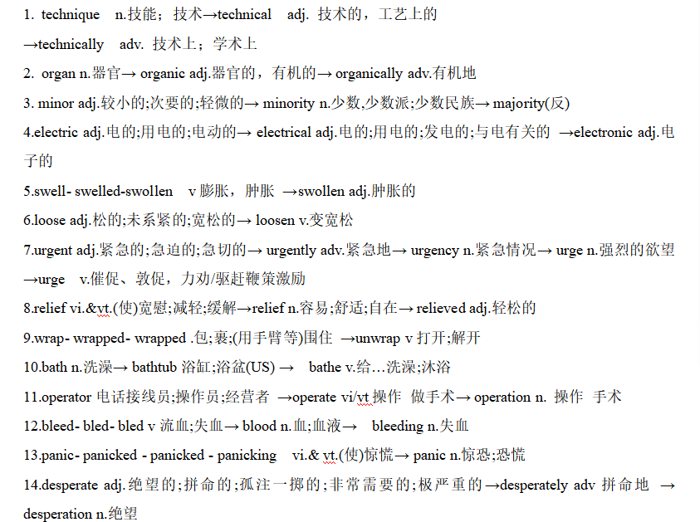
B2 U5

Slide 13
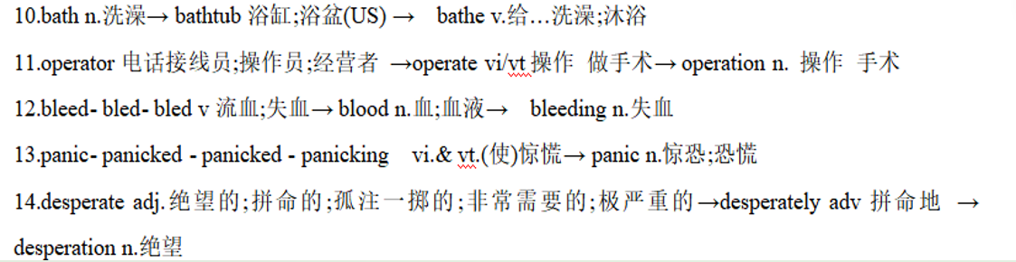
B2 U5

Slide 14
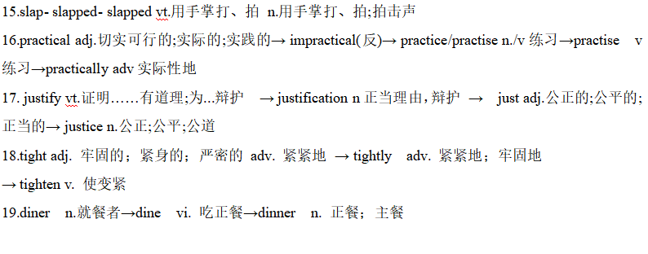
B2 U5

Slide 15
自由复习读后续写--情绪描写学案

Slide 16
2
4月29日
英语早读

Slide 17
1.GR合刊五词汇P19-20（翻页；齐读）
2.读后续写--情绪描写、情绪描写三大句型
3.读后续写范文（我与他人）齐读
Tasks

Slide 18
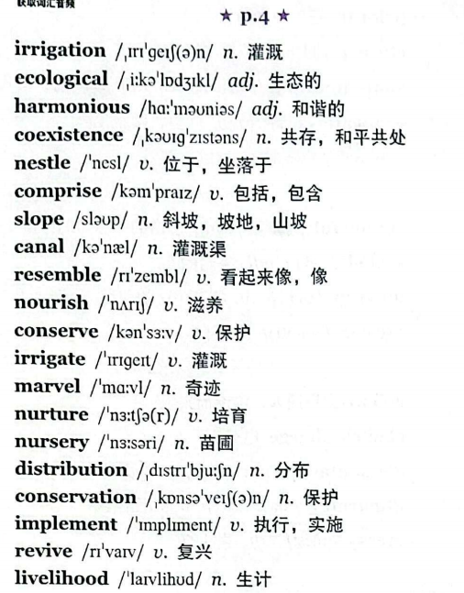
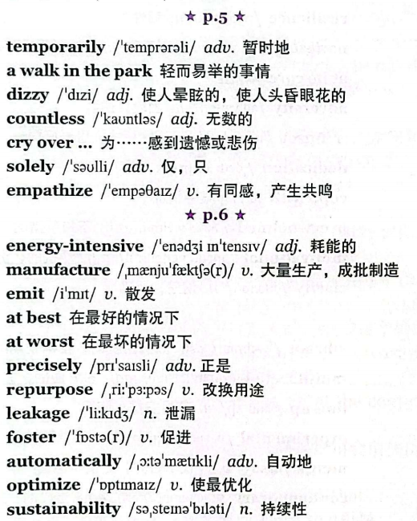

Slide 19
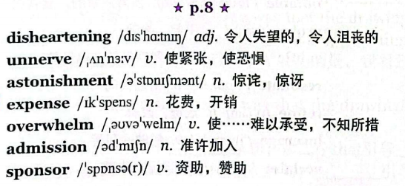
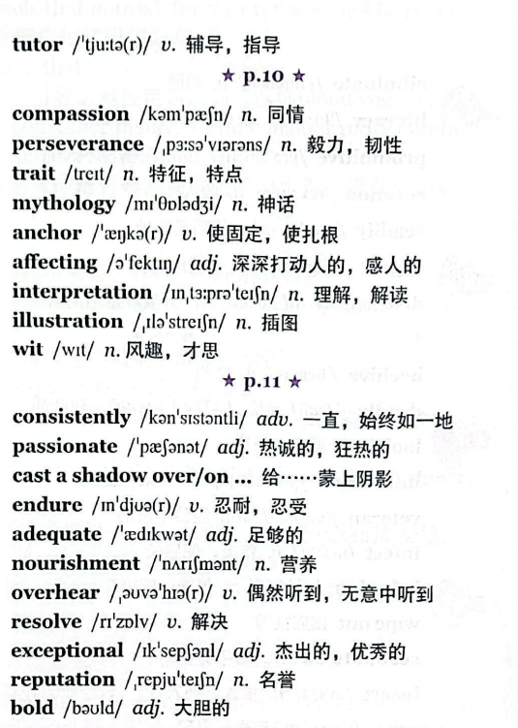

Slide 20
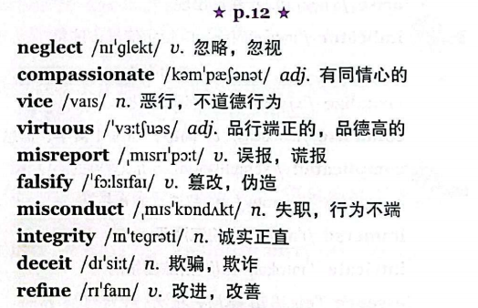
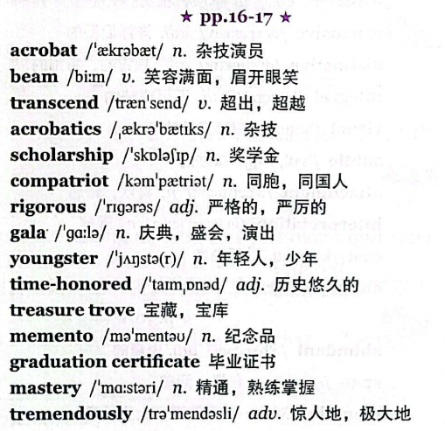

Slide 21
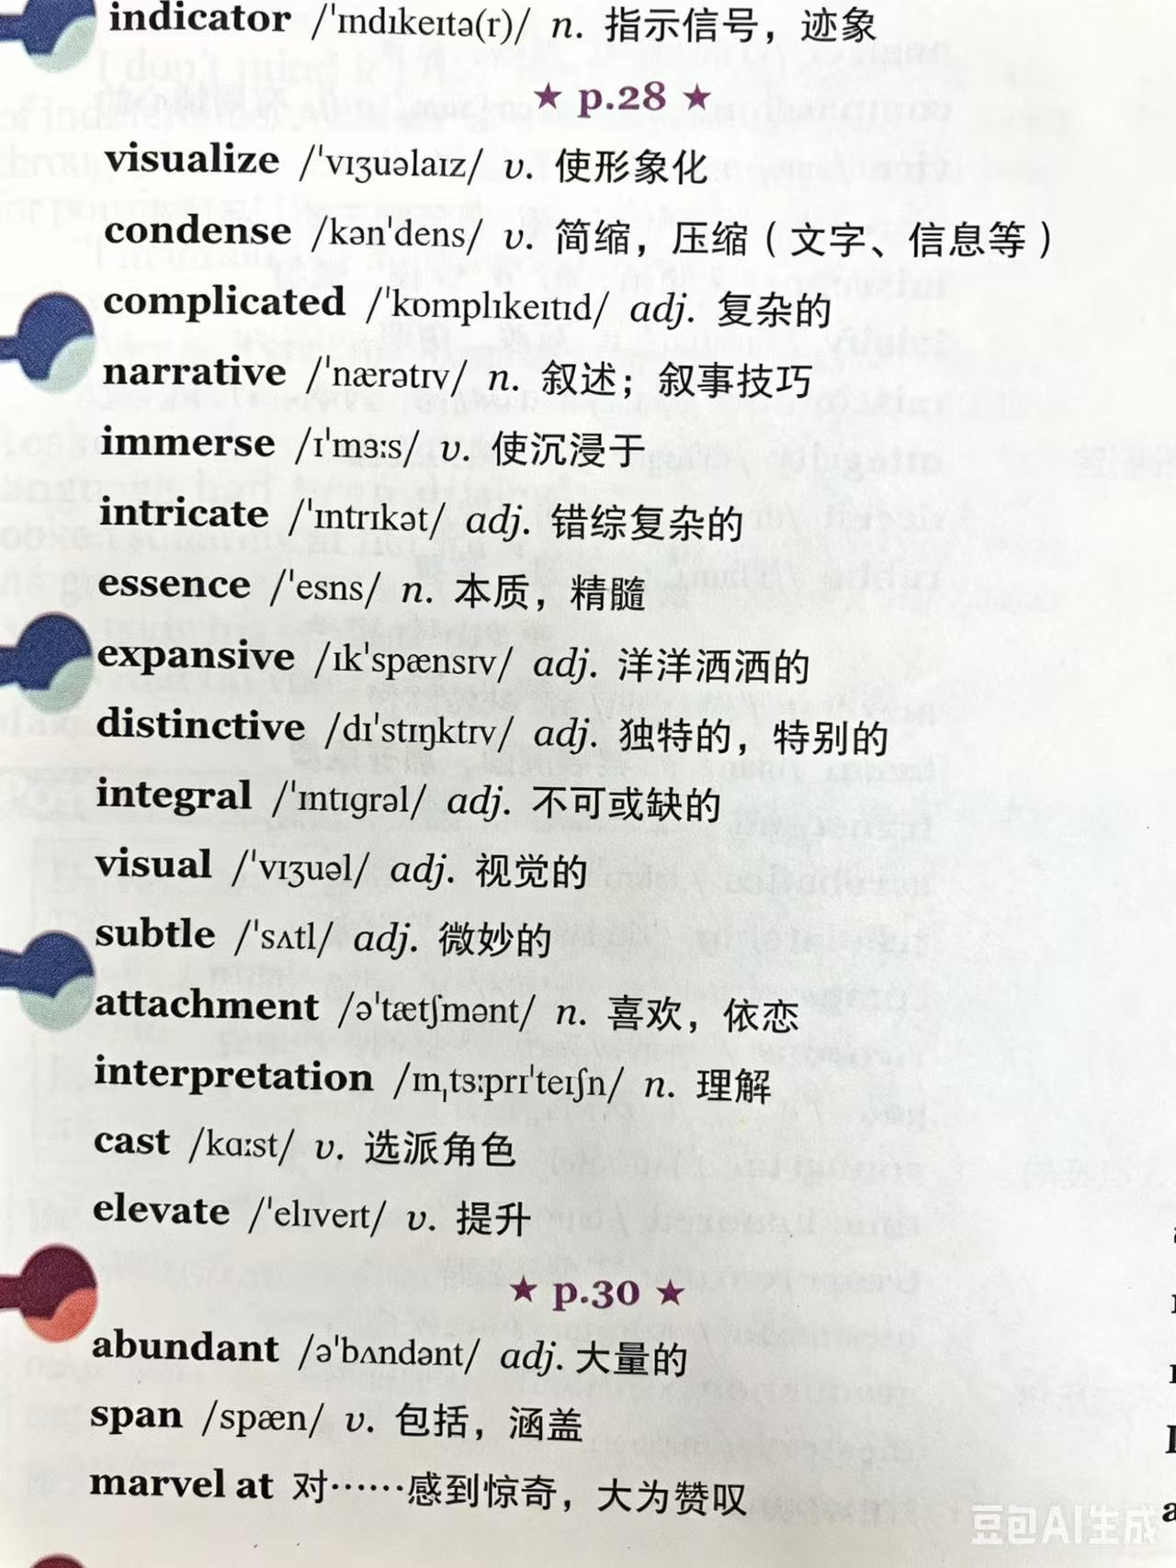
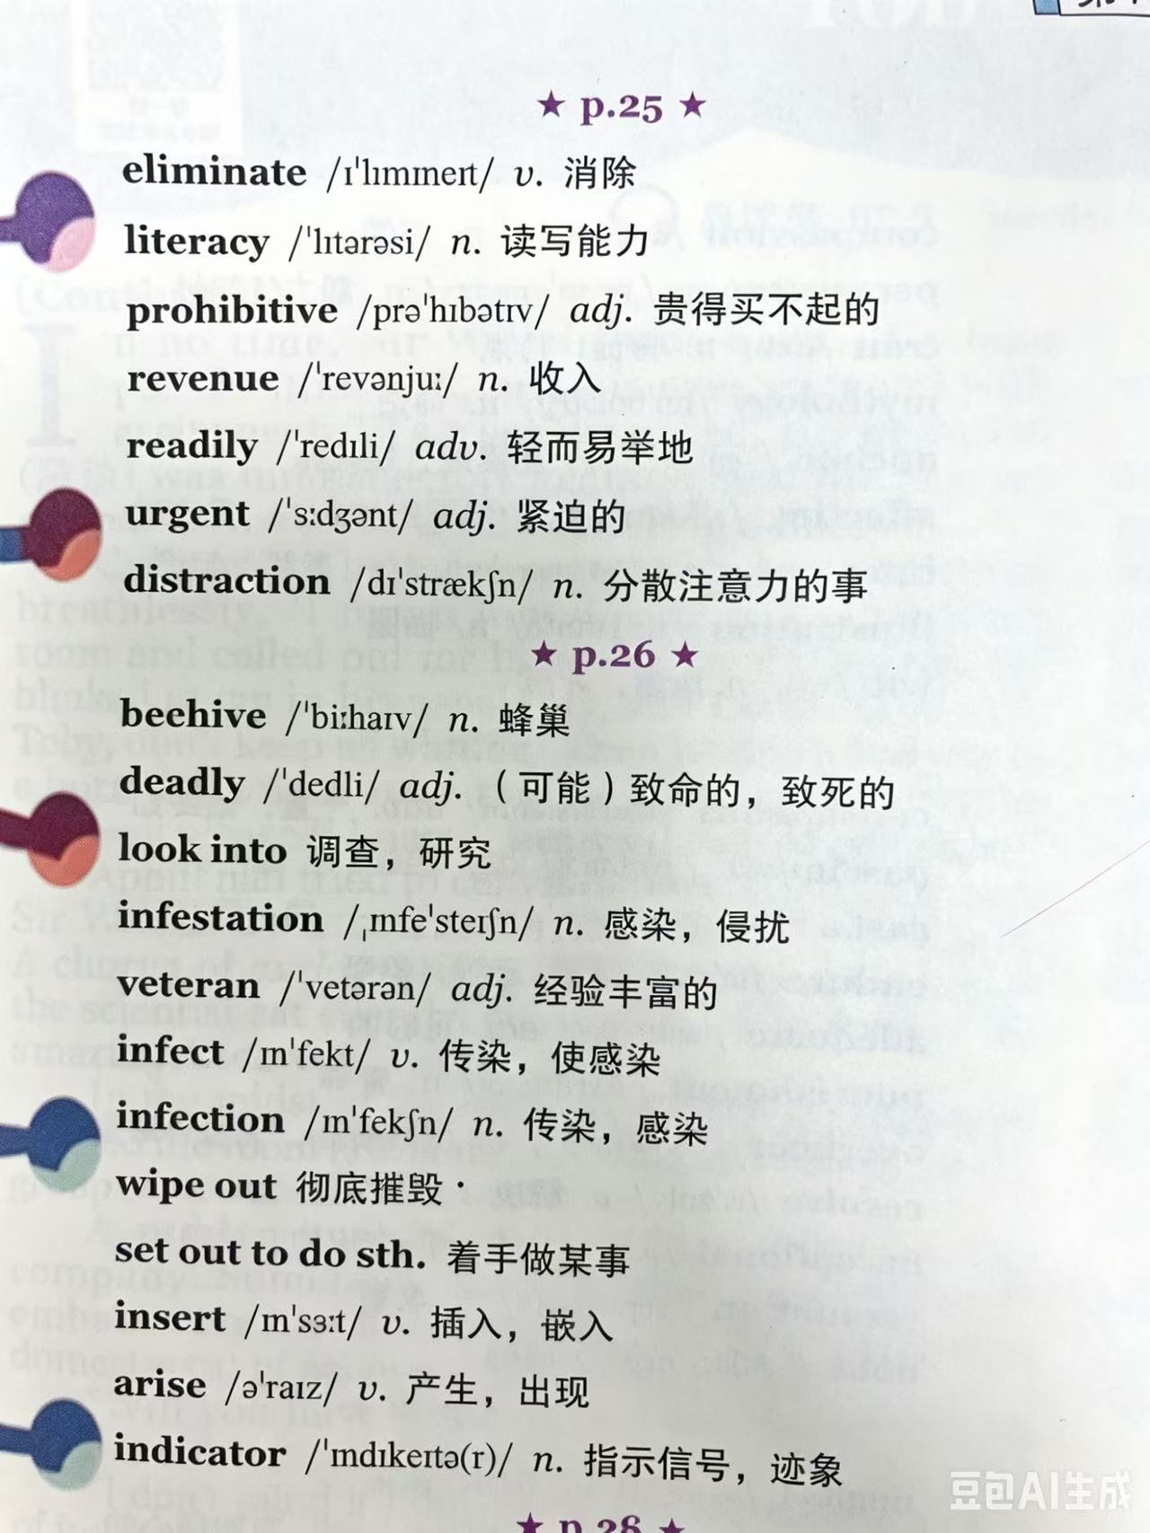

Slide 22
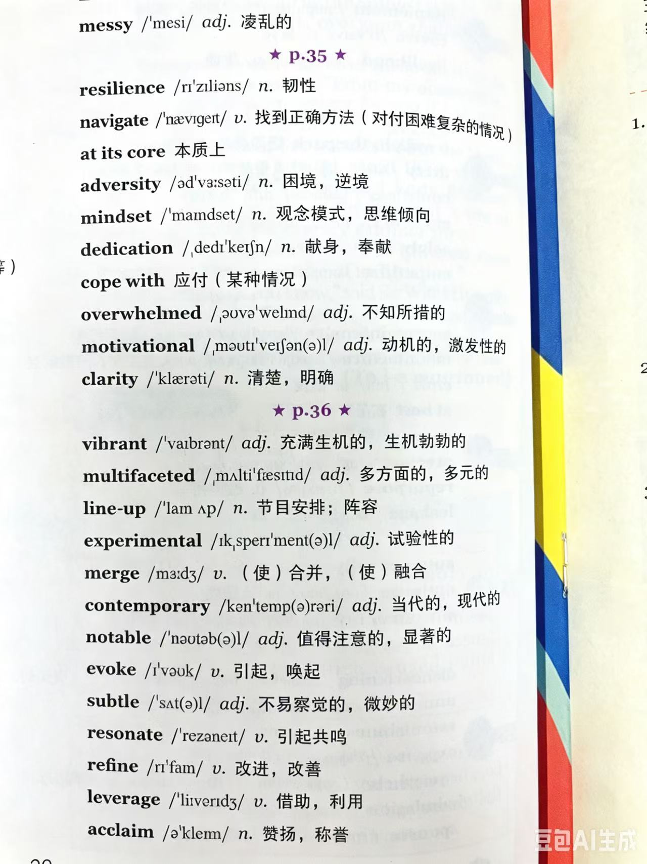
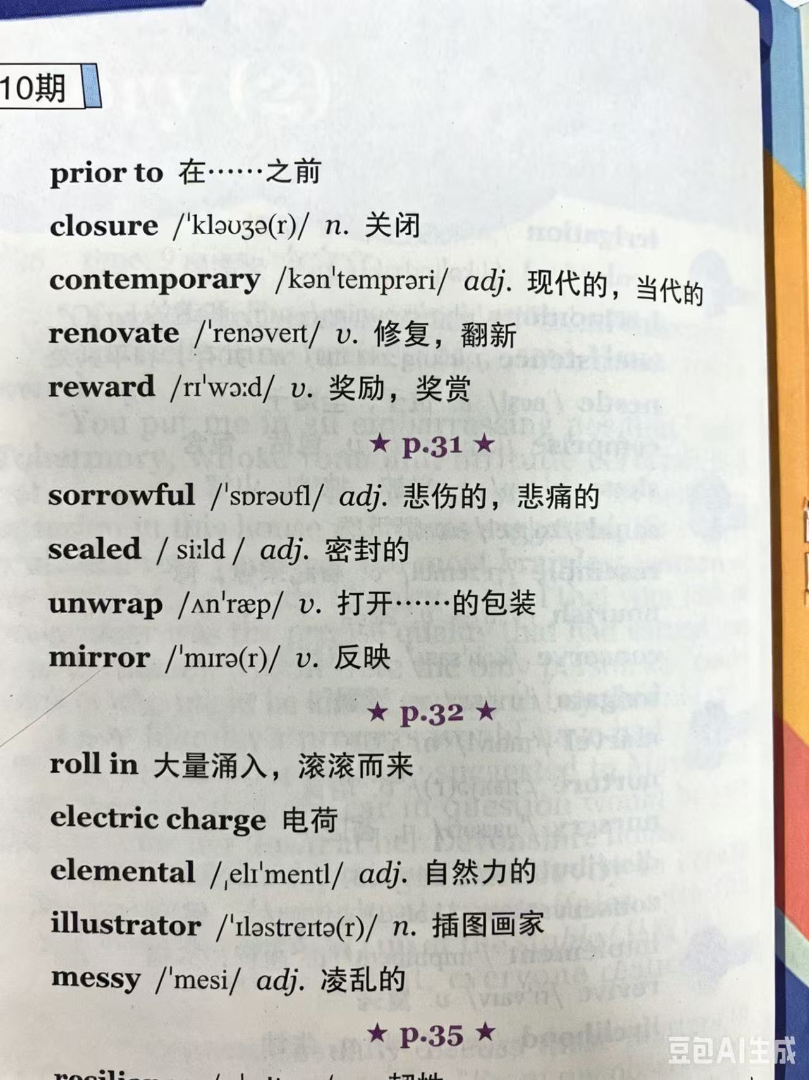

Slide 23
Part 5 悲伤、难过
a flash of grief came upon sb. 感到一阵悲伤
have tears in one’s eyes/eyes fill with tears/tears swim in sb’s eyes眼里噙着泪水
tears roll/run/stream/flow down sb’s cheeks潸然泪下
sob/weep with one’s face hidden in one’s hands掩面啜泣
1. They were immersed in sorrow.他们沉浸在悲痛之中。
2. Upon hearing the bad news, she felt seized by a burst of sadness and couldn't help crying bitterly.
听到这个坏消息，她感到一阵悲伤，禁不住痛哭起来。
3. Her eyes are flooded with tears. 她眼里充满泪水。

Slide 24
Part 6 遗憾、愧疚
a strong sense of loss 强烈的失落感
ease sb. of his pain/trouble减轻某人的痛苦/烦恼
Ashamed and self-blamed/condemned, sb..... 既羞愧又自责，某人.....
1. She felt so ashamed that she could feel her face burning. 她感到羞愧难当，脸上滚烫。
2. So ashamed was she that she could feel the blood rush to her face.
她感到羞愧极了，血液涌上脸颊。

Slide 25
Part 7 失望、沮丧
in low spirits/in an unpleasant mood情绪低落;沮丧
try hard to disguise/ hide one’s disappointment 尽力掩饰某人的失望之情
be overcome/overwhelmed/seized by disappointment /desperation／despair／hopelessness
非常失望／绝望
1.Overcome with bitter disappointment at his failing to win a prize, he locked himself up in his room.
他对未能获奖感到极度失望，于是把自己锁在房间里。
2.His heart sank when he heard the news that he failed to win a prize.
当得知没有获奖时,他心一沉。

Slide 26
Part 8 激动、热情
light up 喜形于色
be wild with joy/delight/happiness 欣喜若狂
in a good mood 心情好 to one's delight/joy 让某人开心的是
on top of the world 高兴坏了 be over the moon 欣喜若狂
a mixture of excitement and happiness 既兴奋又开心
1. When the host announced that she won the prize, her eyes twinkled with excitement. 当主持人宣布她获奖时,她激动得两眼放光。
2.When the host announced that she won the prize,her heart was thumping with excitement. 当主持人宣布她获奖时，她激动得心砰砰跳。
3. Tears filling her eyes, she offered her heartfelt gratitude.
她热泪盈眶，表示衷心的感谢。

Slide 27
Part 9 高兴、 快乐
1.Bathed in sunshine, we all cheered and jumped with joy.
沐浴在阳光下，我们欢呼雀跃。
2. When the mother kissed the baby on the cheek,his face beamed and his bright smile lit up the room. 当母亲亲吻婴儿的脸颊时，他眉开眼笑，笑容照亮了房间。
3. Smiles are dancing in his eyes./Her eyes danced with joy and happiness.
微笑在他的眼睛里跳舞。/她的眼睛里充满了喜悦幸福。

Slide 28
三大情绪描写句型
1. So…that 部分倒装句型
So + 并列情绪形容词 + be动词 + 主语 + that + 主语 + 连续动作
2. 无灵主语句型
Upon doing sth / At the sight of sth / Realizing sth / The moment + 从句, 主语 + feel(s) + 无灵主语 + 表“涌上/席卷”的动词
3. 形容词并列作状语句型
情绪形容词 and/but + 形容词, 主语 + 面部表情 + 动作描写

Slide 29
倒装 So… that…，包含喜、怒、哀、乐，动作：
结构：So + 情绪形容词 + was/were + 主语 + that + did… and did… and doing…
1. So overjoyed and excited was he that he jumped to his feet, clapped his hands wildly and rushed forward, hugging his friend tightly.
2. So furious and annoyed was she that she slammed the door, glared at him sharply and stepped back, breathing heavily.
3. So sad and heartbroken was he that he bowed his head, wiped his tears and sat on the ground, trembling uncontrollably.
4. So delighted and relieved was she that she covered her mouth, smiled widely and nodded repeatedly, feeling relaxed at last.
5. So bitter and disappointed was he that he shook his head, sighed deeply and turned away, walking slowly in silence.

Slide 30
无灵主语+双情绪名词+高级动词
1. A wave of desperation and helplessness swallowed me entirely.
2. A flood of guilt and remorse crept over my heart slowly.
3. A surge of panic and dread overwhelmed me in a second.
4. A wave of sorrow and loneliness enveloped my mind.
5. A flood of relief and gratitude washed over and welled up inside me.

Slide 31
拓展upon hearing / at the sight of / realizing / the moment / on seeing , sb felt a sense of… / a wave of… 情绪涌上来
1. Upon hearing the unexpected good news, she felt a strong sense of joy surging through her.
2. At the sight of his rude behavior, he felt a wave of anger welling up inside him.
3. Realizing he would never see her again, he felt a flood of sorrow overwhelming him.
4. The moment he saw his friends arrive, he felt a warm current of happiness flooding his heart.
5. On seeing the disappointing result, she felt a mixture of sadness and frustration creeping up on her.

Slide 32
形容词并列作状语（可转折、可递进）带面部表情 + 动作
1. Anxious but determined, she lowered her head and bit her lip, trying to hold back her tears.
2. Excited and overjoyed, he widened his eyes and grinned from ear to ear, clapping his hands repeatedly.
3. Frustrated and annoyed, he frowned and turned away, refusing to say another word.
4. Heartbroken and helpless, she stared blankly into the distance, her eyes filled with tears.
5. Relieved and grateful, she smiled softly and nodded, her shoulders finally relaxing.

Slide 33
读后续写范文--人与他人
1. 做爆米花救济他人
2.母亲节的精选

Slide 34
When Mrs. Meredith heard of John’s idea, she thought it was a good one, too. Her eyes lit up with approval as she patted John on the shoulder. “Yay!”Children shouted cheerfully,and they couldn’t wait to tell Bernard their plan. When Bernard heard this, a strong wave of warmth and gratitude washed over him. They head to the local supermarket together, buying a bag of corn and some special bags for popcorn. With Mrs. Meredith’s patient guidance, John and the others got to work, helping Bernard pop the corn and pack it into neat paper bags. The kitchen was full of excitement and energy, as they filled bag after bag, each of them feeling a sense of achievement .

Slide 35
With everything ready, Bernard started out on his new business. Nervous yet excited, he went from house to house, holding his bag of popcorn proudly. At each door, neighbors greeted him warmly, impressed by his polite manners and determination. “You’re doing a great job, young man,” one elderly woman said in a kind voice, handing him a few coins with a kind smile. As he walked back home that evening, his bag much lighter and his spirits high, so moved and thrilled was Bernard that he was close to tears. His hard work and the support of the Merediths had brought hope to his family and joy to the neighborhood. The kindness he received would be something he would always remember and pass on to others.

Slide 36
参考范文2：
As the twins looked around them in disappointment, their father appeared. He must have been woken by Jeff’s cry. Walking in the kitchen, he was shocked to find that the kitchen was in a mess and that Jeff’s hand had been burnt. Hearing Jenna explained what they were doing, Father understood their excellent idea and intended to join them. Under his guidance, Jenna turned down the fire to cook another bread while Jeff paid close attention to the porridge in case it boiled over. Half an hour later, to their satisfaction, breakfast was done perfectly.
The twins carried the breakfast upstairs and woke their mother up. “Happy Mother’s Day!” the twins cheered. The moment Mother glimpsed the breakfast which was giving off a tantalizing aroma, her eyes were moistened. When she took a bite of bread and tasted the porridge, the twins looked anxious, wondering if mom would like their special present. “This is the most wonderful delicacy in the world,” Mom praised, feeling pleased and proud of the Mother’s Day surprise she got. At this moment, the father gently stepped into the bedroom and gazed at the three, smiling not only with his lips but also his eyes. Perhaps nothing was better than the kids’ love and gratitude for their mom. (主旨升华)

