Slide 1

第8周英语早读
4月21、22日

Slide 2
1
4月21日
英语早读

Slide 3

1. 复习人教版选必二Unit3、4、5 词汇 P110-114
2. 合刊五GR 单词 翻页（齐读）
3. 复习维词431-440（齐读）
Tasks

Slide 4
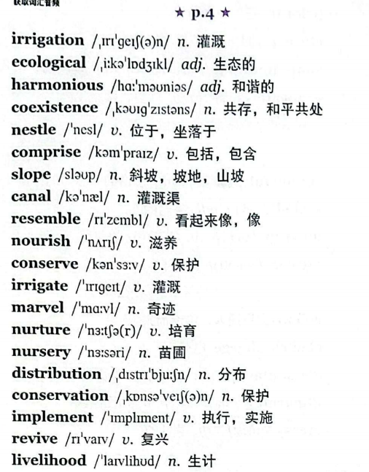
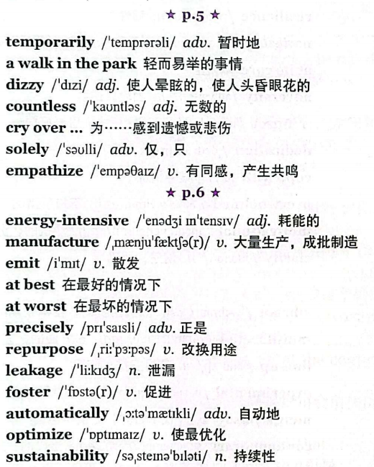

Slide 5
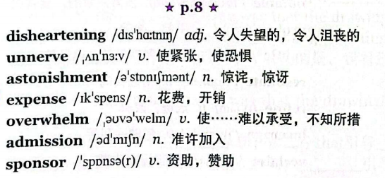
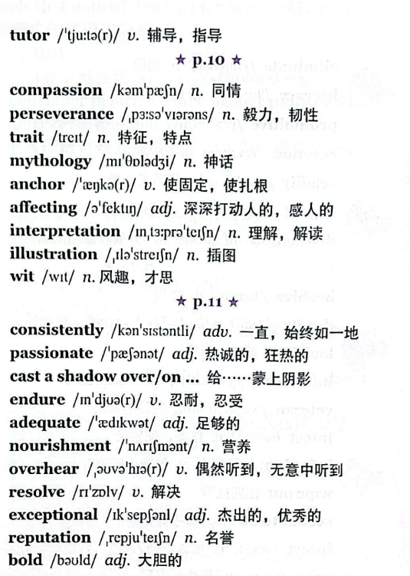

Slide 6
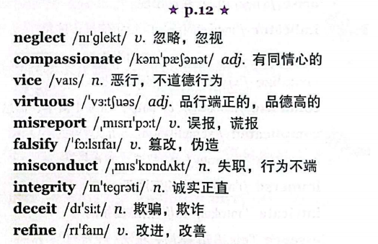
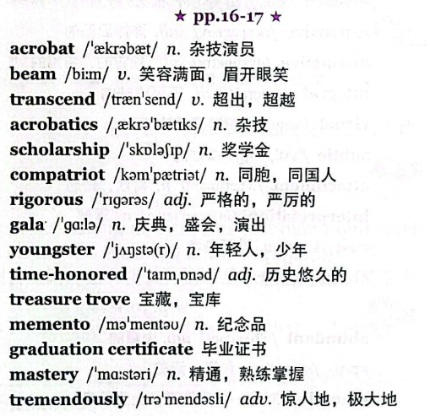

Slide 7
2
4月22日
英语早读

Slide 8
Tasks
1. 复习维词441-450（齐读）
单击此处编辑母版文本样式 第二级 第三级 第四级 第五级
2. 介词搭配 （齐读）
3. 细节描写微技能之动作描写（素材）齐读

Slide 9
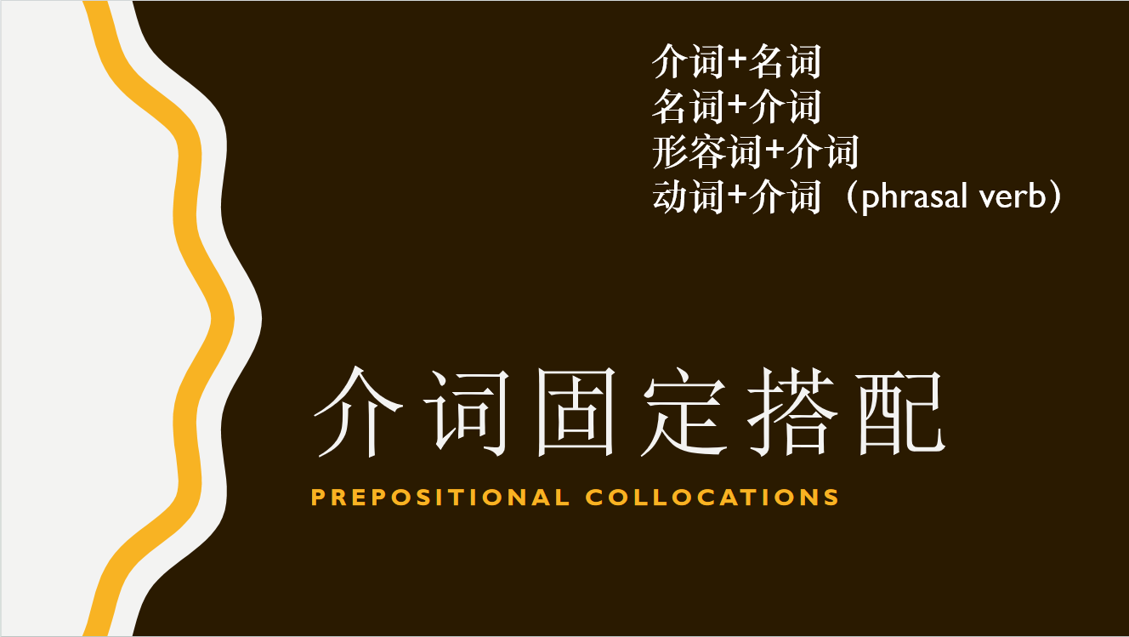

Slide 10
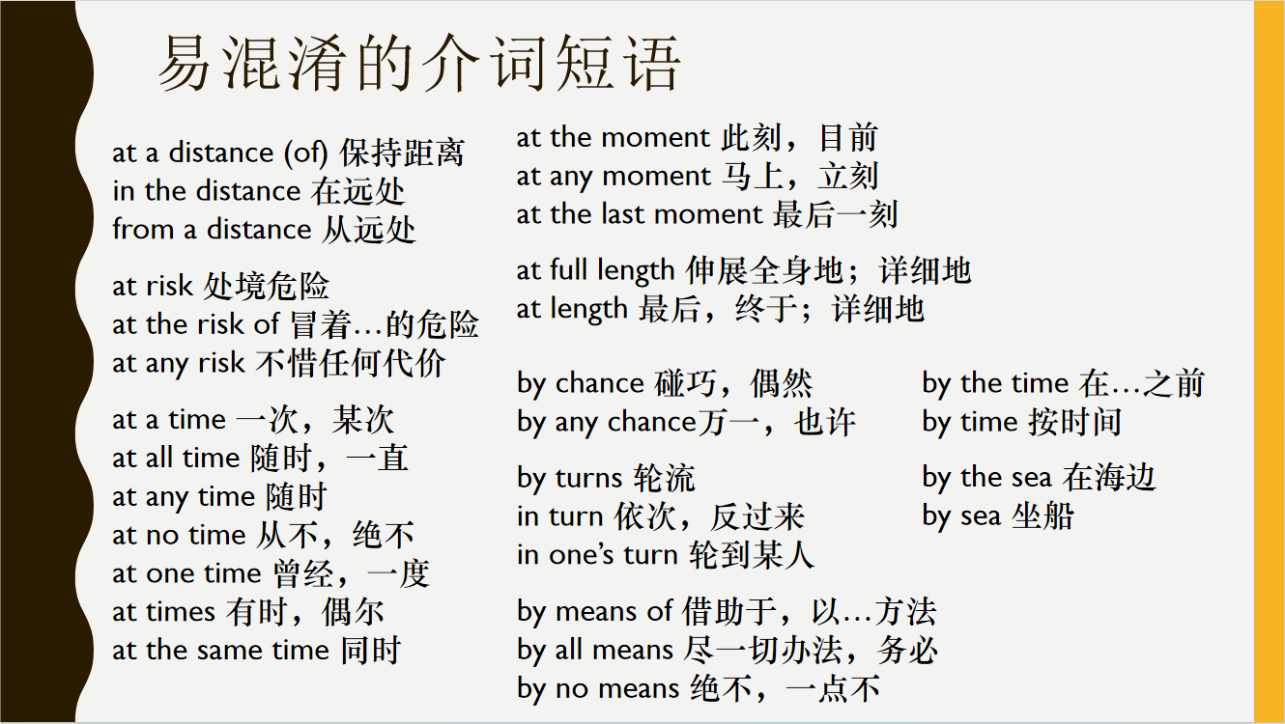

Slide 11
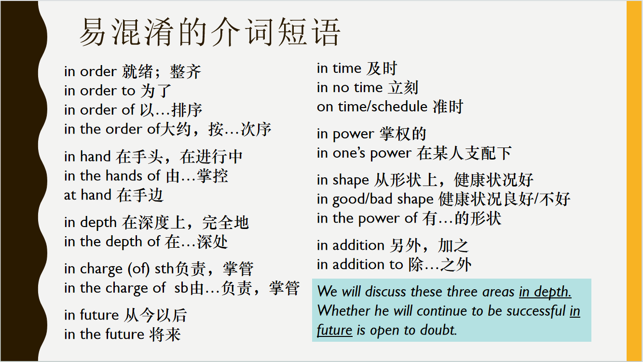

Slide 12
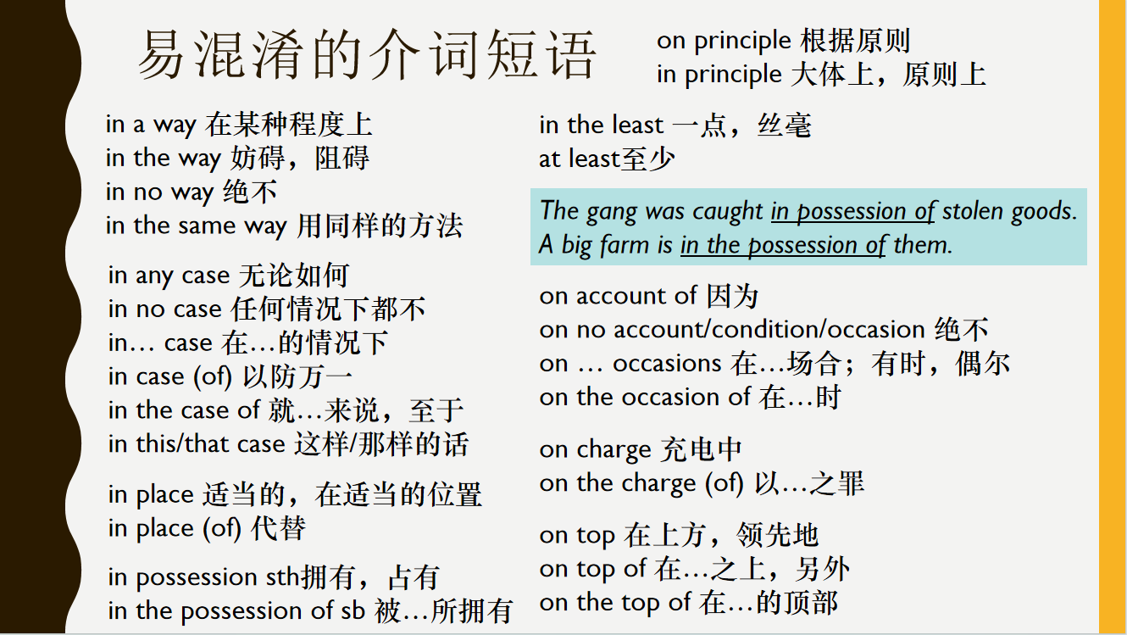

Slide 13
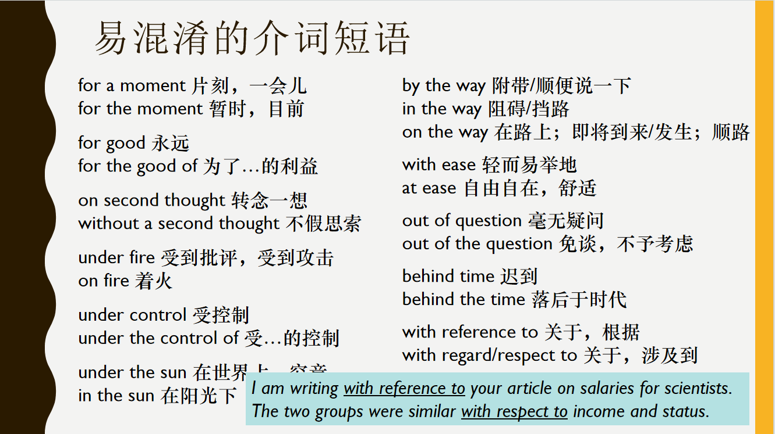

Slide 14
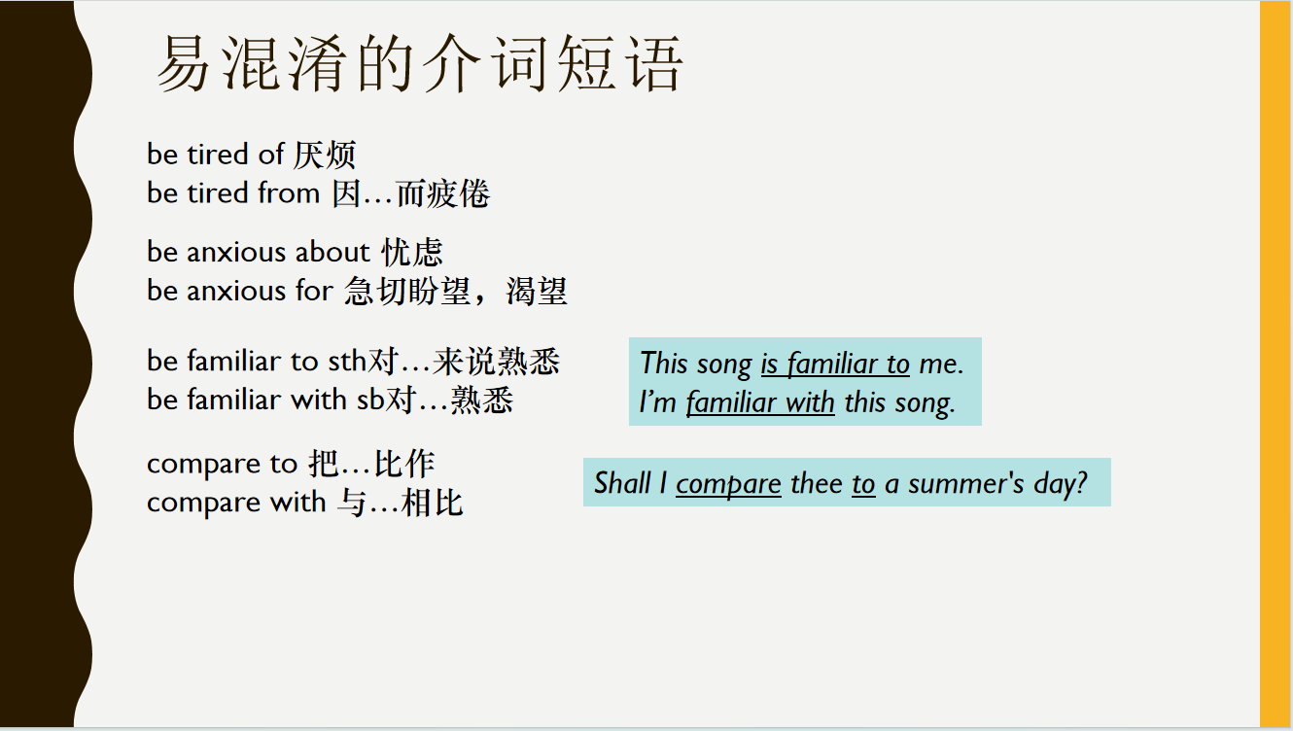

Slide 15
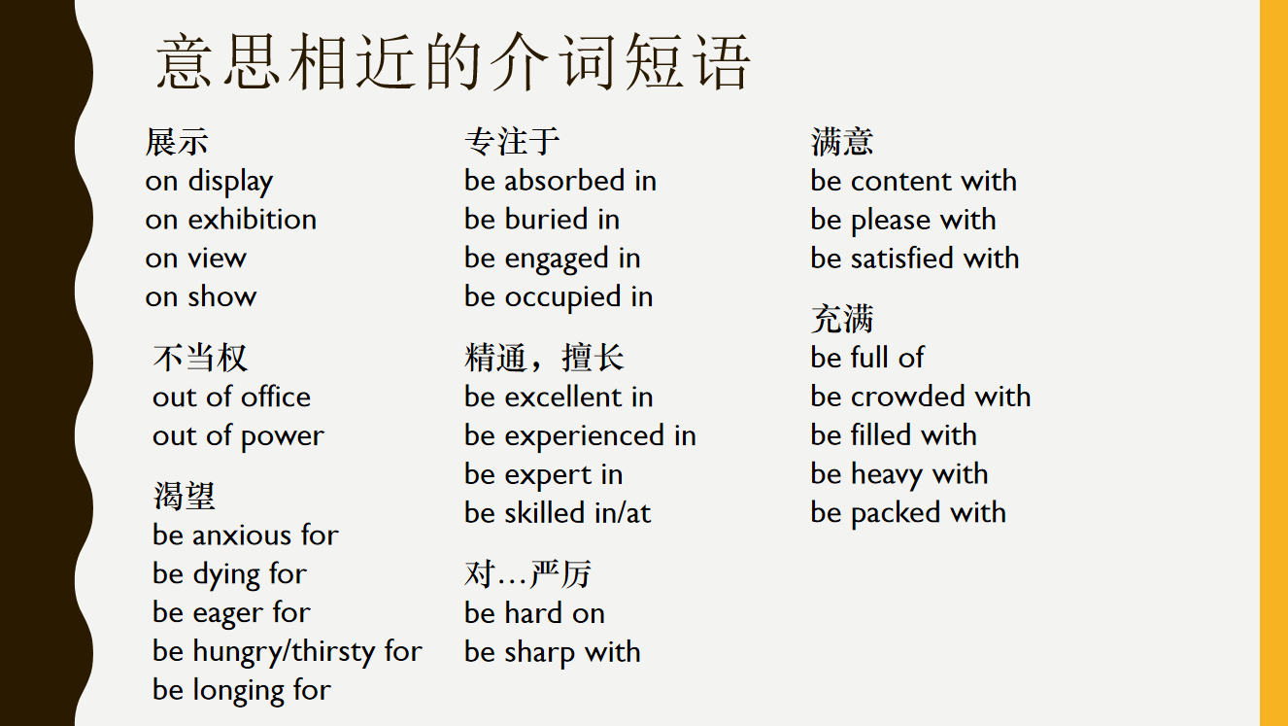

Slide 16
部位 | 动作 | 例句
Head | 低头 | He hung/lowered/bent/bowed/drooped his head in shame. His head drooped.
 | 挠头 | He scratched his head, not understanding a word.
 | 埋头 | She buried her head in the pillow.
 | 靠....在... | She rested her head on his shoulder.
 | 清理思绪 | I decided to go for a walk to clear my head/ mind.
 | 头眩晕 | He could feel his head spinning after only one drink.
 | 前往 | He turned and headed for the door.
Face | 露出笑容 | A bright smile appeared on/spread across/was written on his face.
 | 容光焕发 | Her face lit up/brightened/glowed when I gave her the present.
 | 满脸通红 | Jack's face flushed/burned with embarrassment.
 | 脸色惨白 | Her face paled with fright.
 | 皱眉 | He had a slight frown on his face.
Cheek | 脸颊发烫 | He felt his cheeks burning with shame.
 | 流泪 | Tears rolled down her cheeks.

Slide 17
Eyes | 瞪大眼 | His eyes were wide with horror.
 | 目光落在... | The dog's hungry eyes were on(=landed on/fell on) my sandwich.
 | 目光移到... | He turned his eyes to the door when he heard the handle turning
 | 直视 | She looked her father straight in the eye and answered his question truthfully.
 | 对视 | He seemed unwilling to meet my eyes.
 | 两眼闪光 | She laughed, her eyes shining/ sparking/ sparkling/ glistening/ glowing with excitement.
 | 眼里满是泪水 | Her eyes brimmed with tears =Tears brimmed in her eyes.
 | 注视 | She tried to sit up, her eyes fixed on Jean's face.
 | 模糊视线 | Tears blurred her eyes/ vision.
 | 泪水涌出 | I felt tears well up in my eyes.
Mouth | 目瞪口呆的 | He straightened up and looked at me, open-mouthed.
 | (因紧张)心到嗓子眼 | My heart was in my mouth when I walked into her office
 | 嘴发僵 | Her mouth grew stiff with pain and distress(悲伤).
 | 嘴张开 | She froze, her mouth hanging open.
 | 咬牙切齿 | "Come here now!" she growled through her clenched teeth.
 | 清嗓子 | She cleared her throat, then began to speak

Slide 18
喉咙发出(轻叫) | A small cry escaped his throat.
嘴唇发抖 | His lips were quivering/trembling.
竖起耳朵听 | I strained my ears to catch the conversation in the other room.
笑得合不拢嘴 | He was beaming/grinned/smiled from ear to ear.
对...充耳不闻 | She decided to shut her ears to all the rumors.
握手 | He shook my hand as if we were long lost friends
伸手 | A strong hand reached out and caught hold of her arm. She smiled and hold out/reach out a hand in welcome.
摊开手 | She shrugged and spread her hands. "That's all I can tell you."
抓 | He reached out a hand and caught hold of/grabbed/grasp her arm.
拍手 | The class clapped warmly as Mr. Lee presented me with the reward.
竖手指 | The teacher raised a warning finger and we stopped talking.
轻抚 | She stroked my hair and said: “Of course there is a Santa Clause.”
蘸... | I dipped my finger in the sauce and licked it.
用手指敲椅子 | He was drumming/ tapping his fingers nervously on the arm of the chair
用拳头捶... | He struck/pounded/punched the table with his fist.
紧握拳头 | She clenched her fists to stop herself trembling.
手心冒汗 | I could feel my heart thumping/pounding(=beat wildly) and my palm sweating

Slide 19
抱住... | He ran up to her and put/threw/ his arms around her.
交叉双臂 | She folded/crossed her arms and stared at him.
张开双臂 | They are sure to welcome you with open arms. He held out/opened his arms with a broad smile
拍肩膀 | I tapped/patted the man on the shoulder and asked him to move.
耸肩 | When I asked him why he had done it, he just shrugged his shoulders.
倾诉的对象 | a shoulder to cry on
用肩挤着走 | She shouldered her way through the crowd.
心怦怦跳 | Her heart is beating fast/wildly. Her heart was pounding/thumping with excitement.
心咯噔一下 | Her heart seemed to miss a beat.
心融化 | He smiled and her heart melted/softened.
沉重的心 | With a heavy/sinking/broken heart, she watched him go.
刺痛...的心 | Her words pierced my heart.
向...倾诉心声 | Finally, he broke down in tears and poured out his heart to her.

Slide 20
弯下腰 | He bends/hunches his back when he walks.
倚靠 | He leaned his back against the bar（柜台）.
伸懒腰 | He yawned and stretched his back as he got out of bed.
拖着脚步 | She dragged her feet as she reluctantly followed her parents
跳起来 站起来 | She jumped to her feet when she heard the news. He rose to his feet on shaky legs.
跪着 | He was on his knees, searching for the missing ring.
腿发软 | Suddenly her knees buckled/weakened and she fell to the floor.
抱膝 | He hugged his knees to keep warm.
站起来 | He rose to his feet on shaky legs.他用颤抖的双腿站了起来。
起鸡皮疙瘩 | Just thinking about it makes my skin crawl. The song gave me goosebumps.

