Slide 1
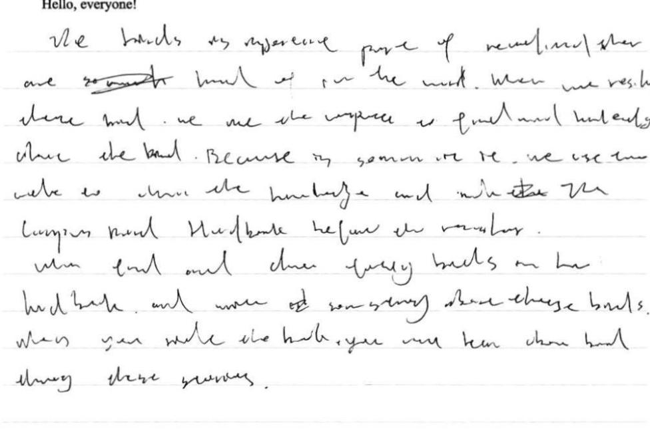

Slide 2
伏笔？

Slide 3
情感/事件层次？
P1: 紧张 → 窘迫 → 坦白 → 被理解 → 释然
P2: 用心准备 → 孩子回来满足欣慰 → 内心释然领悟

Slide 4
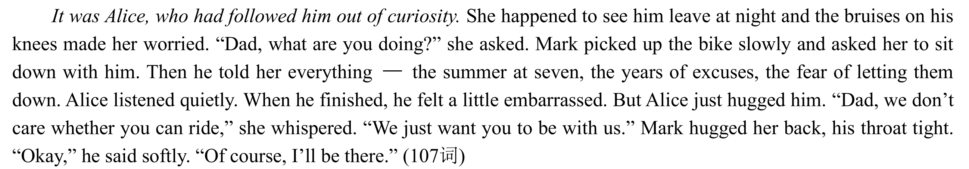

Slide 5
第一段核心链条：紧张 → 窘迫 → 坦白 → 被理解 → 释然
他心跳剧烈，震惊地僵在原地。
His heart raced wildly, frozen to the spot with shock.
一阵窘迫席卷他，秘密被揭穿。
A wave of embarrassment washed over him as the secret was exposed.
他羞愧地低下头，不敢看她担忧的眼睛。
He hung his head in shame, not daring to meet her concerned eyes.
face burning with shame/embarrassment 脸因羞愧/尴尬而发烫
heart sank to one's stomach 沉到了谷底
二轮复习资料P108 P111

Slide 6
第一段核心链条：紧张 → 窘迫 → 坦白 → 被理解 → 释然
But instead of teasing him, Alice knelt down to help him pick up the fallen bike, her voice soft with concern, "Dad, your knees are bleeding again." Overwhelmed by guilt and relief, Mark finally poured out his secret: the failed summer of his childhood, the fear of disappointing his kids, and the lonely nights of secret practice.
But instead of laughing at him, Alice just knelt down beside him. Pulling out a tissue, she gently cleaned his bleeding knees. "Dad, does it hurt?" she asked, her voice soft and full of concern. Touched by his daughter's warmth, he finally poured out the secret he had hidden for years: the failed summer, the fear of disappointing them, and his lonely practice in the dark.

Slide 7
第一段核心链条：紧张 → 窘迫 → 坦白 → 被理解 → 释然
Listening quietly, Alice didn't show any disappointment. Instead, she leaned forward and wrapped her arms around his neck tightly. "Oh, Dad," she whispered softly. "We don't care if you can't ride a bike. We just want you to be with us."
A sense of relief swept over him, bringing him inner peace.
The long-standing fear in his heart gradually melted away.

Slide 8
第二段核心链条：用心准备 → 孩子回来满足欣慰 → 内心释然领悟
That Saturday, when his family went biking, Mark stayed at the campsite happily. Humming a cheerful tune, he set up the tent and lit the campfire, devoting himself to preparing a warm feast: steak, chicken wings, and everything the kids loved. An hour later, the kids came riding back, exhausted but excited. “Daddy! I’m starving!” Bob shouted, eagerly grabbing a piece of steak. Alice, leaning gently against his side, took a sip of the hot chocolate. “You are the best dad in the world,” she whispered. That night, watching his children sleep soundly, Mark smiled a relieved smile. He couldn’t ride a bike, but he could take good care of his family—and that was more than enough.

Slide 9
第二段核心链条：用心准备 → 孩子回来满足欣慰 → 内心释然领悟
升华主题
It dawned on him that the essence of love lay not in absolute flawlessness, but in genuine companionship. (他明白爱不在于完美，而在于陪伴。)
It was his company and care that made him the best father. (正是陪伴与照顾让他成为最好的父亲。)

Slide 10
存在的问题
1. 对话太长，学会转化成间接引语和描写。
2. 描写不充分，可以展开。He shouted passionately. ---
He shouted at the top of his voice to cheer the cycling kids. Though unable to take part himself, he leaned forward and waved his hands constantly, fully absorbed in the joyful atmosphere.
Without the stress from learning bike, he was all smiling, enjoyed the sunshine, preparing snacks for the whole family. ---
Relieved of the frustration of failing to master cycling, he beamed brightly in the soft sunlight, devoting himself to preparing tasty treats for every family member.
3. P1就升华了。两段的侧重点，避免雷同。如P1: 不需要完美 P2: 陪伴与爱
4. P1详略不当，羞愧和窘迫笔墨太多，理解和释怀一笔带过。
5. P2只是记叙活动没有Mark心理活动（释怀与爱的感受）。

Slide 11
26-1
Shocked yet concerned, Alice darted towards the fallen bike, helped Mark to his feet and carefully set the bike aside, tears welling up in her eyes. Without needing further explanation, she immediately understood the situation when she saw another fresh bruise on Mark's knees.（回扣伏笔） Her heart ached, and she reached out her trembling hands（动作） to ask if it hurt. Mark stared at her worried eyes speechless, a heavy silence hanging over the parking lot.（景物描写 Clutching his hands tightly, Alice burst into tears, "I don't care if you can ride a bike—as long as you're there with us!" Upon hearing this, a surge of warmth flooded Mark's heart.（感受） Not until this moment did he（倒装句） realize it was completely okay to be a dad who couldn't do everything. Stars dotted the silky night sky like glistening diamonds as Mark and Alice held hands and walked home, looking forward to the upcoming trip.
Bathed in golden sunshine the next day, Mark felt a warm current surging through his heart（感受）. Out of love for his family（感受点题）, he took out a bag of ingredients, determined to prepare a wonderful picnic. Never had he felt so relieved（感受） as when he frankly confessed his deepest secret to the family. With a light heart,（感受点题） he meticulously arranged each delicate dim sum, the smiling faces of his loved ones popping into his mind. He was so absorbed in preparing that（句型） Alice's exclamation pulled him back to reality（巧妙过渡）. Alice and Bob rushed over and hugged him tightly, while （全家人）Lena stood beside them beaming—sweet affection and tenderness lingered softly in the air. It suddenly dawned on Mark that in family love, it was company, not perfection, that truly mattered.

Slide 12
24.5-6
Mark's face flushed red.
Perhaps it was just time to confess. He brushed the dust off his clothes, took a deep breath, forced a smile and poured out his struggles.
Alice listened attentively, was deeply touched and her heart almost missed a beat—her superhero had such a vulnerable side. （动作感情心理）She stepped close to him, patted his back and gave him a big hug, comforting him, "Dad, it's no big deal."
Mark froze for a moment, but soon his heart welled with warmth and the joy of love. That night, the long-hidden secret was revealed to everyone, and Mark allowed himself to be imperfect.（感受，点题）
Watching the glistening surface of the lake in the sun, he never felt so relieved. Heart thumping with joy, he watched the three set off. He cheered for them at the top of his lungs, and the campsite echoed with their laughter. Lena and the kids rode along the planned route; the gentle wind kissed their faces while the vast landscape unfolded like a painting before them. The three were on the road, but one was always in their hearts—none of them felt alone.（家庭温暖） When the three returned to the campsite, Mark's eyes met theirs, all lit up with joy. Mark beamed heartily, and so did they. With a ripple of happiness spreading in his heart, he thought he had grasped the essence of love.

Slide 13
25.5-9
Mark's throat constricted and shame flooded his cheeks, yet before he could stammer an excuse, Alice stepped forward and crouched beside him. She whispered, "Dad, you never needed to hide this from us." Her soft voice was quivering, not with disappointment, but with a tenderness that stung his eyes. Something inside him shattered and mended all at once.（心理描写） Beneath the pale, dim light, his twelve-year-old daughter wrapped her arms around him, and for the first time, Mark allowed himself to be imperfect.
Sunlight filtered through the canopy, dappling the ground with gold as he prepared sandwiches and chilled lemonade with a lightness he had never felt before. When their ringing laughter echoed back across the lake, Mark smiled—not the tight, guarded smile as before, but one serene and unburdened. He had finally confessed his struggle to the entire family, and their embrace of his vulnerability had freed him. （前后对比突出主题）Watching them return, flushed and triumphant, he understood that true courage is not hiding one's cracks, but allowing love to fill them. In that sunlit clearing, surrounded by undimmed admiration, Mark had never felt stronger.

Slide 14
24.5-9
Feeling as embarrassed as the kid who’d failed to ride a bike years before, Mark lowered his eyes, his face flushing instantly. “Dad, are you okay?” Worry flooded Alice’s heart when she saw his bleeding knees. Silence hung heavy in the air.（情景交融） Though hesitant, he finally decided to tell her the truth—including his unbearable childhood experience. “Sorry I messed it up,” Mark said, his eyes brimming with guilt. But Alice replied that everyone had their shortcomings, and he was still a perfect father to them. Those words dispersed the gloomy clouds in his heart, and he finally let go of the burden.（情绪心理）
The lake was crystal clear, glinting like a sparkling gem under the sun. But the most precious sight was what he saw before him（由景入情，凸显主题）: his wife and kids riding freely and excitedly in the gentle breeze. When they were about to reach the finish line, Mark yelled loudly to cheer them on. “Dad, let us teach you to ride whenever you want—it’s so exhilarating!” They panted heavily but cheerfully. This time, Mark grinned and accepted their offer eagerly. We should accept our imperfections and embrace ourselves even when we’re doing our best.

Slide 15
25.5-11
It turned out that she had watched his clumsy attempts all week, which filled her with concern and made her eager to figure out what was going on（好奇）. Mark froze on the spot, his face blushing with embarrassment and shame. A temporary silence reigned over the lot. Sensing her father's unease, Alice knelt down to help him brush the gravel dust off his scraped knees. Drooping his head, Mark mustered up his courage to open up about his hidden secret and his childhood shame（坦白）. Softly, Alice patted his arm and murmured, "You don't have to do all this, Dad. You don't have to be perfect, and we'll love you always."
He dragged out the folding chairs, strung fairy lights between the trees, and started the campfire to keep the evening chill away. He unpacked the snacks Lena had prepared, grilled hot dogs on the fire, and waited for his family. When Alice and Bob came back, tired but glowing, they found the campsite warm and welcoming, the smell of roasted marshmallows floating in the air（聚会气氛）. They threw their bikes down and ran into his arms, chattering about every turn on the trail（谈话内容）. As they sat together around the fire, Mark realized he didn't need to ride a bike to be part of their joy—being the one who made the warmest homecoming for them was enough.

