Slide 1

The plant which my father gave me grows well.
Attributive Clause 定语从句
who(m)
which
that
whose
why
when
where
relative pronoun 关系代词
preceding noun 先行词
关系副词

Slide 2
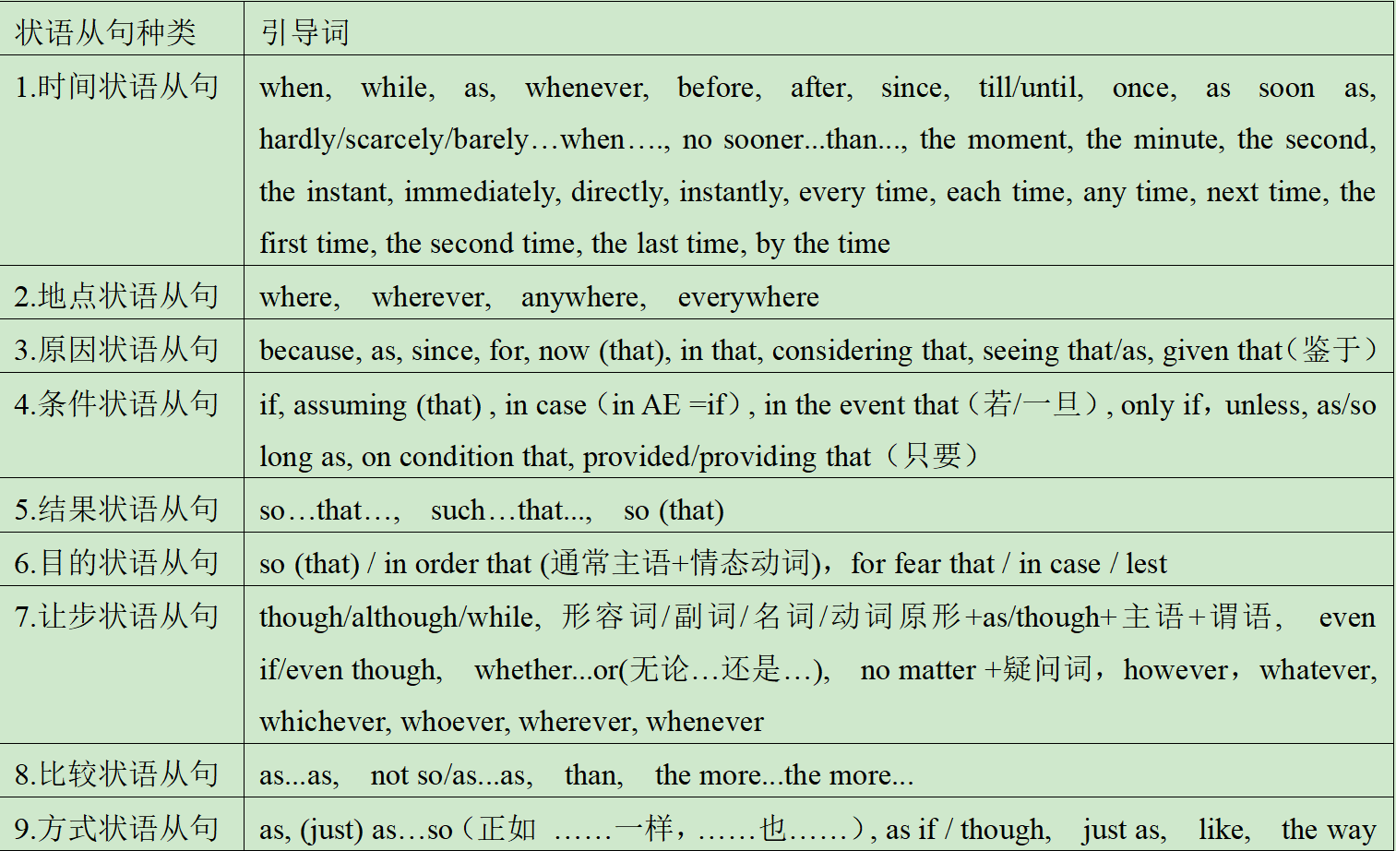

Slide 3
Whoever thought of that is a genius.
I know who said it.
You are what you eat.
The news that schools would reopen excited us all.
subject
a clause
（subject +verb）
functions as a noun
object
predicative
appositive

Slide 4
连接词
主从接词 ：that、if、whether
无词义
“是否”
不作成分
2. 连接代词 ：who、 whom 、 what、 which、 whose、 whoever、 whomever、 whatever、 whichever
主、宾、表、定
3. 连接副词： when、 where、why、how
状语

Slide 5
when
1. I still remember the day _____ he was killed.
I have no idea ______ he was killed.
I was not there ______ he was killed.
when
when
where
2. That ’s the house ______ the king was born.
The question _______ we should go has not been discussed.
You put it ________ it belongs.
where
where
why
3. I don’t know the reason ____ he was absent.
Can you answer the question _____ he was late.
why

