Slide 1
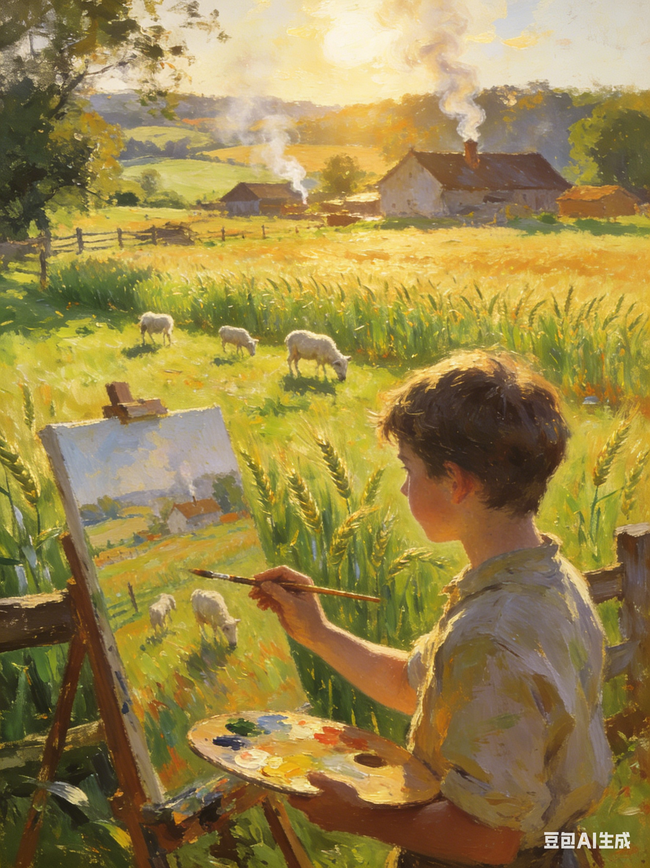
发现小镇之美
关注：
故事山读懂情节，五感点亮画面

Slide 2
At the library, Nate Jasper noticed a sign for the "First Annual Highland Drawing Contest." It asked for artwork showing the unique beauty of their town. Noticing his interest, the librarian, Ms. Kim, handed him a flyer. "The winning drawings will be displayed right here in the library," she added.
Sitting on the library steps outside, Nate was lost in thought. He had always loved art. He could never have too many sketchpads (素描本) and crayons. "I have to enter this contest!" he said to himself.
But something troubled him. Years of living in the small town had convinced him that it was a dull place. "There's nothing special about it — only ordinary farms, animals, and trees!" he frowned. "What will I draw?"
Just then, Briana Williams, a new girl in his class who had just moved from Houston, a large modern city in Texas, walked out. Spotting Nate, she sat down beside him and noticed the flyer. "A drawing contest? That sounds fun!"
"Not really," Nate sighed. "Trust me, this town is a big bore."
Briana looked surprised. "Well, everything here may seem boring to you, but to me, it's all new! I'd love to see more of it. Show me around sometime. And bring your sketchpad — you might find something worth drawing."
The next Saturday, they wandered down a quiet lane together. Briana stopped beneath a large maple and gazed up in awe. Nate paused beside her. At first, it felt strange to admire a tree he'd passed a hundred times. But as he followed her gaze, the sun was shining through the branches, turning the red and yellow leaves into a sea of burning gold.
"There's nowhere this quiet and pretty in Houston," Briana said softly.
Nate felt something clicked in his mind. Highland wasn't a big bore — he was just too used to it. He began to wonder what other hidden beauty was waiting to be discovered.
Paragraph 1:Inspired, Nate suggested they visit his Grandpa's farm.
Paragraph 2:On the day of the award ceremony, the library was crowded.

Slide 3
1 Story Elements（记叙文要素）
Time | A weekend in a small town; the award ceremony day of the drawing contest
Place | Highland (a quiet small town), library, quiet lane, Grandpa’s farm
Main Characters | 1. Nate: A boy who loves art but ignores the beauty of his familiar hometown 2. Briana: A new girl from a big city, good at finding ordinary beauty 3. Ms. Kim: A kind librarian who encourages Nate to join the contest
Major Conflict | Internal conflict: Nate is eager to take part in the drawing contest, but he firmly believes his town is dull and has no special beauty to draw.
Theme | Beauty exists everywhere in ordinary life; familiarity makes people ignore the beauty around; we need a careful heart to discover and cherish simple beauty.

Slide 4
故事山读懂情节
At the library, Nate Jasper noticed a sign for the "First Annual Highland Drawing Contest." It asked for artwork showing the unique beauty of their town. Noticing his interest, the librarian, Ms. Kim, handed him a flyer. "The winning drawings will be displayed right here in the library," she added.
Sitting on the library steps outside, Nate was lost in thought. He had always loved art. He could never have too many sketchpads (素描本) and crayons. "I have to enter this contest!" he said to himself.
But something troubled him. Years of living in the small town had convinced him that it was a dull place. "There's nothing special about it — only ordinary farms, animals, and trees!" he frowned. "What will I draw?"
Just then, Briana Williams, a new girl in his class who had just moved from Houston, a large modern city in Texas, walked out. Spotting Nate, she sat down beside him and noticed the flyer. "A drawing contest? That sounds fun!"
"Not really," Nate sighed. "Trust me, this town is a big bore."
Briana looked surprised. "Well, everything here may seem boring to you, but to me, it's all new! I'd love to see more of it. Show me around sometime. And bring your sketchpad — you might find something worth drawing."
The next Saturday, they wandered down a quiet lane together. Briana stopped beneath a large maple and gazed up in awe. Nate paused beside her. At first, it felt strange to admire a tree he'd passed a hundred times. But as he followed her gaze, the sun was shining through the branches, turning the red and yellow leaves into a sea of burning gold.
"There's nowhere this quiet and pretty in Houston," Briana said softly.
Nate felt something clicked in his mind. Highland wasn't a big bore — he was just too used to it. He began to wonder what other hidden beauty was waiting to be discovered.
Paragraph 1:Inspired, Nate suggested they visit his Grandpa's farm.
Paragraph 2:On the day of the award ceremony, the library was crowded.
Beginning (起点):Nate finds a drawing contest poster at the library and decides to join.He loves art deeply but thinks his hometown, Highland, is dull and ordinary, with no special beauty to draw.
Development (发展):Briana, a new girl from a big city, tells Nate the town feels fresh and beautiful to her.They walk together; Briana’s admiration for a common maple tree makes Nate rethink his opinion of the town.Nate realizes he has ignored the town’s beauty because he is too familiar with it.
Climax (高潮，续写核心段 1):Inspired by Briana, Nate takes her to Grandpa’s farm and discovers hidden beauty in daily scenes (farms, animals, sunlight, nature).He creates his contest artwork based on these simple but precious moments.
Falling Action & Ending (结局，续写核心段 2):At the award ceremony, Nate’s work wins praise.He understands the theme: beauty exists everywhere; we just need a heart to find it.

Slide 5
Climax (高潮，续写核心段 1):Inspired by Briana, Nate takes her to Grandpa’s farm and discovers hidden beauty in daily scenes (farms, animals, sunlight, nature).He creates his contest artwork based on these simple but precious moments. ?
故事山读懂情节
2 Story Mountain Analysis
Development (发展):Briana, a new girl from a big city, tells Nate the town feels fresh and beautiful to her.They walk together; Briana’s admiration for a common maple tree makes Nate rethink his opinion of the town.Nate realizes he has ignored the town’s beauty because he is too familiar with it.
Falling Action & Ending (结局，续写核心段 2):At the award ceremony, Nate’s work wins praise.He understands the theme: beauty exists everywhere; we just need a heart to find it. ?
Beginning (起点):Nate finds a drawing contest poster at the library and decides to join.He loves art deeply but thinks his hometown, Highland, is dull and ordinary, with no special beauty to draw.

Slide 6
3 plot building
故事山读懂情节
Paragraph 1: Inspired, Nate suggested they visit his Grandpa's farm.
What can they see/hear/touch on the farm?
How does Nate feel when he sees these ordinary things?
What does he draw? Why?
How does Briana react to the farm scenery?
Paragraph 2: On the day of the award ceremony, the library was crowded.
How does Nate feel before the result?
Does he win? What does his painting show?
What do people say about his work?
What does Nate finally learn?

Slide 7
Paragraph 1 ：Inspired, Nate suggested they visit his Grandpa's farm.
启发问题 | 微技能 | 对应前文伏笔
1. What can they see/hear/touch on the farm? | 视觉（阳光、麦田、农场景物） 听觉（羊叫、风声） 嗅觉（青草、泥土香） 触觉（微风、温暖阳光） | 前文：Briana 被枫树的光影震撼，发现小镇宁静之美
2. How does Nate feel when he sees these ordinary things? | 心理描写（惊喜、感动、陶醉、恍然大悟） 细节动作（掏素描本、快速绘画） | 前文：Nate 认为小镇 dull，内心纠结不知画什么
3. What does he draw? Why? | 画面聚焦（枫树叶、农场、炊烟、光影） 主题回扣（平凡中的美） | 前文：比赛要求 show the unique beauty of their town
4. How does Briana react to the farm scenery? | 神态描写（惊讶、赞叹、微笑） 语言描写（简短赞美） | 前文：Briana 来自大城市，觉得小镇一切新鲜美好
Sensory Details：五感细节刻画
五感点亮画面

Slide 8
Paragraph 1 ：Inspired, Nate suggested they visit his Grandpa's farm.
一踏入农场耀眼的阳光便倾泻在一望无际的翠绿麦田上，斑驳的树影在地面缓缓流动。（视觉；关键词：dazzling sunlight, pour, endless wheat fields, dappled shadows）
The moment they stepped into the farm, dazzling sunlight poured over the endless green wheat fields, and dappled shadows flowed slowly across the ground.
小羊羔发出轻柔的咩叫声，微风穿过草丛发出沙沙的声响，构成一曲温柔的田园乐章。（听觉 / 比喻；关键词：lambs, bleat, breeze, rustle, pastoral melody）
Gentle bleats came from lambs, and soft rustles arose as the breeze swept through the grass, forming a tender pastoral melody.
五感点亮画面

Slide 9
Paragraph 1 ：Inspired, Nate suggested they visit his Grandpa's farm.
清新的青草香混着湿润的泥土气息扑面而来，让人心旷神怡。（嗅觉；关键词：fresh grass, moist soil, refresh, delightful）
The fresh smell of grass mixed with the scent of moist soil rushed towards them, refreshing both their bodies and minds.
温暖柔和的风轻轻拂过脸颊，带来午后独有的舒适与惬意。（触觉；关键词：warm breeze, brush, cheek, comfort, coziness）
A warm and soft breeze brushed their cheeks gently, bringing the unique comfort and coziness of an afternoon in the countryside.
五感点亮画面

Slide 10
陶醉
He was completely absorbed/immersed in the breathtaking rural view.
Lost in the picturesque sight, he forgot all his worries and unease.
Bathed in the peaceful atmosphere, he savoured every detail of the scenery with all his heart, unwilling to move an inch.
took his breath away, be captivated by , hold sb in fascination,

Slide 11
/感动
warmth, be moved/ touched by,
Warmth flooded his heart, soft and gentle like the breeze in the fields.
His heart was filled with gentle affection for this peaceful farmland.
Looking at the rolling fields and neat fences, he felt a quiet sense of warmth settling in his chest.
Every inch of the land carried simple happiness, moving him deeply beyond words.

Slide 12
心理描写-恍然大悟
it occurred to/struck him that... , Nate come to realize that ...？
It dawned on Nate all of a sudden that he had finally found the inspiration he had long been craving.
It dawned on Nate all of a sudden that true beauty was never far away, but lay right in the ordinary world around him.
It dawned on Nate all of a sudden that what he sought for the contest was not grand scenes, but simple and warm rural charm.
。

Slide 13
/惊喜
welled up in sb, swept over sb, be overwhelmed by ...
face, eyes
A surge of joy welled up inside him, and his eyes lit up with delight.
He could hardly contain his excitement at this wonderful discovery.
A burst of pleasant surprise swept over him. Never had he seen such lovely scenery that touched his heart deeply.
His face broke into/lit up with a bright smile, overwhelmed by the unexpected beauty before his eyes.

Slide 14
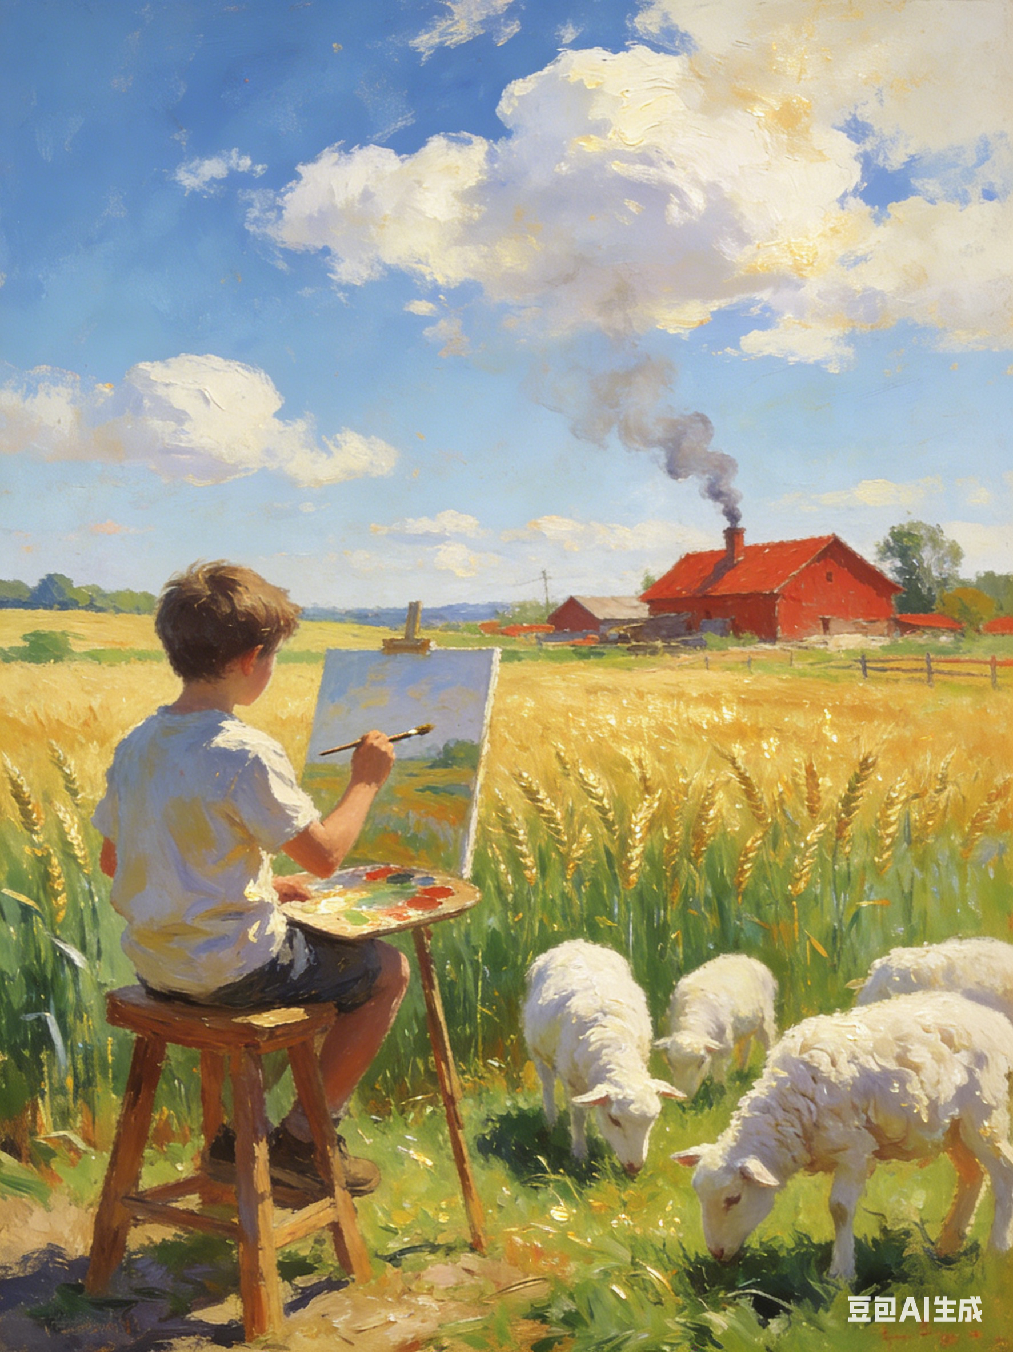
画画
动作？身体部位？跃然纸上？
Bent slightly forward, he let his crayon dance across the page, capturing the lovely scenery in swift, fluid strokes/flowing lines.
Without hesitation, he set about drawing, his fingers moving nimbly and steadily, racing against time to record the beauty.
Eyes fixed on the farmland, he moved his crayon rapidly over the paper, outlining the views in quick strokes.
He set about drawing at once, turning the lovely scenery before his eyes into delicate lines and vivid images on the paper.
Stroke by stroke, he captured every tender detail, letting the peaceful rural view live on in his drawing.
Bit by bit, the lovely scene took shape in his painting.

Slide 15
好句 （心理活动）
It was at this time that he made up his mind to watch closely and find the beauty hidden in the farm .
Lost in the peaceful noon, Nate followed his heart and let the colorful crayons dance naturally on his sketchpad.
Having lived in busy Houston, Briana marveled at every peaceful rural view, gazing around with sparkling eyes. Standing beside her, Nate truly saw the farm's charm he had overlooked for years.
He surprisingly found that the ordinary scenes he had ignored were filled with unique charm.

Slide 16
Paragraph 2 ：On the day of the award ceremony, the library was crowded.
发问题 | 可使用微技能 | 对应前文伏笔
1. How does Nate feel before the result? | 心理描写（紧张、忐忑、期待） 动作细节（攥紧拳头、低头、心跳） | 前文：Nate 从不看好小镇到重新发现美，心态转变
2. Does he win? What does his painting show? | 画面描写（画作内容：农场 / 枫树 / 阳光） 点题句（平凡即美） | 前文：比赛作品将在图书馆展出，画小镇独特之美
3. What do people say about his work? | 侧面描写（观众称赞、点头、拍照） 环境烘托（安静、掌声） | 前文：小镇在当地人眼中普通，在外乡人眼中珍贵
4. What does Nate finally learn? | 主题升华（感悟句） 神态描写（释然、微笑） | 前文：Nate 内心顿悟 Highland wasn’t dull; he was just too used to it
Sensory Details：五感细节刻画
五感点亮画面

Slide 17
紧张 ---惊讶
Paragraph 2 ：On the day of the award ceremony, the library was crowded.
身体部位？too...to..., so ...that..., as if...., couldn’t help doing..., swept, envelped,
Nate stood nervously in the corner of the crowd, his palms sweating slightly and his heart beating wildly with anxiety and strong expectation.
He stayed fixed in his seat, too tense to move an inch. He felt so nervous that his throat tightened and his arms turned stiff. He couldn’t keep his hands still, and the whole world around seemed to slow down, as if it stood still.
Upon hearing his name, Nate raised his head unbelievably. He was so amazed that his head went blank for a while. He couldn’t help trembling slightly out of excitement. Happiness enveloped him, as if he were floating on soft clouds, and he knew he was on top of the world. his work The Beauty of the Town was hung in the most eye-catching place of the exhibition hall.

Slide 18
Disappointed, Nate was about to lower his head when his name rang out in the hall. His mind went blank as he heard the crowd chanting his name as the champion.
be replaced by

Slide 19
成就感
He felt so proud that a bright smile spread across his face.
He couldn’t help beaming with a triumphant smile.
A triumphant smile lingered on his lips, as if he had gained the most precious treasure.
A warm triumphant smile appeared on his face, and a strong sense of achievement welled up in his heart.

Slide 20
Paragraph 2 ：On the day of the award ceremony, the library was crowded.
画中满是农场的暖阳、枫树的金叶与田园的烟火气，传递出最真挚的美好。（视觉 / 修辞；关键词：warm sunshine, golden maple leaves, pastoral vitality, sincere beauty）
The painting was filled with warm farm sunshine, golden maple leaves, and pastoral vitality, conveying the most sincere beauty.
雷鸣般的掌声瞬间响起，观众们纷纷点头称赞，眼中满是欣赏。（听觉 / 侧面描写；关键词：thunderous applause, burst out, nod, praise, admiration）
Thunderous applause burst out at once, and the audience nodded in praise, their eyes filled with admiration.
五感点亮画面

Slide 21
Paragraph 2 ：On the day of the award ceremony, the library was crowded.
内特望向布里安娜，两人相视而笑，他终于懂得：美不在远方，而在我们用心发现的每一个平凡瞬间。（心理 / 主题升华；关键词：smile at each other, beauty, discover, ordinary moments）
Nate looked at Briana and they smiled at each other. He finally understood: beauty is not far away, but in every ordinary moment we discover with our heart.

Slide 22
参考范文：
Inspired, Nate suggested they visit his Grandpa’s farm. Briana’s eyes lit up, and the two set off right away. When they arrived, Briana gasped, “This is amazing!” Her wonder was infectious – Nate looked around, feeling as if he were seeing the farm for the first time. Golden wheat fields swayed in the breeze like a rolling ocean, fluffy sheep grazing peacefully in the sunlight. He stood there, completely captivated. Then, Briana gently nudged him. “You should draw this, Nate. It’s a perfect scene.” That was it. Nate pulled out his sketchpad immediately, his pencil dancing across the paper. As his painting took shape, he wondered why he had never thought to draw the farm before. Once he looked closely, it really was a fascinating place. By sunset, his sketchpad was filled with lively drawings.
On the day of the award ceremony, the library was crowded. Local residents gathered around, buzzing with anticipation. Nate stood nervously among them, his heart pounding. Ms. Kim stepped onto the stage. “Every drawing captures the unique beauty of our town,” she said warmly, “but one work truly stood out.” She paused, and then announced Nate’s name. He walked up in disbelief, hands trembling as he accepted the award. The audience applauded loudly, and Briana waved at him from the crowd, beaming with pride. Nate stepped back, looking at his winning piece on the wall – a vivid scene of Grandpa’s farm bathed in golden sunlight. A warm smile spread across his face – beauty had always been there, and sometimes all it took was a pair of fresh eyes to see it.

Slide 23
下水作文：
Inspired, Nate suggested they visit his Grandpa's farm. The moment they stepped into the farm, dazzling golden sunlight poured over the endless green wheat fields, and dappled shadows drifted slowly on the soft soil. Lambs bleated gently and wind rustled through the grass, making a peaceful pastoral song. The fresh smell of grass and moist soil filled the air, while a warm breeze brushed their cheeks comfortably. Briana’s eyes widened with wonder, totally attracted by the quiet beauty around them. Nate quickly took out his sketchpad and fixed every wonderful scene on paper. At that moment, he truly saw the hidden beauty in the ordinary town.
On the day of the award ceremony, the library was crowded. Bright lights shone on all the works, and the whole room fell into quiet expectation. Nate stood nervously in the corner, his palms sweating and heart beating fast. He kept replaying the farm scenes in his mind, wondering if his work could move others. When the host called his name, he looked up in surprise—his painting The Beauty of the Town was placed in the most eye-catching place. Thunderous applause spread around the library. Nate exchanged a joyful smile with Briana, realizing that beauty lies in every simple moment we care to discover.

Slide 24
农场五感描写语料库
视觉 Sight
Golden sunlight spilled over the green wheat fields.
金色的阳光洒在绿油油的麦田上。
Dappled shadows drifted slowly across the soft grass.
斑驳的树影在柔软的草地上缓缓移动。
Curling smoke rose slowly from the cottage roof.
袅袅炊烟从农舍屋顶缓缓升起。
Fluffy sheep wandered lazily on the hillside.
毛茸茸的绵羊在山坡上悠闲漫步。
The maple leaves glowed like burning gold in the sun.
枫叶在阳光下宛如燃烧的金子般闪耀。
经典句（选自田园文学）
The field was clothed in soft green.
田野披上了一层柔和的绿衣。

Slide 25
农场五感描写语料库
听觉 Sound
Lambs bleated softly in the distance.
小羊在远处轻柔地咩叫。
A gentle breeze rustled through the grass.
微风拂过草丛，沙沙作响。
Bees hummed happily among the flowers.
蜜蜂在花丛中快乐地嗡嗡吟唱。
A rooster’s crow broke the morning quiet.
一声鸡鸣打破了清晨的宁静。
经典句
The wind sang through the leaves.
风在树叶间歌唱。（拟人）

Slide 26
农场五感描写语料库
嗅觉 Smell
The fresh smell of grass filled the air.
空气中弥漫着清新的草香。
The warm scent of soil came with the wind.
风里带着泥土温润的气息。
The sweet smell of wild flowers flowed everywhere.
野花的甜香四处飘荡。
经典句
The air was thick with the scent of earth and growth.
空气中满是泥土与生命生长的芬芳。

Slide 27
农场五感描写语料库
触觉 Touch
A warm breeze brushed my cheeks softly.
温暖的微风轻轻拂过脸颊。
The sunlight felt gentle and comfortable on the skin.
阳光照在皮肤上，温柔而舒适。
The grass was soft and cool underfoot.
脚下的青草柔软又清凉。
经典句
The wind was as soft as a kiss.
风轻柔得像一个吻。（比喻）

Slide 28
农场五感描写语料库
味觉 Taste
The air tasted fresh and sweet.
连空气都尝起来清新甘甜。
The wind carried the slight taste of wild fruit.
风里带着一丝野果淡淡的清香。

Slide 29
农场五感描写语料库
视觉 Sight
Golden sunlight spilled over the green wheat fields.
金色的阳光洒在绿油油的麦田上。
Dappled shadows drifted slowly across the soft grass.
斑驳的树影在柔软的草地上缓缓移动。
Curling smoke rose slowly from the cottage roof.
袅袅炊烟从农舍屋顶缓缓升起。
Fluffy sheep wandered lazily on the hillside.
毛茸茸的绵羊在山坡上悠闲漫步。
The maple leaves glowed like burning gold in the sun.
枫叶在阳光下宛如燃烧的金子般闪耀。
经典句（选自田园文学）
The field was clothed in soft green.
田野披上了一层柔和的绿衣。

Slide 30
11-Cai
Inspired, Nate suggested they visit his Grandpa's farm. It was at this time that he made up his mind to watch closely and find the beauty hidden in the farm . All around him lay splendid rural scenery , which filled him with surprise as he walked on . There were neat fences at the sides of the road , painted a dainty blue color , and beyond them were fields of grain and vegetables in abundance . The land looked like a beautiful woven blanket and spread out upon the ground just for him . It dawned on Nate all of a sudden that this was exactly the subject he had been searching for the painting contest. He grabbed his crayons and gradually outlined the picturesque scenery unfolding right before his eyes . Briana approached silently and looked on . Lost in his creation , he completed the picture shortly afterwards and signed up for the contest . The peaceful view set off his restless heart , full of tension and anticipation .

Slide 31
On the day of the award ceremony, the library was crowded. Warm sunlight streamed through the windows , casting soft light over countless paintings . Soft voices spread around the room , and every corner was filled with joy and expectation . Surrounded by so many wonderful works , Nate stood quietly beside the wall . So nervous was he that he dared not look up at the stage now and then . Soon the host appeared , and the noisy room turned completely silent at once . All eyes were focused on the front , waiting eagerly for the final results to come out . The moment his name was announced , warm cheers rang out across the library . Nearby stood Briana , wearing a big smile and sharing his happiness sincerely . He finally realized that beauty exists everywhere in ordinary life . Only by observing carefuly carefully can we discover the warm and lovely scenery around us .

Slide 32
8-Xu
Inspired,Nate suggested they visit his Grandpa's farm. With Briana's eyes glistening with delight, they set up out in a mixture of curiosity and excitement. No sooner had they arrived at this vibrant place than the amber-like sunshine wrapped them and brought cozy warmth. Birds sang with joy, cattle wandered around on grassland leisurely and wheat danced in a gentle breeze. It was such a fascinating place that he used to losing lose sight of. "Thank you,Briana. ,"a smile curved on his lips,"I really find found something worth drawing." Breathing in the aroma of fresh air, Nate began to depict the place where he grew up. It was not long before an excellent painting was finished.

Slide 33
On the day of the award ceremony, the library was crowded. Nate's painting, which won the first prize has drawn all the people's attention. Not only did it show the vivid image of the farm,but it also awoke people's passion for searching for the beauty of Highland- ,the place they got used to. A sense of fulfillment and achievement welled up in his heart. Hearing his heart beating wildly,he could feel the sunlight stroking his cheeks like the day he created the picture. It dawned on him that owning the ability to find out the hidden beauty near him is was of vital significance. Had it not been for this ability, he would not have won this prize. Ordinary things can revitalize with new energy as long as you are willing to pay attention to it them.

Slide 34
修改
On the day of the award ceremony, the library was crowded. Everyone was talking about who would win the prize. Then, a woman walked onto the stage holding a piece of paper. "It's time to announce the winner of the contest," she said. Every heart stopped beating, and every eye was fixed on that paper. "Nate Jasper! Congratulations." Nate was so shocked that he couldn't believe his ears until Briana pushed him. "Come on, show them your painting." Then everyone saw his work: it depicted Nate's grandpa working hard to gather fruits. There was nothing special about the painting, but the beauty of daily life touched every heart. "Daily things aren't boring—we're just too used to them. Life isn't lacking in beauty; what's really lacking is the eye to find it." Everyone clapped sincerely again.

Slide 35
修改
On the day of the award ceremony, the library was crowded. Everyone was talking about who would win the prize. Then, a woman walked onto the stage holding a piece of paper. "It's time to announce the winner of the contest," she said. Every heart stopped beating, and every eye was fixed on that paper. "Nate Jasper! Congratulations." Nate was so shocked that he couldn't believe his ears until Briana pushed him. "Come on, show them your painting." Then everyone saw his work: it depicted Nate's grandpa working hard to gather fruits. There was nothing special about the painting, but the beauty of daily life touched every heart. "Daily things aren't boring—we're just too used to them. Life isn't lacking in beauty; what's really lacking is the eye to find it." Everyone clapped sincerely again.

