Slide 1


早
读
week 16

Slide 2


6.16
01/
朗读 人教选必三Unit2词汇P107-108
02/
朗读 人教选必三
Unit2 Reading and Thinking P14-15
朗读 人教选必三
Unit2 Using Language P20-21
03/
04/
朗读 人教选必三Unit2 Workbook P71

Slide 3
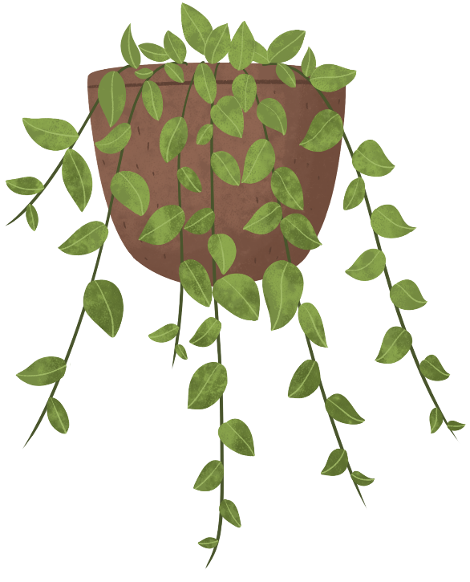

6.17早读安排
1
朗读“校园急救技能培训”报道范文2遍
2
朗读国画展宣传稿范文2遍
3
准备本周维克多听写P501-510

Slide 4
task 1
假定你是校青年志愿者协会（Youth Volunteers Association）会长李华。为了普及急救知识，上周五你校邀请了红十字会的专业人员，为高一学生举办了一场“校园急救技能培训”（First Aid Skills Training）。
请你为校英文报写一篇短文，报道此次活动。内容包括：
1. 活动的时间、地点和参加人员；
2. 活动过程（理论讲解与实操演练，如CPR或伤口包扎）；
3. 活动反响与收获。

Slide 5



task 1朗读2遍
Last Friday, an enlightening First Aid Skills Training was successfully held in our school lecture hall, which attracted all the Senior One students to participate.
The activity began with an expert from the Red Cross explaining essential first aid rules, such as checking the injured person’s state of consciousness and breathing as well as learning ways to stop bleeding effectively. Following the lecture, a hands-on session was conducted, where students were guided to perform CPR and proper wound bandaging on training models. They tried repeatedly to get each movement right. Whenever someone successfully mastered first aid skills, warm cheers and applause burst out among the crowd.
Most attendees agreed the training was eye-opening. Not only did it equip us with practical skills to handle emergencies, but it also reminded us that everyone can be a helper in critical moments.

Slide 6
task 2
昨天你参观了学校举办的学生国画作品展。请给校英文报写一篇宣传稿，内容包括：
1.展览时间、地点；2. 观展感受；3. 推荐观展。
注意：词数 80 左右；可以适当增加细节，以使行文连贯。（21 浙江）

Slide 7
task 2朗读2遍
Yesterday, I visited the exhibition of traditional Chinese paintings created by students in our school. Held in the school hall, the exhibition will run for a whole month, open to all teachers and students during school hours.
Wandering around the gallery, I was deeply impressed by every work on display. The paintings range from expressive landscape pieces to lifelike flower-and-bird works, each vividly showing the unique charm of Chinese art. Some even depict scenes from classic poems, bringing the lines to life before my eyes. The splendid scenery and lively daily life portrayed in them fully reflect the students’ remarkable talent and creativity.
I strongly recommend you visit this exhibition. It is a real visual feast that will not only arouse your interest in Chinese painting, but also deepen your understanding of traditional Chinese culture. Don’t miss this wonderful chance to feel the beauty of art!

Slide 8
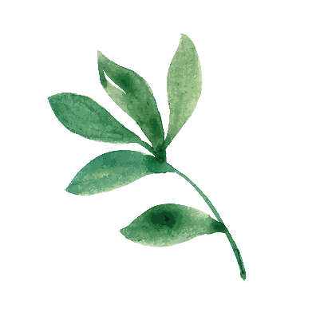
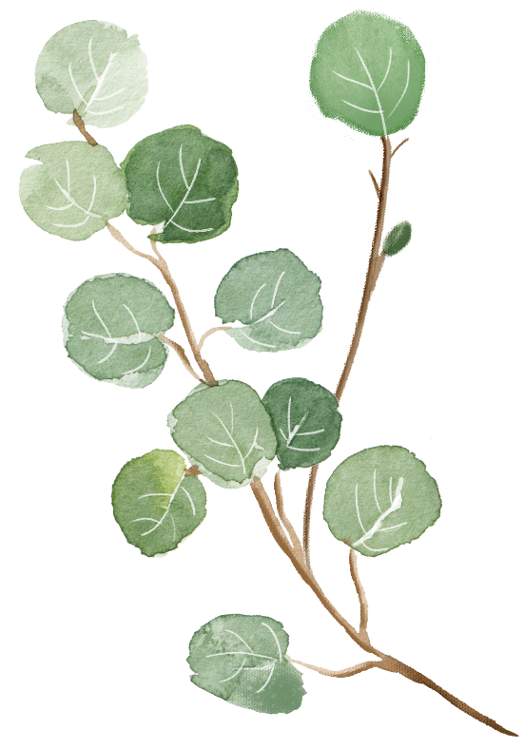
准备本周维克多听写P501-510

