Slide 1
高考读后续写
精彩结尾 主题升华

Slide 2
考试注意事项：
1.e听说写作纸上要贴条码（学号上方）。 写作时段首句要抄上。 格子尽量写满，字数达标。
2. 25+5有5分的书写分，请重视书写，高考22分以上的书写基本上接近完美。
3. 评分标准：先按剧情（内容/逻辑/条理）定档，档内考虑表达（长难句/高级词）和字迹。
1）内容是否丰富，情节必要的内容不可缺省。 （动作+情感+思想+景物）
2）是否可以拓展句子（动作链/情景交融/细节/形容词副词）？
3）长难句（强调/倒装/until/hardly...when/独立主格/非谓语/四大从句等）数量为？ 是否有高级词汇短语？

Slide 3
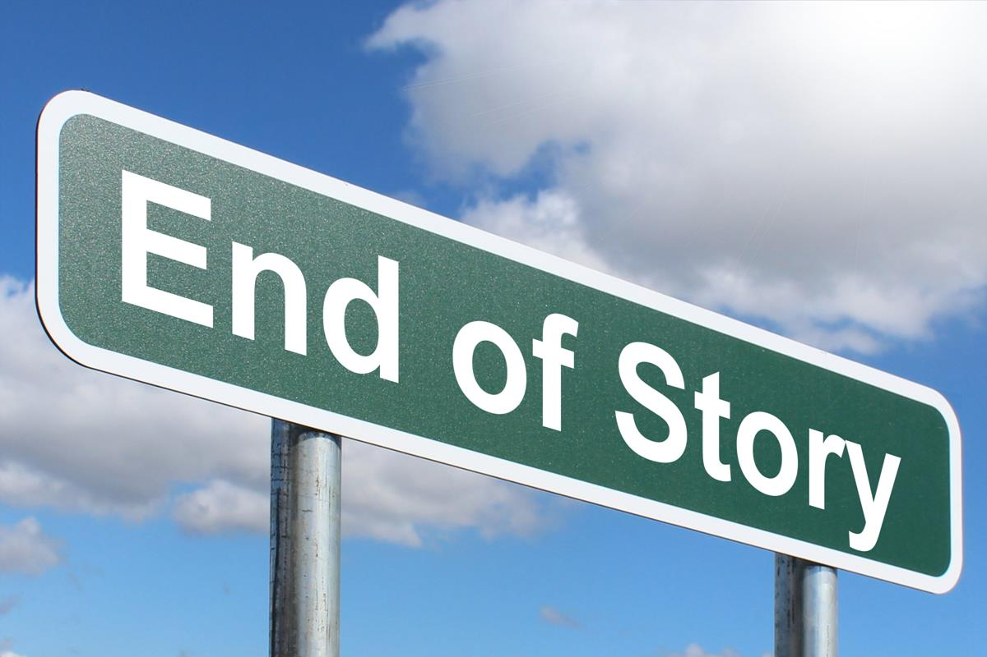
为了点明记叙内容的意义，作者常常在记叙文的结尾，融入自己的观点和评价。
精彩的结尾，可以凸显文章的主题，升华事件的意义，起到画龙点睛的作用。

Slide 4
五种简单易学的结尾方式：
哲理点睛
对话收尾
画面定格
首尾呼应
结尾留白
1.not...but ...(what matters...)
2.had it not been for..., would not ...
3.It was not until... that
4. It dawned on me that...

Slide 5
哲理点睛

Slide 6
Many years have gone by, but when I looked back to that day, I still remember the lesson he taught me: Honesty is the best policy. / Forgiveness is more powerful than hatred. / It’s unwise to judge people by their looks.
Staring at the blisters on my palms and the test paper covered with red crosses. I slumped down on the playground steps, the thought of giving up surging in my mind. Just then, a quote from Winston Churchill popped into my head: “success is not final, failure is not fatal. It is the courage to continue that counts.” All of a sudden, I realized that one setback meant nothing. True growth always took root and sprouted from the courage to stand up again after every fall.
直接点出主题，升华意义，起到画龙点睛的作用。
可结合文本分析后采取：1）引用名言；2）自己组织哲理性语言。

Slide 7
积累各类名言警句
Only by love, life is kept together and moves forward.
It is love that makes the world go around.
Where there is great love, there are always miracles.
Kindness is the golden chain by which society is bound together.
Even small acts of kindness can make a big difference.
The best way to defeat your fear is to face your fear head-on.
Never underestimate yourself, for you have no idea what you are capable of.
Storms make trees take deeper roots.
Dreams that seem impossible can be realized with determination and persistence, no matter what the odds are.
Without the dark, you would never see the stars.

Slide 8
首尾呼应

Slide 9
文中： I had an interesting childhood. It was filled with surprises and amusements, all because of my mother—loving, sweet, yet absent-minded and forgetful. One strange family trip we took when I was eleven tells a lot about her.
结尾：Despite mom's being absent-minded and forgetful（呼应）, she was still a kind and nice mom.
文中：Twenty years ago, I drove a taxi for a living. ..."You have to make a living," she answered. "Oh, there are other passengers," I answered. She said thanks to me, but she looked so sad.
结尾：When it was time to leave, she hugged me, softly. It made me feel that it was so fortunate to drive a taxi and meet her, which was more than making a living（呼应）.

Slide 10
正文：I wasn't used to this sort of emergency-I'd never been trained as a lifeguard-but I didn't think twice about trying to save them. I supposed in a way I wanted to impress everyone: at 19, a deal like that can seem like a good opportunity to show off.
结尾：He laughed as we all knew the true reason: the happiness of helping others is not about impressing anyone (呼应） but about giving two souls a second chance at life .
结尾呼应原文提到的某种物品或某种思想，利用主人公的变化成长深化主题，起到画龙点睛的效果。

Slide 11
案例分析

Slide 12
Monty’s Dream
I：审题
Theme:
Conflict:
Stick to dreams.
Never give up dreams however unrealistic they seem to be.
A boy’s big dream VS
the reality in the adult’s world

Slide 13
II. 情节设计:
Para 1. The boy went home and thought about it long and hard.
Contents:
soul-searching; self-dialogue; self-reflection; dialogue between father and son...
Methods:
descriptions & dialogues (mental activities; judging and weighing between dreams and reality; environment...)
Transition to Para 2:
response to the teacher and grade with an unchanged mind.

Slide 14
Plot Design:
Para 2: Twenty years later, the teacher brought 30 students to camp out on a ranch for a week.
Contents:
brief description of the ranch; ranch owner’s identity recognized; teacher’s apology; instructive lesson to the students; elevation of the ending...
Methods:
descriptions & dialogues & moral
▲第二段涉及到的情节和要点较多，注意详略和手法

Slide 15
Problems:
Para 1 没有聚焦在thought about it long and hard上面，立马坚定信念，不改初衷，接着大量篇幅写了毕业后努力奋斗的过程，人物和场景频繁转换，和Para 2开头的 二十年后接不上。
Para 1 和Para 2的衔接过渡不恰当，写了坚定信念，不改初衷，却没有写对老师和成绩“F”的回应。
Para 2 农场景观过多（东南西北，traces，stables, buildings...）、孩子们活动（骑马，游戏...）描写过多、师生相认的过程铺垫过多、老师自我检讨、道歉过多、Monty描述奋斗历程过多，都会导致篇幅过长，情节分配不均衡，telling和showing手法侧重不恰当。

Slide 16
五种简单易学的结尾方式：
哲理点睛
对话收尾
首尾呼应
画面定格
结尾留白

Slide 17
方法一：哲理点睛
Twenty years later, the teacher brought 30 students to camp out on a ranch for a week. As they wandered around the 200-acre land, admiring the well-built stables and spacious house, the teacher was stunned to recognize the layout—it was presumably the one in the paper he marked an F decades ago. Just then, Monty walked over smiling. “Welcome to my ranch, sir,” he said. The teacher stared in awe, regret and pride filling his eyes. “I was wrong back then,” he admitted softly. Monty shook his head gently: “Dreams aren’t measured by how realistic they seem, but by how fiercely we chase them.” The students listened quietly, their young minds grasping the truth that persistence can turn even the wildest dream into reality.
As Helen Keller once said, “The only thing worse than being blind is having sight but no vision.” The students around fell silent, their hearts stirred. They realized that dreams are not bound by reality’s limitations; they are fueled by the courage to hold on, even when the world says “impossible.”

Slide 18
方法二：对话收尾
Twenty years later, the teacher brought 30 students to camp out on a ranch for a week. As they wandered around the 200-acre land, admiring the well-built stables and spacious house, the teacher was stunned to recognize the layout—it was exactly the one in the paper he marked an F decades ago. Just then, Monty walked over smiling. “Welcome to my ranch, sir,” he said. The teacher stared in awe, regret and pride filling his eyes. He realized how wrong he was back then! “I should’ve never told you to give up!” he said earnestly. Monty clapped him on the shoulder: “No, sir. Your words made me want to prove it even more.” The teacher smiled, relief washing over him: “Then I’m glad I was wrong. Victory belongs to every soul that holds a dream and strives to realize it ”

Slide 19
Under Monty’s guidance, the students looked around the office in delight and excitement. To their surprise, they found a huge “F” in red on the wall. Smiling, Monty told them the story, which he ended by saying “Go for your wildest dreams, kids, because nothing is impossible / impossible is nothing!”

Slide 20
方法三：首尾呼应
Twenty years later, the teacher brought 30 students to camp out on a ranch for a week. As they wandered around the 200-acre land, admiring the well-built stables and spacious house, the teacher was stunned to recognize the layout—it was exactly the one in the paper he marked an F decades ago. Just then, Monty walked over smiling. “Welcome to my ranch, sir,” he said. The teacher stared in awe, regret and pride filling his eyes. “I was wrong back then,” he admitted. Monty pulled out a tattered paper book from his drawer—the seven-page dream he’d written as a senior, marked with a red F. “I kept all these things to remind myself why I started,” he said smilingly. The teacher looked at the old paper, then at the ranch, and understood: the boy who once dreamed of a ranch had turned that F into a future beyond imagination.

Slide 21
方法四：画面定格
Twenty years later, the teacher brought 30 students to camp out on a ranch for a week. As they wandered around the 200-acre land, admiring the well-built stables and spacious house, the teacher was stunned to recognize the layout—it was exactly the one in the paper he marked an F decades ago. Just then, Monty walked over smiling. “Welcome to my ranch, sir,” he said. The teacher stared in awe, regret and pride filling his eyes. “I was wrong back then,” he admitted. The setting sun dipped below the horizon, painting the ranch in warm gold. Monty stood beside the teacher, watching the students laugh as they fed the colts, the wind carrying the faint whinny of horses across the grassland—a perfect snapshot of a dream come true.

Slide 22
方法五：结尾留白
Twenty years later, the teacher brought 30 students to camp out on a ranch for a week. As they wandered around the 200-acre land, admiring the well-built stables and spacious house, the teacher was stunned to recognize the layout—it was exactly the one in the paper he marked an F decades ago. Just then, Monty walked over smiling. “Welcome to my ranch, sir,” he said. The teacher stared in awe, regret and pride filling his eyes. “I was wrong back then,” he admitted softly. Monty nodded, looking out at the endless grassland stretching to the horizon. The students were already planning to explore the stables tomorrow, their voices full of excitement. As the stars began to twinkle in the sky, the teacher turned to Monty, who was gazing silently at the ranch—the very ranch that had once been a “ridiculous” dream on paper. He opened his mouth, as if to say something more, but finally just smiled. The night breeze carried the faint whinny of horses, and nothing more needed to be said.

Slide 23
Version 1

Slide 24
The boy went home and thought about it long and hard. He tossed and turned in bed, the teacher’s harsh words echoing in his ears. However, the vivid blueprint of the horse ranch kept flashing before his eyes. After a sleepless night, he made up his mind to stick to his dream. The next day, Monty walked into the classroom with the unaltered paper and handed it to the teacher. （呼应）“I’m sorry, sir, but I can’t rewrite my dream,” he said earnestly. The teacher shook his head in disappointment. However, Monty resolved to hold on to his dream, never letting go of the ranch he had so vividly envisioned.
Twenty years later, the teacher brought 30 students to camp out on a ranch for a week. They wandered about the sprawling pasture, admired the red-roofed barn and chatted with the gracious rancher. It was not until she spotted a child’s drawing framed on the wall that she froze.（呼应） The rancher was Monty! Memories flooded back and guilt washed over her. The teacher stepped forward, voice trembling with regret. “I owe you an apology dear.” Monty smiled gently, eyes crinkling as he waved off her remorse. “This drawing pushed me to hold on to my dream.” Warm applause rose from the students, their cheers of admiration mingling with the breeze. While the golden sunset dripping down the ranch, the teacher wore a tearful smile and Monty stood tall in the tender glow.

Slide 25
Version 2

Slide 26
The boy went home and thought about it long and hard. He tossed and turned in bed, the teacher’s harsh words echoing in his ears. However, the vivid blueprint of the horse ranch kept flashing before his eyes. After a sleepless night, he made up his mind to stick to his dream. The next day, Monty walked into the classroom with the unaltered paper and handed it to the teacher. “I’m sorry, sir, but I can’t rewrite my dream,” he said earnestly. The teacher shook his head in disappointment. However, Monty resolved to hold on to his dream, never letting go of the ranch he had so vividly envisioned.
Twenty years later, the teacher brought 30 students to camp out on a ranch for a week. As they wandered around the 200-acre land, admiring the well-built stables and the spacious farmhouse, the teacher suddenly recalled a student’s paper years ago,“Wait, didn’t a student once write about wanting a ranch, too? I think I gave that paper an F.” Just then, Monty walked over with a smile. “Welcome to my ranch, everybody!” he said. Stunned and remorseful, the teacher regarded the rancher in awe, eyes filled with regret. “I’m sorry Monty. I was so wrong back then,” the teacher agologized sincerely. “Dream is not something to be compromised, but a vision to be treasured and chased. Our children should follow your lead, daring to dream big.”

Slide 27
实战演习

Slide 28
Model version 1
Finally, opening night arrived. I sat next to Mom and Dad in the auditorium. When the curtain rose, everyone saw a magical land with rolling hills, a beautiful carriage, and a shining castle. Against the fabulous setting, Kristie and Prince danced elegantly to the music. Obviously, she was a wonderful Cinderella. When the play was over, the enthusiastic audience was cheering with thunderous applause.
Then Ms. Carson called me up to the stage. She said into the microphone, “I’ d like to thank the many students who painted the sets. And a special thanks to Shayna, who designed them. Her effort and talent made tonight extra special.” Everyone clapped. For me! I never thought that I would get a chance to stand on the stage! But I did get a part in the play after all. And it was just as good as being Cinderella.

Slide 29
Model version 2
Finally, opening night arrived. The auditorium was bathed in warm soft lights, and the seats were quickly filled with excited parents and students. As the curtain slowly rose, gasps of pleasant surprise rippled through the crowd. The once plain cardboard castle now glowed with shiny gold paint and vivid hand-drawn stained-glass windows, with delicate tiny paper roses winding up its rough towers. Kristie, in her beautiful sparkly dress, danced gracefully with the Prince, her eyes bright with pure joy every time she glanced at the amazing transformed set. I stood quietly backstage, my heart swelling with proud happiness as the audience leaned forward, completely enchanted by the scene.
Then Ms. Carson called me up to the stage. Blushing slightly, I hesitated for a second before stepping into the warm spotlight. “This wonderful magical set is all Shayna’s amazing doing,” Ms. Carson announced to the crowd in a warm clear voice. Kristie immediately rushed over to me and gently squeeze my hand, her eyes shining brightly with sincere gratitude. The audience erupted into thunderous applause that filled the whole auditorium, and happy tears of joy pricked the corners of my eyes. In that unforgettable moment, I truly realized that success wasn’t about landing the lead role—it was about using your unique gifts to lift others up and create something beautiful together.

Slide 30
The end

Slide 33
对话收尾

Slide 34
Chester said his father told him he had tried to search for him and his brother, but both brothers had changed their last names. “He does remember me and my older brother and he told me that he’s been looking for us ever since we lost contact,” he said. Chester said his brother has since flown to Colombia to be reunited with Urea as well. When asked how the reunion with his father will change his life, Chester said，“I got family everywhere, so it might lead to many more trips now.”
…They hung all the things back to the wall. Jack asked Paisley, “Are you really willing to lead a tough life with me?” She patted away the ashes on her hands and looked at the walls with loads of stuff on them satisfactorily, saying, “Yes! For me, it is not a suffering to live anymore.”
借文章人物之口点题，对话应简洁且蕴含深意。

Slide 35
画面定格

Slide 36
They stood there for a moment, side by side, waiting for the rushing holiday current and for their place in it. Then the daughter glanced over and momentarily regarded her mother. And slowly, almost reluctantly, she placed her arm with apparently unaccustomed affection around her mother’s shoulders and gently guided her back into the deluge.
His hard work paid off! Holding the soda tin firmly, Reuben rushed for the shop to buy the brooch. The moment he got the beautiful brooch, he burst through the front door and placed it in Dora’s hand. Never had Dora received such a gift. Speechless and happy, she held her son tightly into her arms, with tears welling up in her eyes.
将故事结尾以一幕景象呈现，塑造画面感。

Slide 37
结尾留白

Slide 38
The beggar hesitated for a moment, and decided to open it. “Who cares? He wanted me to have it anyway. I might as well enjoy it now.” he declared aloud. Then he unwrapped the white tissue paper. To his surprise, there was no hard rock candy inside. Instead, into his fingers fell a shiny white pearl worth thousands of dollars.
用故事结尾留白，给予读者想象空间。
但此类技巧较难把握，谨慎使用。

Slide 39
结尾句的语言提升

Slide 40
原题回顾（2018浙江高考续写）
原文讲述父亲带我去Uncle Paul的农场度假，想体验真正的西部野外生活。第二天上午看到父亲和Uncle Paul骑着马，赶着羊去吃草，我也很想去骑马逛逛。下午，在父亲的陪伴下，父子俩骑马进山。在出发前，Uncle Paul 还不忘叮嘱我们要沿着山路走，不要迷了路。
① Suddenly a little rabbit jumped out in front of my horse.
② We had no idea where we were and it was getting dark.

Slide 41
Problem 1: 结尾大同小异，句式单一
①This is a day I will never forget.
② It was an unforgettable experience.
③What a frightening experience!
④What an exciting experience!
⑤It was really a meaningful experience!

Slide 42
Approach 1: 语言多样化
复合结构，添加非谓语
主句/ 感叹句 （排比）+ 形容词的运用
Sample 1:
Having studied volcanoes now for many years, I am still amazed at their beauty as well as their potential to cause great damage.
(选自教材M6 U5 An exciting job)
Sample 2:
What a wonderful, limitless world it was down here! And what a tiny spot I was in this enormous world.
(选自教材M7 U3 A New Dimension of Life)

Slide 43
Approach 1: 语言多样化
选修词汇，熟词生义
v-ed；无灵主语；词性变化
即便是今天，我仍然将此番经历视为值得珍藏的记忆。
Even today, I still _______ this experience _____ treasured memory.
这个惊险的假期将永远不会从我的头脑中淡忘。
The thrilling vacation will never f_____ from my mind.
regard as
fade

Slide 44
Approach 2: 内容具体化
你抒发感受、下结论或做评价等时，可加上背景、处境或动作，作为伴随或者递进(定语从句/同义句/感叹等句式)
Back in the farmhouse, we reflected on the exciting yet dangerous experience, which was carved in our mind permanently.
Many years have passed. Till now, I still remember the thrilling trip to the Wild West.
Life is full of dilemmas and conflicts, but we should smile and never give up, just like Kelly.

Slide 45
Problem 2: 升华牵强，脱离主题
Which could be the proper ending of the passage?
    A. It was really a meaningful experience. Animals and people can live in peace.
    B. After that I became helpful and warm-hearted.
    C. It dawned on me that (我逐渐明白) a thoughtless action would lead to danger.
    D. If we never lose hope in adversity, there will be a way out.

Slide 46
Approach 3: 结尾不要笼统，紧扣主题
① 在险境中学会遇事不慌，沉着冷静。
② 脱险后亲朋相聚的喜悦和激动。
我逐渐明白如果我们在险境中不放弃希望，总是会有出路的。
It dawned on me that if we never lose hope in adversity, there will be a way out.
坐在客房里，我意识到有你所爱的人陪伴着，这是多么幸福的事啊！
Sitting in the guestroom, I found it really blissful to be accompanied by my beloved ones!

Slide 47
Other possible versions
Keep calm no matter what happened, and then you can overcome everything. That’s what I've learned from this adventure with my dad.
It turns out that there’s always a way out of any plight as long as we stay calm.

