Slide 1
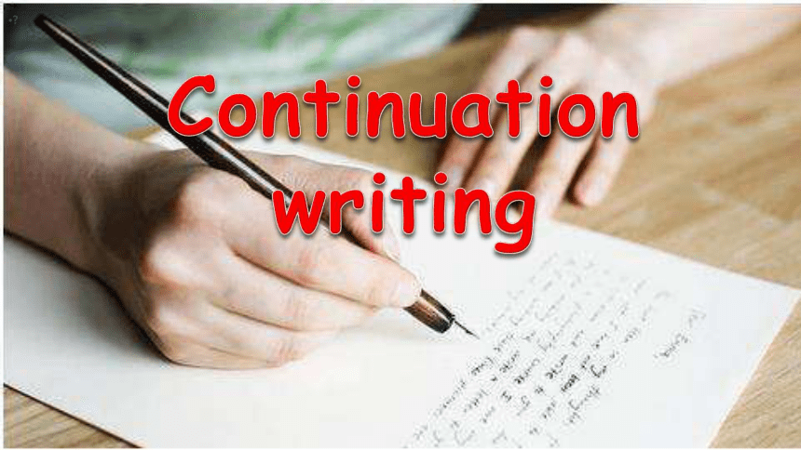
读
后
续
写
1

Slide 2
读后续写的具体要求
提供一段350词以内的语言材料，要求考生依据该材料内容、所给段落开头语(和所标示关键词)进行续写（150词左右），将其发展成一篇与给定材料有逻辑衔接、情节和结构完整的短文。
To understand is one thing, to express is another.
To appreciate is one thing, to create is another.

Slide 3
读后续写的题型解读及能力要求
要求考生在理解一篇不完整文章的基础上，充分调动想象创新思维，大胆预测文章缺失部分的内容走势，进行充满个性色彩的设计，并用英语进行续写表达。
所提供短文多以记叙文故事类文章或夹叙夹议类文章为主，故事情节曲折有起伏，但故事线索的逻辑性比较强。
挑战：创造性+逻辑性+丰富性
Notes:
1111

Slide 4

Reading for Writing
读
The depth of reading determines the height of writing.
How?
浅层-信息定位能力
深层-文本分析能力

Slide 5
How to develop your idea
Step 1
Read for
elements
Step 2
Read for
plots
Step 3
Read for language
& Gather ideas
Step 4
Make predictions

Slide 6
读后续写练习1
阅读下面短文，根据所给情节进行续写，使之构成一个完整的故事。
Steve was the most amazing person in all of Minneapolis, and he was my cousin. By the age of 19, Steve was a star baseball player at the University of Minnesota. I wanted to be exactly like him. So when Steve asked me to go with him on a spring fishing trip in northern Minnesota, I was excited!
After planning the trip, we gathered clothes and supplies, and began our great adventure. We reached the Superior National Forest in northern Minnesota by early evening. On our way to the campsite, Steve pointed to a small house faraway in one of the mountains, saying that it was the ranger station (护林站) where the forester worked.
Finally, after a long walk, we reached the campsite and set up the camp as the sun was setting. Steve knew all the tricks of an experienced wilderness camper. After we gathered enough wood from the forest, he started the campfire using only stone and steel — no matches. For supper we feasted on freeze-dried beef, wild rice and pea soup. I ate greedily after all that work.

Slide 7
Tired enough, we climbed into our sleeping bags early and talked about our plans for fishing the next day. We were still talking quietly when a sudden north wind picked up; the temperature dropped and it began to snow. Steve found a way to increase the temperature inside the tent. He dragged a log from the forest to the opposite side of the campfire. Then he wrapped aluminum foil (铝箔) around the log. The heat from the fire reflected off the foil and into the tent. Soon images of lake fish were filling my dreams.
The snow had stopped, but sometime later a powerful wind must have kicked up the flames of our dying fire. I was suddenly awakened by Steve. Our tent was on fire. Frightened, I ran out of the tent immediately. The tent collapsed (倒塌) with Steve inside. Without any thought of endangering myself, I reached into the burning tent and pulled him to the icy lake. Fortunately, we were not seriously hurt.
注意:
1. 所续写短文的词数应为 150 左右；
2. 续写部分分为两段，每段的开头语已为你写好；

Slide 8
Paragraph 1:
Later, as we stood by the burning tent to keep warm, we considered our difficult situation.
Paragraph 2:
Suddenly, we heard a noise in the forest.
审题：判断主题语境及确定主旨（theme）
三大主题语境：人与自我、人与社会、人与自然
Typical themes: 历险脱困类、趣事类、个人成长类、
亲情友情类、善举助人、人与动物 ...

Slide 9
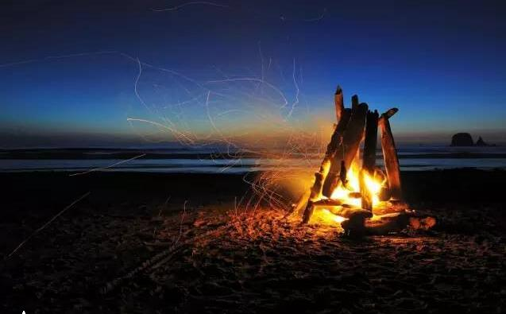
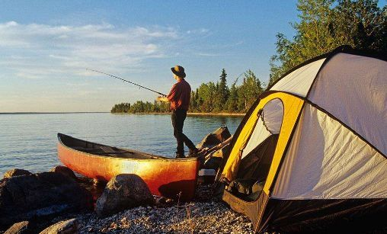
Step 1 Read for Key Elements
续写内容？
Why & How
when
where
why
A story
who
how
what

Slide 10
Key Elements From the Given Text
What
An adventurous fishing trip
Who
I, Steve, forester
When
In spring
Where
campsite, forest

Slide 11
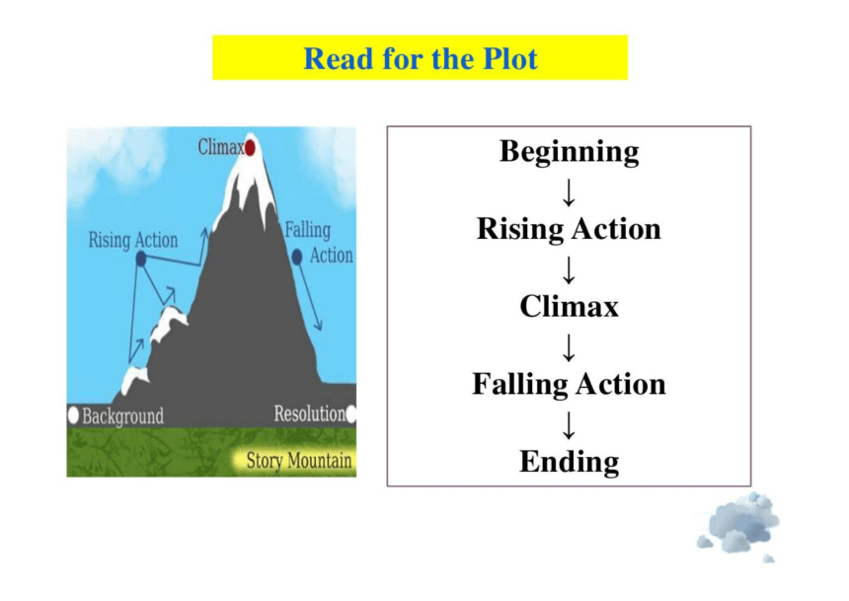
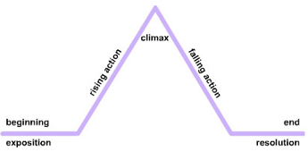
Step 2 Read for plots

Slide 12
Climax/Conflict (the main problem)
Our tent was on fire and we escaped to the icy lake.
Development
We reached the campsite
and set up the camp.
?
Story Mountain
Beginning
(character and setting)
Ending
(how things end up)
Steve asked me to go on a spring fishing trip.

Slide 13
Step 3 Read for language & Gather ideas
读后续写练习1：An adventurous fishing trip
划线词 | Character
 | Setting
 | Action
 | Mood
划出 段首句 关键词 | Para. 1: Later, as we stood by the burning tent to keep warm, we considered our difficult situation. Para. 2: Suddenly, we heard a noise in the forest.
划线词 | Character | Steve, me, forester
 | Setting | clothes, supplies, campsite, forest, cold, fire
 | Action | set up, increase the temperature, caught fire, collapsed, ran out
 | Mood | frightened
段首句 关键词 | Para. 1: Later, as we stood by the burning tent to keep warm, we considered our difficult situation. Para. 2: Suddenly, we heard a noise in the forest.

Slide 14
Step 4 Make predictions
Paragraph 1:
Later, as we stood by the burning tent to keep warm, we considered our difficult situation. _________________________________________________________________________________________________________________________________________________________
Paragraph 2:
Suddenly, we heard a noise in the forest. _______________________________________________________________________________________________________________________________________
P1续写思路？
P2续写思路？

Slide 15

Possible predictions
Have a discussion to make some possible predictions: 2-3 minutes; group leaders to share
Difficult situations: Challenges | Noise: Helpers? Threats？ How to get out of the forest?

Slide 16
Difficult situations: Challenges | noises and response
1. The fire had burned down the tent as well as their clothes and supplies. 2. The temperature had dropped to be very low. 3. No signal for smart phone to work for calling help. 4. Beasts might wander around and attack them. 5. The wood had run out and it was in complete darkness. 6. … | 1. They were worried about the approaching of wild animals. 2. Some one may come to help them out, e.g. the forester 3. They could yell/shout for help. 4. They might light up fire torches to find a way out. 5. Ask for an Uber service? Kidding, haha

Slide 17
写作步骤1：四句定框架
写好四句话，基本搭建了续写框架：
S1: 按第一段的提示语句写第一段的第一句，一般是段首句的拓展句
S2: 再把两段的衔接句写好，即第一段的最后一句，注意要承上启下
S3: 紧接着按第二段的提示语句写第二段的第一句，一般是角色的response
S4: 把第二段最后一句写好，即：全文主题句
3.

Slide 18

unity
Paragraph 1:
Later, as we stood by the burning tent to keep warm, we considered our difficult situation.
A: We quickly jumped into our jeep car to keep warm, waiting for the dawn to come.
B: Our campsite was in the deep of the forest, really far away from the highway.
√

Slide 19
S1--首段拓展句
Paragraph 1:
Later, as we stood by the burning tent to keep warm, we considered our difficult situation.
S1.Our campsite was in the deep of the forest, really far away from the highway. ......
S1. Our clothes and supplies were all buried in the tent, leaving us shivering in the biting cold wind.
S1. Our campsite was deep in the forest, so with all of our supplies consumed by the fire, we were almost completely cut off from the outside world.

Slide 20
S2--两段衔接句
Paragraph 1:
Later, as we stood by the burning tent to keep warm, we considered our difficult situation.
...
S2. The only thing we could do was just sit in the cold air and wonder how to get out of the forest.
S2. The night was deadly silent except for the helpless pounding of our hearts.
S2. After waiting what seemed like centuries, we were on the edge of mental collapse.
Paragraph 2:
Suddenly, we heard a noise in the forest.

Slide 21
S3--次段拓展句
Paragraph 2: Suddenly, we heard a noise in the forest.
S3. Anxiously we listened and stared into the darkness.
S3. Steve and I held our breath and exchanged glances in confusion and fear, while turning towards the source of the noise.
S3. As it became louder and closer, Steve recognized it as the sound of a jeep.

Slide 22
S4--主题句
Paragraph 2: Suddenly, we heard a noise in the forest.
S4. (After this camping adventure, Steve began to treat me more like a friend rather than a younger cousin. )Our friendship continues to this day.
S4. It was only when we got on the highway that we finally realized we had managed to survive the accident narrowly in the wild.
S4. We might not have caught the fish, but we had certainly caught a story to tell– a story about survival in the wild and the bond of friendship after the adventure.

Slide 23
写作步骤2：三大原则补全段落
接下来就是把每段的中间补充完整，记住三大原则：
1.Action—Response原则（原文一致）：角色A的所言、所行、所感、所想会引起其它角色的系列反应。若对话应简短1-2句，不一定都要说话，无声的动作也是response。注意内容要前后衔接，上下连贯，语言表达风格一致。
2.Conflict—Solution原则 (曲折性）：故事皆有跌宕起伏，困难或问题最终能解决。一般而言第二段会有solution。第一段通常无明确解决方案。
3.Negative—Positive原则（正能量）：要体现情感的变化，无论前面如何negative，最终都是积极的。故事内容要弘扬核心价值观，i.e.迷路了但最终一定回到家；失败了或遇到困难了，最终一定成功；吵架了最后一定言归于好和睦相处；犯错了，最后一定会改过自新重新做人；贼逃了，最后一定绳之以法 ，不能投机不能杀死动物等等。
3.

Slide 24
One possible version 1:
Later, as we stood by the burning tent to keep warm, we considered our difficult situation. Our campsite was in the deep of the forest, really far away from the highway. We were in the middle of nowhere, wearing only underwear, with our supplies burnt into ashes, including our cellphones. Even Steve was unsure what to do next. The only thing we could do was just sit in the cold air and wonder how to get out of the forest.
Suddenly, we heard a noise in the forest. Anxiously we listened and stared into the darkness. A jeep appeared. A forester had spotted the light from the fire and had come to have a check. We jumped into the warm vehicle and the forester drove us to the ranger station, where we were given clothes and were able to call our parents. Steve and I had many more camping adventures from then on, but it was on this trip that Steve began to treat me more like a friend rather than a younger cousin. Our friendship continues to this day.

Slide 25
One possible version 2:
Later, as we stood by the burning tent to keep warm, we considered our situation. Our campsite was deep in the forest, so with all of our supplies consumed by the fire, we were almost completely cut off from the outside world. Our bodies shivered as all we had on was thin underwear. We yelled for help, but there was no response. “The ranger station!” Steve suddenly shouted with excitement, “If only we could catch the foresters’ attention!” We fed more wood into the fire, pinning all our hopes on someone noticing it. After waiting what seemed like centuries, we were on the edge of mental collapse.
Suddenly, we heard a noise in the forest. As it became louder and closer, Steve recognized it as the sound of a jeep. Then I saw a dark shape moving towards us when the noise came to an abrupt end. It was a forester! Luckily enough, he had spied the light and smoke and came to check immediately. Still badly shaken, we could hardly whisper thank-you but quickly jumped into his warm vehicle as he put out the fire. At the ranger station, we put on some warm clothes and called our parents. It was only when we hung up the phone that we realized we had managed to survive the accident narrowly in the wild.

Slide 26
情绪三阶段：
第一阶段：开端或冲突出现时的消极情绪
1.焦虑（Anxiety）
2.恐惧（Fear）
3.悲伤（Sadness）
4.愤怒（Anger）
5.内疚（Guilt）
第二阶段：转折点的过渡情绪
6. 平静（peace)
6. 希望（Hope）
7. 犹豫（Hesitation）/谨慎（Caution）
第三阶段：结局或问题解决后的积极情绪
9. 喜悦（Joy）/ 快乐（Happiness）/ 兴奋（Excitement）
10.安心（Relief）/ 轻松（relaxation）
11.感激（Gratitude）
12.自信（Confidence）
13.成长（Growth）/ 成熟（Maturity）/ 领悟（Realization）
14.理解（Understanding）/ 领悟（Realization）
15.勇气（Courage）

Slide 27
续写要点
【评分要点】
第一、续写部分和原文及首句的融合度
第二、内容丰富
细节是否丰富？（心理情绪，动作，语言，环境）
情节如何推进？（solution在P2，动作链）
第三、语言
语法和词汇的准确性；
词汇和语法的丰富性
语法结构
连贯性 体现上下文的逻辑
1.精读原文，理清文脉，确定文章主旨。留意可能的伏笔（性格，情感，物件，环境，其他人物）
2.寻求原文与段首句的内在联系，从作者的角度，设计并发展情节，想象要合理，情节要连贯，尽量符合原文思路。
3.三观要正，续写内容要积极健康，展示美好。
4.语言---继承原作风格，准确地道表达。适当高级表达增强表现力。

Slide 28

第五档：21分-25分
第四档：16分-20分
第三档：11分-15分
第二档：6分-10分
第一档：1分-5分
第五档： 21分-25分
与所给短文融洽度高，与所提供各段落开头语衔接合理。
内容丰富，应用了5个以上短文中标出的关键词语。
所使用语法结构和词汇丰富，准确，可能有些许错误，但完全不影响意义表达。
有效地使用了语句间的连接成分，使所续写短文结构紧凑。
评
分
标
准

