Slide 1
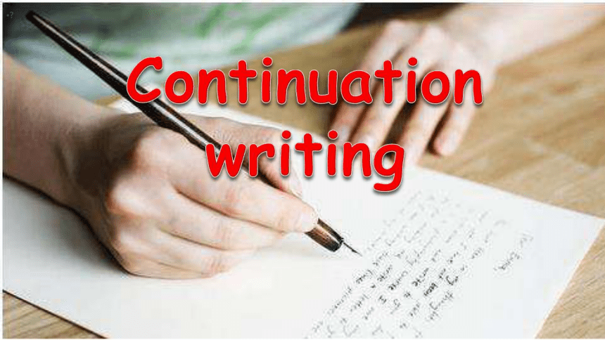
2
读
后
续
写

Slide 2
Review: Steps to continue a story
Step 1: Read for elements/basic information
(when, where, who, what, how, why)
Step 2: Read for the main plot
Step 3: Gather ideas & Read for the language
Step 4: Make predictions/Infer the development
(the plot, the given two sentences)
Step 5: Continue the story
(the requirements)
Step 6: Polish your writing
(refer to the Criteria for Assessment)
Notes:
In the end, to cope with this type of writing, you may follow the six steps here.

Slide 3
读后续写练习2
阅读下面短文，根据所给情节进行续写，使之构成一个完整的故事。
One weekend in July, Jane and her husband, Tom, had driven three hours to camp overnight by a lake in the forest. Unfortunately, on the way an unpleasant subject came up and they started to quarrel. By the time they reached the lake, Jane was so angry that she said to Tom, “I’m going to find a better spot for us to camp” and walked away.
With no path to follow, Jane just walked on for quite a long time. After she had climbed to a high place, she turned around, hoping to see the lake. To her surprise, she saw nothing but forest and, far beyond, a snowcapped mountain top. She suddenly realized that she was lost.
“Tom!” she cried. “Help!”
No reply. If only she had not left her mobile phone in that bag with Tom. Jane kept moving, but the farther she walked, the more confused she became. As night was beginning to fall, Jane was so tired that she had to stop for the night. Lying awake in the dark, Jane wanted very much to be with Tom and her family. She wanted to hold him and tell him how much she loved him.
Jane rose at the break of day, hungry and thirsty. She could hear water trickling (滴落) somewhere at a distance. Quickly she followed the sound to a stream. To her great joy, she also saw some berry bushes. She drank and ate a few berries. Never in her life had she tasted anything better. Feeling stronger now, Jane began to walk along the stream and hope it would lead her to the lake.
As she picked her way carefully along the stream, Jane heard a helicopter. Is that for me? Unfortunately, the trees made it impossible for people to see her from above. A few minutes later, another helicopter flew overhead. Jane took off her yellow blouse, thinking that she should go to an open area and flag them if they came back again.

Slide 4

Paragraph 1：
But no more helicopters came and it was getting dark again.
Paragraph 2：It was daybreak when Jane woke up.
审题：判断主题语境及确定主旨（theme）
练习1：划出文中关键词：Character ? Setting? Action? Mood?
划出段首句关键词：
练习2：情节梳理 Draw Story Mountain based on the main plot：
Beginning:
development:
Climax/conflict:
Ending:

Slide 5
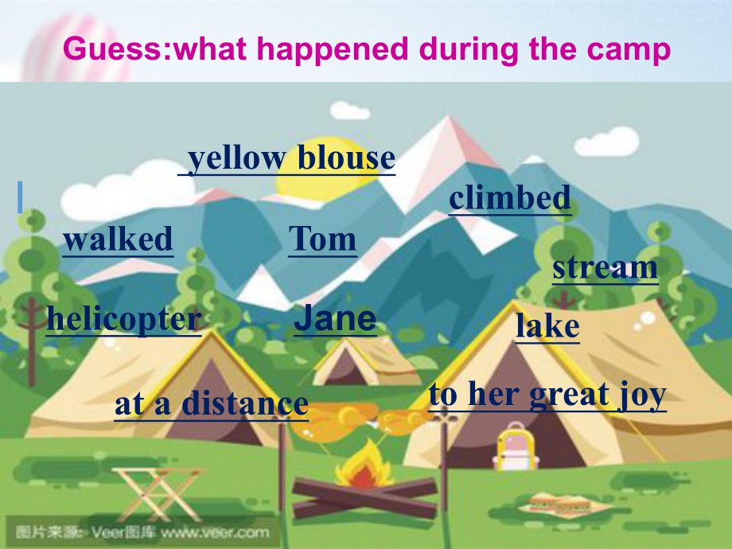
The underlined words
Character: Tom, Jane
Setting: stream, lake, helicopter, yellow blouse
at a distance
Action: walked, climbed
Mood: to her great joy

Slide 6
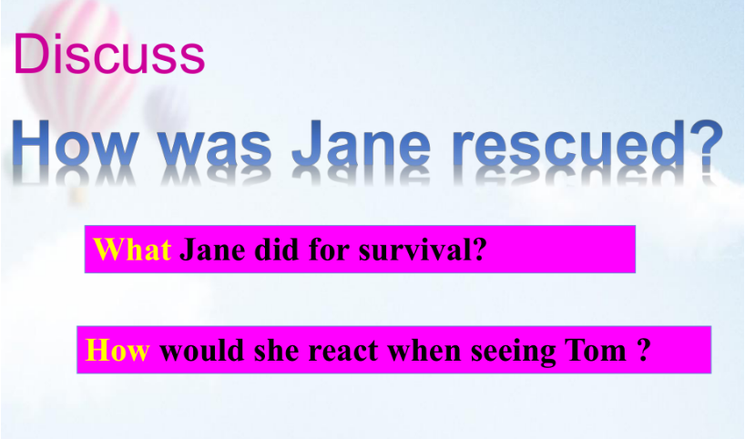
Conflict/Climax
看见直升飞机
(helicopters)
Development
confused，tired
lost 迷路
quarrel
吵架，生气离开
rescued?
被救？
angry
Beginning
Ending

Slide 7
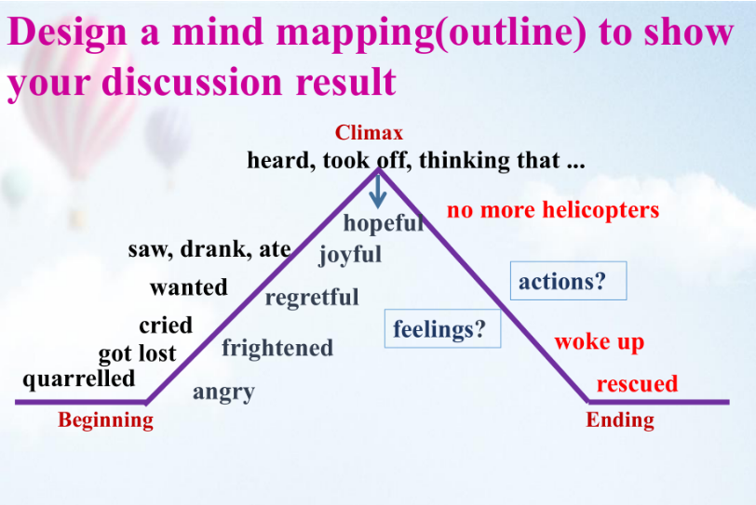

Slide 8
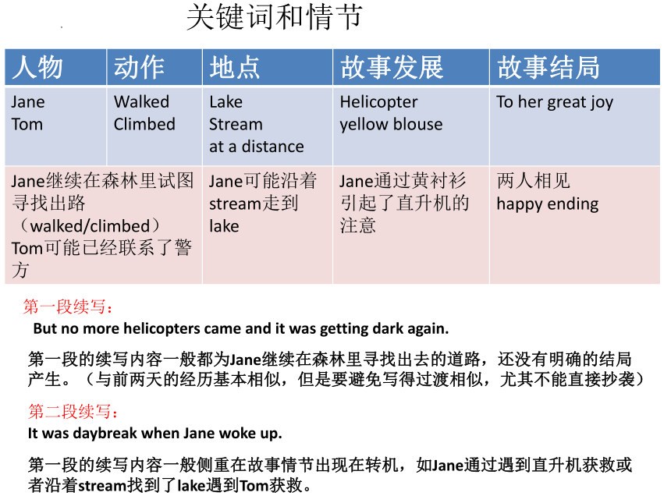
细读两段续写的开头语，理顺续写段落的逻辑关系；
围绕划定的关键词，合理创新故事情节。
Para. 1: But no more helicopters came and it was dark.
续写思路：简当时的感受？
简是如何过夜的？
简睡着了吗？
Para. 2: It was daybreak when Jane woke up.
续写思路：简获救了吗？
谁救了简？
怎么救的？
她当时的感受？

Slide 9
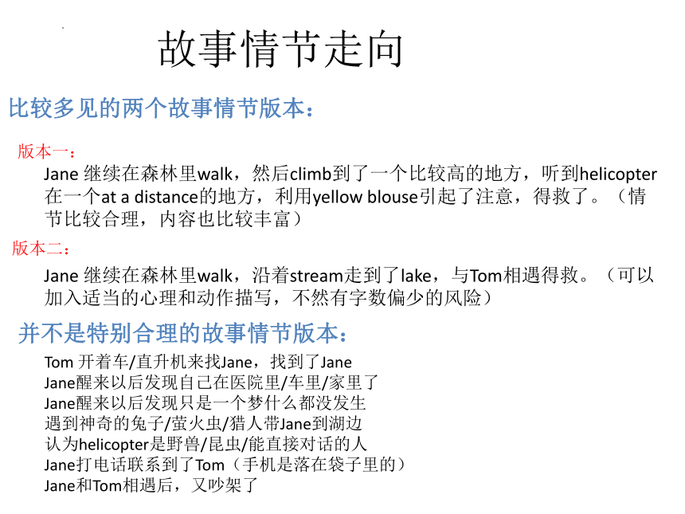
补全段落

Slide 10
Practice：四句定框架
Paragraph 1：But no more helicopters came and it was getting dark again.
S1 (P1第一句):
S2(P1结束句,即衔接句）:
Paragraph 2：It was daybreak when Jane woke up.
S3(P2第一句）:
S4(P2结束句,即主题句）:

Slide 11
Practice：四句定框架
Paragraph 1：But no more helicopters came and it was getting dark again.
S1: Feeling disappointed, Jane had to stay alone for another night.
S1: Jane's heart dropped realizing that there would be no one coming to her rescue.
S1: Feeling unbearably cold and extremely exhausted, Jane was quite at a loss as to how to cope with the terrible situation.
S2: Only in this way could Jane feel better and fall asleep.
S2: Hopeless and exhausted, Jane fell into a sound sleep where she dreamed of Tom’s warm embrace.
S2: So weak was Jane that she lay on the thick grassland and fell asleep again.
Paragraph 2：It was daybreak when Jane woke up.

Slide 12
Practice 1：四句定框架
Paragraph 2：It was daybreak when Jane woke up.
S3: Feeling refreshed, she continued to walk along the stream to find the way out.
S3: Two days of fruitless searching had drained her energy but the desire for getting back to Tom was stronger than ever, so she set off again.
S3: To her great joy, a helicopter flew straight towards her direction.
S4: They got home and have led a happy life ever since.
S4: With joyful tears streaming down their faces, the couple hugged each other tightly and determined to never let go of the other's hands for the rest of their lives.
S4: Both of them learned a valuable lesson taught by nature: never abandon yourself to despair/emotions when in the wild.

Slide 13
Practice 2：补全段落
需注意：
第一、融合度（和原文及首句）
第二、内容丰富
细节是否丰富？
情节如何推进？
第三、语言
语法和词汇的准确性；
词汇和语法的丰富性
语法结构
连贯性 体现上下文的逻辑
三原则：
1.Action—Response原则（原文一致）：注意内容要前后衔接，上下连贯， 语言表达风格一致。
2.Conflict—Solution原则 (曲折性）：故事皆有跌宕起伏，困难或问题最终能解决。
3.Negative—Positive原则（正能量）：要体现情感的变化，无论前面如何negative，最终都是积极的。
故事内容要弘扬核心价值观。

Slide 14
One possible version 1:
But no more helicopters came and it was getting dark again. Feeling disappointed, Jane had to stay alone for another night. After walking a long distance again, it occurred to her that she had a box of matches with her. She was wild with joy and used them to burn some branches so that she could get some warmth. Staring at the jumping fire, Jane thought of all the things that she and Tom had experienced together. Only in this way could Jane feel better and fall asleep.
It was daybreak when Jane woke up. Feeling refreshed, she continued to walk along the stream to find the way out. At noon, to her great joy, she finally caught sight of a wide water surface at a distance. It was the lake! Also she spotted a crew of policemen seeking along the bank! It seemed that they also spotted her because they were moving towards her! It was Tom who called the police. Finally, they led her to her husband. And the minute they met, they hugged together firmly as if they would never separate again. They got home and have led a happy life ever since.

Slide 15
One possible version 2:
But no more helicopters came and it was getting dark again. Feeling unbearably cold and extremely exhausted, Jane was quite at a loss as to how to cope with the terrible situation. She could do nothing but keep on going to find an open place, praying that the helicopter would come again. Nevertheless, there was not a soul in sight and everything was so dead-looking. Being in the depth of despair, Jane tried in vain to keep back her tears and promised herself that she would never act on impulse again. So weak was Jane that she lay on the thick grassland and fell asleep again.
It was daybreak when Jane woke up. Two days of fruitless searching had drained her energy but the desire for getting back to Tom was stronger than ever, so she set off again.
To her great joy, a helicopter flew straight towards her direction. In a desperate attempt to catch the rescuer’s attention, she yelled and waved her yellow blouse with all her strength. This time, luckily, Jane was spotted. Instantly she was sent to the local hospital, where stood her dear husband, who suffered great anxiety when Jane was nowhere to be found. Tears of joy and relief welled up as they finally held each other tightly. Both of them learned a valuable lesson taught by nature: never abandon yourself to despair when in the wild.

Slide 16
Attention！
1.不能脑洞大开随心所欲地写，段落开头语引导思路向哪方面发展，续写部分要在其基础上拓展发挥。
2.续写所给语言材料多是记叙文之故事类文章，情节曲折跌宕，线索性和逻辑性较强。读后续写要求读写并重，对材料精确理解，抓住故事的叙事线索，续写部分才不偏离主题。
3.依据原文的写作思路续写文章并适当发散，续写部分的思路和内容并不一定是唯一的，考生可根据自己对上文材料的理解，文章的结尾可有不同诠释。

Slide 17
Assessment Criteria for Writing
Items （条目） | Levels （档次）
Cohesion （与所给短文和段落开头衔接融合程度） | ☆ ☆ ☆ ☆ ☆
Use of underlined words （下划线词汇使用情况） | ☆ ☆ ☆ ☆ ☆
Rich Content（内容的丰富性） | ☆ ☆ ☆ ☆ ☆
Accuracy of language （语法结构和词汇使用的准确性） | ☆ ☆ ☆ ☆ ☆
Variety of language （语法结构和词汇使用的丰富性） | ☆ ☆ ☆ ☆ ☆
Coherence （上下文以及语句间的连贯性） | ☆ ☆ ☆ ☆ ☆
Content:
cohesive (well connected), rich, reasonable, logical
Language:
accurate, rich, coherent, more than 5 underlined key words

Slide 18

unity
Paragraph 1:
Later, as we stood by the burning tent to keep warm, we considered our difficult situation.
A: We quickly jumped into our jeep car to keep warm, waiting for the dawn to come.
B: Our campsite was in the deep of the forest, really far away from the highway.
√

Slide 19

Paragraph 2:
Suddenly, we heard a noise in the forest.
A. Anxiously we listened and looked into the black environment. A jeep came. A forester had seen the light from the fire and had come to take a look.
B. Anxiously we listened and stared into the darkness. A jeep appeared. A forester had spotted the light from the fire and had come to have a check.
√

Slide 20

非谓语结构；
状语从句；
定语从句；
名词性从句…
倒装句;强调句；
高级精准词汇；
1. He was alone, and he was concerned about his dog:
Polished:
He was alone, worried about his dog.
He was alone, by which the feeling of worrying about his dog was triggered.
It was his loneliness that stimulated his worrying about his dog.
2. He was so strange. And he decided to go back to the village.
Polished:
So strange was he that he decided immediately to get back to the village.

Slide 21

Sticking Together
1. Arrange details in the order of time, logic, space and importance.
2. Use various transitions (linking words).
Some Transitions for Time
at first, next, meanwhile, after a while, and then,
in addition, at last …
Some Transitions for reason
Hence, therefore, consequently, as a result, thus, …

Slide 22
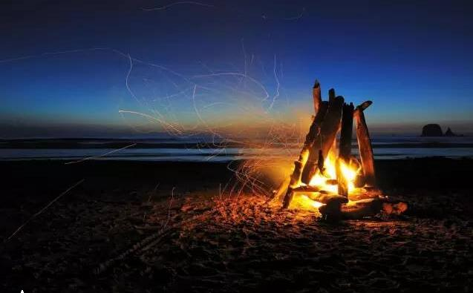
续写要点回顾
1.精读原文，理清文脉并明确作者的论点，确定文章主旨。
2.寻求原文与段首句的内在联系，站在作者的角度，设计并发展情节，想象要合理，情节要连贯。后续情节一般为故事的高潮或延续，是原作者声音的延续、态度的延伸，因此，要尽量符合原文思路。
3.三观要正，所续写内容要积极、健康向上，把事物美好的一面展示出来。
4.语言---继承原作者风格，准确地道地表达，充分展示语言的表现力。提高关联词与过渡语的使用率，增强整句表现力。

