Slide 1
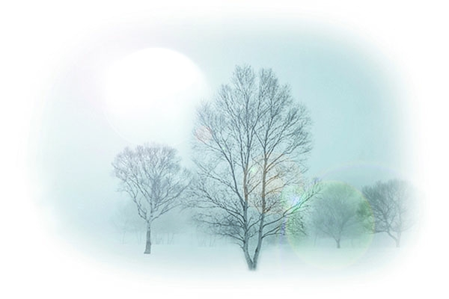

情态动词

Slide 2





Slide 3
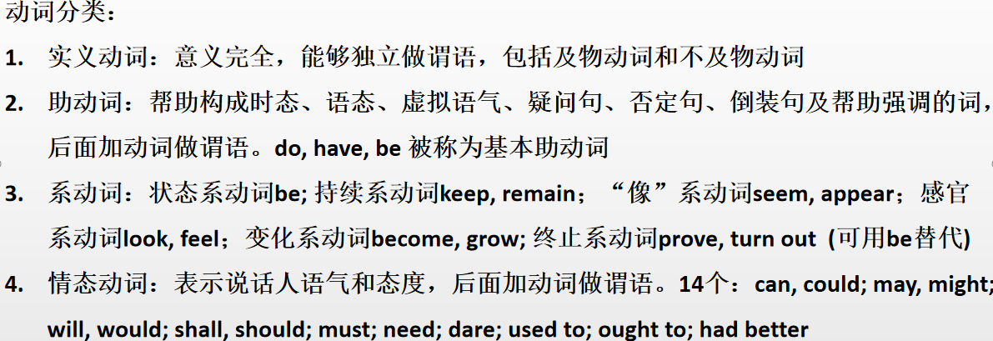

Slide 4
基本概念
和助动词不同，情态动词有一定的意义，无人称和数的变化。
和助动词相似，帮助后面的动词构成谓语，表示时态，语气等，可以构成疑问和否定， 如be, do, have, shall, will, would, should等。
Will they have anything to do tonight?
They would do everything to save the child.
I shall study harder at English.
He must not leave.
May I come in?

Slide 5
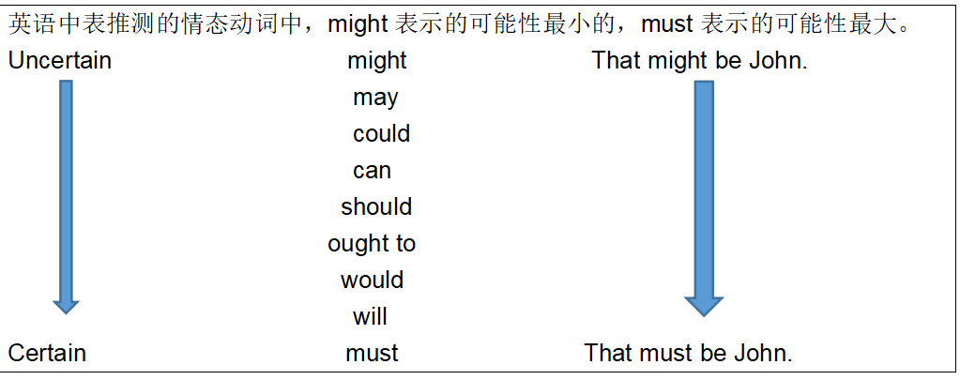

Slide 6
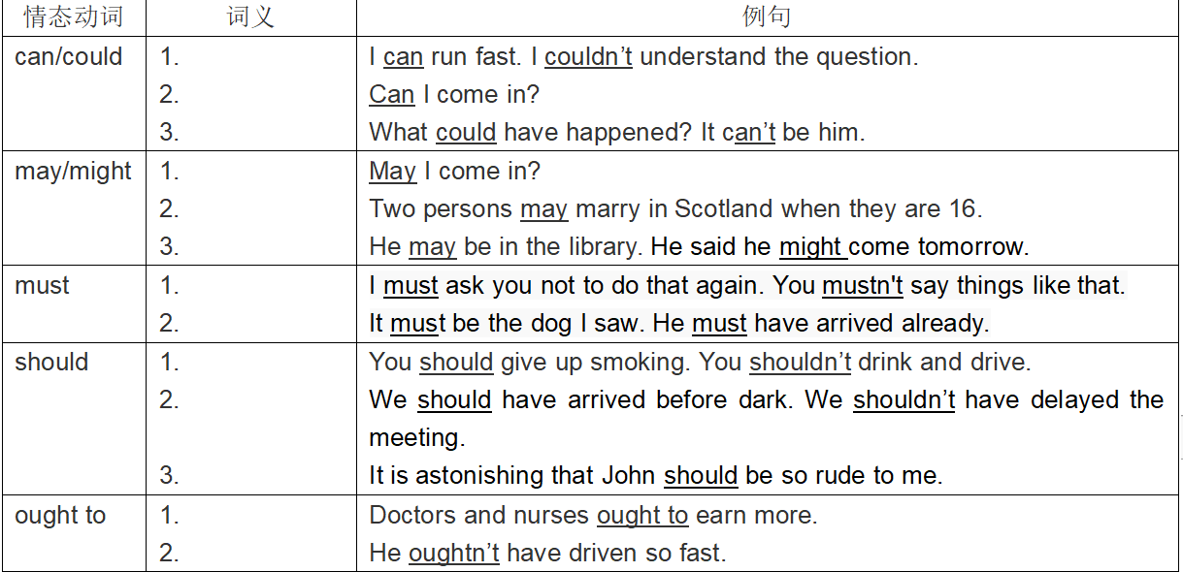
能力
be able to: 具体，努力，做成
能够（请求/允许）
可能（推测）
可以（请求/允许）
可以（请求/允许）
也许（推测）
必须
have to 客观， don’t have to 不必
must表推测只用于肯定句
一定（推测）
应该（责任/义务）
本应该（虚拟）
竟然（推测）
应当（责任/义务）
本应当（虚拟）

Slide 7
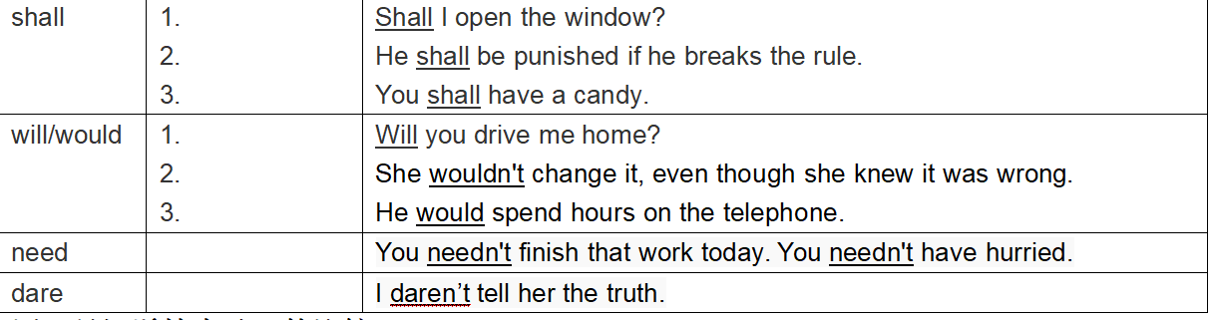
可以（请求/允许）
警告/命令
在条约，规章制度中用shall表示义务或者规定。
允诺
意愿
意愿/决心
过去的习惯
used to do过去习惯，现在不做了
需要
敢
need, dare实义动词？
4.用非人称主语时，won’t和wouldn’t 表示某物暂时的特性，“就是不能”。
The door won’t shut. Better have it repaired. That morning my car wouldn’t start.
open,close, stop, move

Slide 9
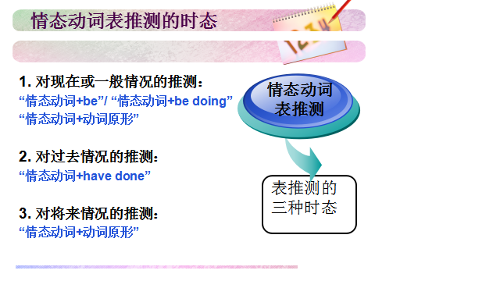


can't be donig
must be doing
might be doing

Slide 10
情态动词＋ have done

Slide 11
must have done | 对过去某事的肯定推测：一定已经
can’t / couldn’t have done | 对过去某事的否定性推测： 想必不可能
may / might have done | 1.对过去推测： 可能已经 2. 虚拟：本可能做的事实际没做（might)
could have done | 1.对过去推测：可能已经 2.虚拟：本能做的事实际未做
should/ (ought to) have done | 1. 对过去推测：应该已经 2. 虚拟：对已经出现的事态感到“惊奇、惊喜、怀疑”。 3. 虚拟：本应该做的事实际却未做
would have done | 虚拟：本要做的事实际没做
need/needn't have done | 本（不）需要做的事实际没做
Don't move her. She might have broken something.
I might have become a doctor if I had studied harder.
The accident could have been avoided yesterday.
He was Minister; he ought to have been expert on Dark stuff.
I'm surprised that he should have been so foolish.
He should have asked for some help last time.
If I had known that, I wouldn’t have said that.

Slide 12
 | 虚拟 | 推测
may/might have done | 本可能 | 过去可能（不太确定）
could have done | 本能够 | 过去可能（比较确定）
should have done | 本应该
would have done | 本要，本会
否定 （略）
1.我本来要去你家，但我妈病了。
2.我本来能不在老师帮助下自己做出来这道数学题的。
3. 昨天如果我跑慢点，可能就要错过巴士了。
4. 你本应该告诉我事实真相，但你却撒谎了。
1. 他没接电话，他可能忘记充电了。
2. 街道是湿的，昨晚可能下过雨。

Slide 13
can 和 could
can/could 表示能力，过去式 (could) 。be able to？
He ________ sing this song in English in a few minutes, too.
Luckily, he ________ escape from the big fire in the end.
2. can 表示客观可能性.
Anybody can make mistakes.
It can be cold in winter in the south.
3. 表示许可. You may/can come in.
will be able to
was able to

Slide 14
1. He could swim across the English Channel. But he didn’t feel like it that day. (本身具有的能力）
2. Yesterday I was able to get home before the heavy rain.
be able to do sth= manage to do sth
= succeed in doing sth

Slide 15
The fire spread through the hotel very quickly but everyone ____ get out.
A had to B would
C was able to D could
C
表示成功地做了某事
_______ you do me a favour?
委婉

Slide 16
4. 用在否定句、疑问句或感叹句中,表推测,怀疑,惊讶
That _____ be Tom. He went to London two weeks ago. (can’t / couldn't) ?
Can it be our teacher?

Slide 17
1.___he___a famous doctor at that time?He was so young then.
A Can ; be B Must ; be C Can ; have been D Must ; have been
C
can have done \ could have done 用于表示对过去发生的事进行猜测,can 只能用于疑问句,否定句, could have done还课用来表示“本来能做而没做,有责怪的意思 ”
例 (1) -Where can she have gone?
-She can not have gone to the church.
-She could have gone swimming.
(2) -Why didn’t you come back? You could have
saved her.
没有 can have done形式
could have done 肯定时表虚拟，否定和疑问表猜测

Slide 18
2.My English-Chinese dictionary has disappeared. Who___ have taken it?
A should B must
C could D would
C

Slide 19
3.---I stayed at a hotel in New York. ---Oh,did you? You___with Barbara.
A could have stayed
B could stay
C would stay
D must have stayed
A

Slide 20
may 和 might
1. 表示允许或请求 May/ Can I help you?
2. 没有把握的推测。
She may come tomorrow, but I'm not sure.
She may not(可能不） go to the party tonight.
might 表示推测时, 不表示时态, 只是可能
性比may 小。
They might be having a meeting, but I’m not sure.
3. 放在句首, 表示祝愿。
May God bless you!

Slide 21

1. Sorry I’m late. I____ have turned off the alarm clock and gone back to sleep again.
A. might B. should C. can D. will
2.—Are you coming to Jeff’s Party?
—I’m not sure. I ___ go to the concert instead.
A. must B. would
C. should D. might

Slide 22
have to和must
1.have to表示由于客观因素 “不得不做”
must表示说话人的主观意志, 看法 “必须，一定”
My brother was very ill, so I had to call the doctor in the middle of the night.
He said that they must work hard.

Slide 23
2. have to有人称、数、时态的变化，而
must只有一种形式。
He had to look after his sister
yesterday.
3. 否定结构中 don’t have to表示“不必”
mustn’t表示“禁止，千万不要”
You don’t have to tell him about it.
你没必要把此事告诉他。
You mustn’t tell him about it.
你千万不要把这件事告诉他。

Slide 24
–Must I return the book today?
-Yes, you must.
-No, you needn’t.
No, you don’t have to.

Slide 25
4) must用于肯定句，可以表示推测且语气强烈，翻译为：一定或想必。后面接动词的一般/进行时，表示对现在的推测，接动词的完成式，表示对过去的推测。
She must live near here, for she comes to work on foot.
The light is out. They must be sleeping now.
She was absent from class. There must have been something wrong with her.
Mary's score on the test is the highest in her class. She ____ have studied very hard.
A) may
B) should
C) must
D) ought to

Slide 26
I’m sure he ___have the computer sooner or later.
A shall B can
C must D would
C

Slide 27
含有must时，反义疑问句的归纳
① 若must表示“必须”或“有必要”，
You must leave at once, mustn’t [needn’t] you?
你必须(有必要)马上离开，是吗?
但是若陈述部分有mustn’t表示禁止
You mustn’t laugh, must you? 你不准笑，知道吗?

Slide 28
② 若must表示对现在的推测，
He must be tired, isn’t he? 他一定累了，是吗?
He must be good at maths, isn’t he?
根据must后的动词结构采用相应的动词形式

Slide 29
③当must用来表示对过去的情况进行“推测”（must + have done）时
She must have read the novel last week, didn’t she?
她上星期一定读了这本小说了，是吗？
You must have told her about it, haven’t you? 你一定把这事告诉她了，是吗？

Slide 30
1.He must be angry,_________?
2.He must have been angry just now, _____ ?
3.He must have gone abroad,______?
4.He must have gone abroad last month,________?
isn’t he
wasn’t he
hasn’t he
didn’t he

Slide 31
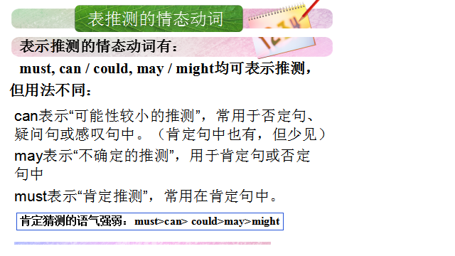
can不肯(could可以），may不问（might可以），must肯定不否问

Slide 32
表示否定的情态动词的用法:
mustn’t 不准, 禁止
needn’t 没必要 ( = don’t have to )
can’t 不能; 不可能
may not 不可以; 可能不
shouldn’t 不应该 ( = ought not to )

Slide 33
can't be donig
must be doing
might be doing

Slide 34
情态动词＋ have done

Slide 35
must have done | 对过去某事的肯定猜测： 一定已经
can’t / couldn’t have done | 对过去某事的否定性猜测： 想必不可能
need/ needn't have done | 本（不）需要做的事实际没做
should / ought to have done | 1.对过去猜测：应该已经 2. 虚拟：对已经出现的事态感到“惊奇、惊喜、怀疑”。 3. 虚拟：本应该做的事实际未做
may / might have done | 1. 对过去猜测： 可能已经 2. 虚拟：本可能做的事实际没做（might)
would have done | 虚拟：本要做的事实际没做
could have done | 虚拟：本能做的事实际却未做

Slide 36
should

Slide 37
1). should(主观) 和ought to(客观) 都表示劝告,建议或有责任,义务去做某事，“应该”。
You should do as I told you.
ought to 强调在客观上（法律，章程和道义）比should语气强。
You ought to have an operation at once.
2). should/ought to have done “本应该”表示在过去本应该做而实际未做; （虚拟）
shouldn’t/oughtn’t have done ：“本不应该”做而实际却做了.
You should have come here earlier.
You shouldn’t have been there.

Slide 38
构成其他虚拟语气。
He suggested that we should act at once.
4）用于表推测。 语气较肯定，意为 “可能、该…
The boys shouldn’t be playing football.
They should be at school.
3.It should be fine tomorrow.
4. *He left hours ago. They should have arrived home by now.

Slide 39
He should have passed the exam, but he didn't. 本能够，虚拟
*He should have passed, but I don't know for sure. 应该已经通过了，对过去推测
I'm surprised that he should have failed in the test. 竟然， 虚拟

Slide 40
shall
在疑问句中shall用于一, 三人称,表示征求对方的意见或指示
Shall those goods be sent over to you at once?
What shall I do to help you?
2) 在陈述句中shall 用于二,三人称,表示说话者给对方的告戒,警告,命令,决心,允诺等意图.
He shall go with us.
I think you shall do it.
表示强制,用于法令、条约、规章中,意为“必须,应该”
3）陈述句的shall用于第一人称，将来或决心。

Slide 41
判断语气：
1. You shall do as I say. 命令
2. Nobody shall say a word. 命令
3. You shall fall behind in your exam if you keep playing. 告戒,警告
4. You shall have a nice present for your birthday. 允诺
5. He shall have the book when I finished reading it. 允诺

Slide 42
---Excuse me, but I want to use your computer to type a report.
---You ____have my computer if you don’t take care of it.
A shan’t B might not
C needn’t D shouldn’t
A

Slide 43
will 和would
1.will 在疑问句主语是第二人称中表示请求和建议.would 比will 更婉转,礼貌
Will you come to my office?
2.表示愿意去做某事或决心做某事. would 为过去式
I will marry you.
If you will come to the party, we will be very happy.
(作为情态动词will 可以用于条件状语从句)
3.“通常会”“总是” 用于表明某动作通常以特定方式发生， would 为过去式（will表示现在的习惯，would表示过去的习惯）
Fish will die without water.
Whenever I passed my school I would see my teachers who taught me 5 years ago.
4. 表功能。The computer won't start.

Slide 44
would和used to
1）used to表示过去与现在或过去某时与后来的情况有不同，而would只表过去的习惯(过去往往)。常与often, every day连用
People used to think that the earth was flat.
We would sit in the yard every evening and listen to his story.(过去重复的行为)
2）表示过去经常的状态用used to
She used to be fat.
There used to be to park here.

Slide 45
need和dare
1) 作为情态动词时，两者都主要用于疑问句、否定句和条件句,need无时态变化，dare 有过去式dared
2) 作实义动词时，和普通动词用法相同，后面的不定式须带to

Slide 46
---Dare you go there alone?
---Yes,I _____.
---No, I _______.
dare
dare not
You dare go there alone, ____________ ?
You dare to go there alone, ___________?
daren’t you
don’t you

Slide 47
We ___ to school on Sundays.
A needn’t going
B needn’t to go
C don’t need go
D needn’t go
D

Slide 48
Exercises

Slide 49
1. —Could I borrow your dictionary?
—Yes, of course, you____.
A. might B. will C. can D. should
答案C. could表示委婉的语气，并不为时态。答语中of course，表示肯定的语气，允许某人做某事时，用can和 may来表达，不能用could或might。

Slide 50
2. —Shall I tell John about it?
—No, you ___. I’ve told him already.
A. needn’t B. wouldn‘t
C. mustn't D. shouldn't
答案A。needn't 不必，不用。 wouldn't 将不, 不会的。 mustn't 禁止、不能。 shouldn't 不应该。本题为不需要，不必的意思，应用needn't。

Slide 51
3. —Don’t forget to come to my
birthday party tomorrow.
—______.
A. I don't B. I won't
C. I can't D. I haven't
答案B. will既可当作情态动词，表请求、建议、也可作为实义动词表"意愿、意志、决心"，本题表示决心，选B。

Slide 52
4. Tom ought not to ___ me your secret,
but he meant no harm.
A. have told B. tell
C. be telling D. having told
答案A。由于后句为过去时，告诉秘密的动作又发生在其前因，此地应用过去完成时，但它在情态动词 ought to 后，所以用have。

Slide 53

5.The poor girl has neither shoes or skirt.That’s why she ___ stay at home.
A. must B. has to
C. should D. ought to
6.Johnny, you ____ play with the knife, you ____ hurt yourself.
A. won’t ; can’t B. mustn’t , may
C. shouldn’t; must
D. can’t, shouldn’t

Slide 54
7. — There were already 5 people in
the car but they managed to take
me as well.
— It ___ a comfortable journey.
A. can’t be
B. shouldn’t be
C. mustn’t have been
D. couldn’t have been

Slide 55
10. My sister met him at the Grand Theatre yesterday afternoon, so he ___ your lecture.
A. couldn’t have attended
B. needn’t have attended
C. mustn’t have attended
D. shouldn’t have attended

Slide 56
情态动词重点总结
区别can/be able to; must/have to;
should/ought to; would/used to
2. 表推测时，can不用于肯定句，must只能用于肯定句。
3. shall用于二，三人称时的特殊语气。
（命令/警告/决心/法令强制/允诺）
4. need/dare 既作情态动词，也作实义动词。
5. 情态动词+have done的用法：推测和虚拟
6. must have done的反意疑问句时态有两种。
（一般过去时/现在完成时）
You shall have a candy.

Slide 57
虚拟语气重点总结
1. 虚拟语气在有if条件句的复合句中的三种时态情况（条件句和主句的时态配套）；错综条件句
2. 省略if的条件句： 保留主句。
倒装(were/had/should)和
含蓄(but for, without, otherwise)
3. I wish/If only/I would rather/ as if 引导的从句时态基本相同, 类比if条件句中if从句的时态。
4. should的用法（应当/竟然）：命令要求建议； 重要惊讶遗憾
5. 特殊句式： It's (high/about) time that...
6. 做题时，可通过配套原则、时间标志、上下文语境去判断虚拟的时间。

Slide 58
③当must用来表示对过去的情况进行“推测”（must + have done）时
She must have read the novel last week, didn’t she?
她上星期一定读了这本小说了，是吗？
You must have told her about it, haven’t you? 你一定把这事告诉她了，是吗？

Slide 59
must have done | 对过去某事的肯定推测： 一定已经
can’t / couldn’t have done | 对过去某事的否定性推测： 想必不可能
may / might have done | 1.对过去推测： 可能已经 2. 虚拟：本可能做的事实际没做（might)
could have done | 1.对过去推测：可能已经 2.虚拟：本能做的事实际未做
should/ (ought to) have done | 1. 对过去推测：应该已经 2. 虚拟：对已经出现的事态感到“惊奇、惊喜、怀疑”。 3. 虚拟：本应该做的事实际却未做
would have done | 虚拟：本要做的事实际没做
need/needn't have done | 本（不）需要做的事实际没做
Don't move her. She might have broken something.
Of course, you could have eaten it.
He was Minister; he ought to have been expert on Dark stuff.
I'm surprised that he should have been so foolish.

Slide 60
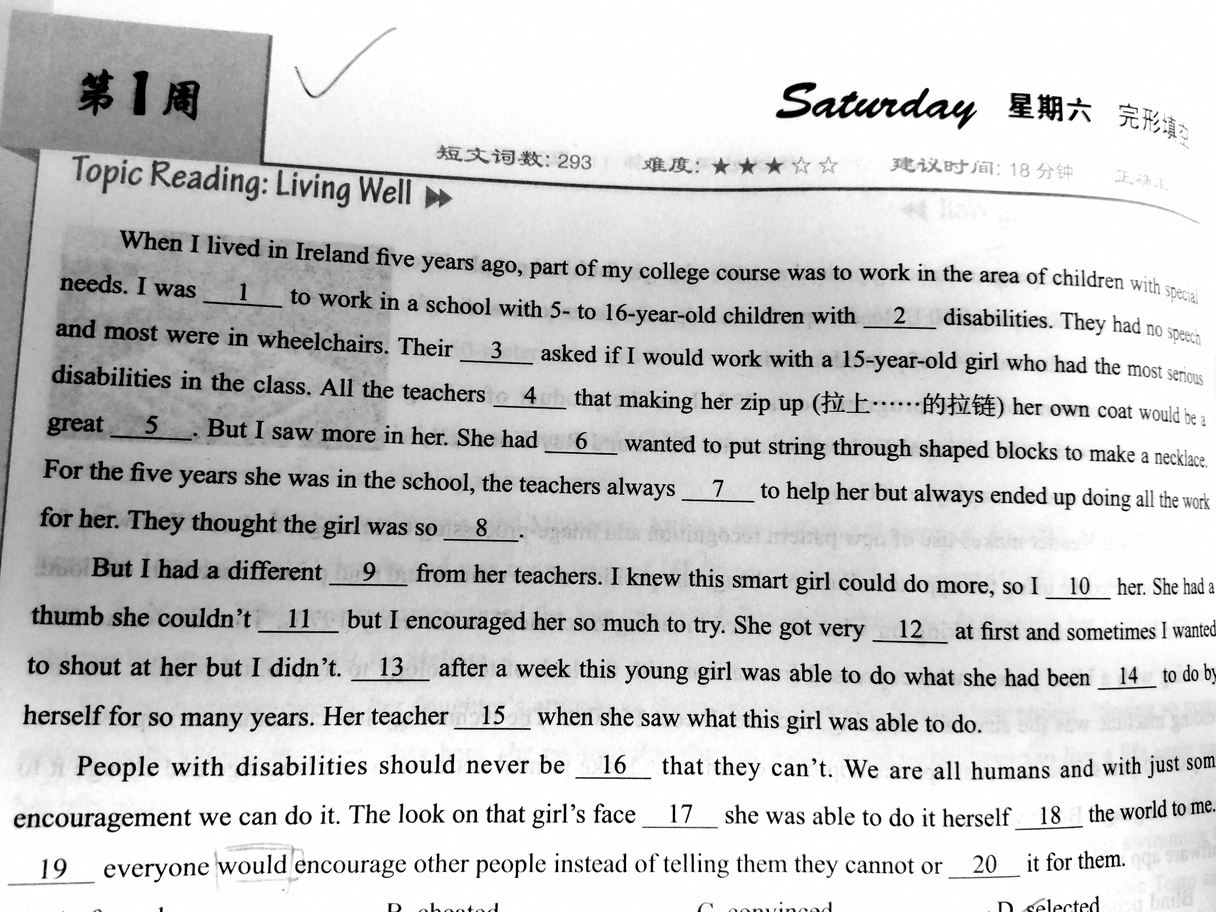

unable to take care of yourelf or things without the help of others
unhappy/disappointed/worried
无自理能力的，不能自立的，无助的。

Slide 61


