Slide 1


情态动词

Slide 2





Slide 3
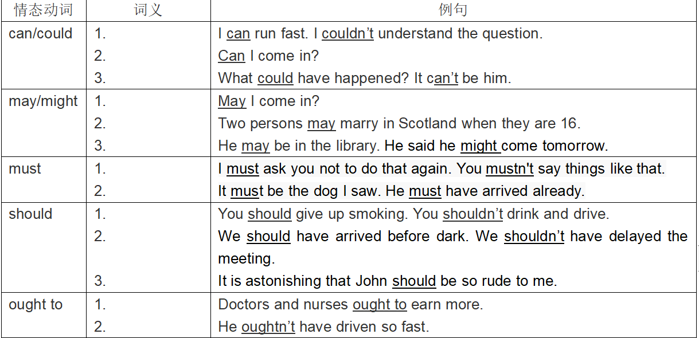
能力
be able to: 具体，努力，做成
能够（请求/允许）
可能（推测）
可以（请求/允许）
可以（请求/允许）
也许（推测）
必须
have to 客观， don’t have to 不必
must表推测只用于肯定句
一定（推测）
应该（责任/义务）
本应该（虚拟）
竟然（推测）
应当（责任/义务）
本应当（虚拟）

Slide 4
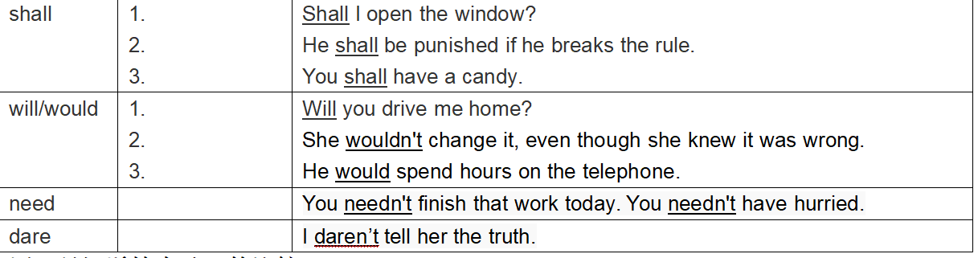
可以（请求/允许）
警告/命令
在条约，规章制度中用shall表示义务或者规定。
允诺
意愿
意愿/决心
过去的习惯
used to do过去习惯，现在不做了
需要
敢
need, dare实义动词？
4.用非人称主语时，won’t和wouldn’t 表示某物暂时的特性，“就是不能”。
The door won’t shut. Better have it repaired. That morning my car wouldn’t start.
open,close, stop, move

Slide 5
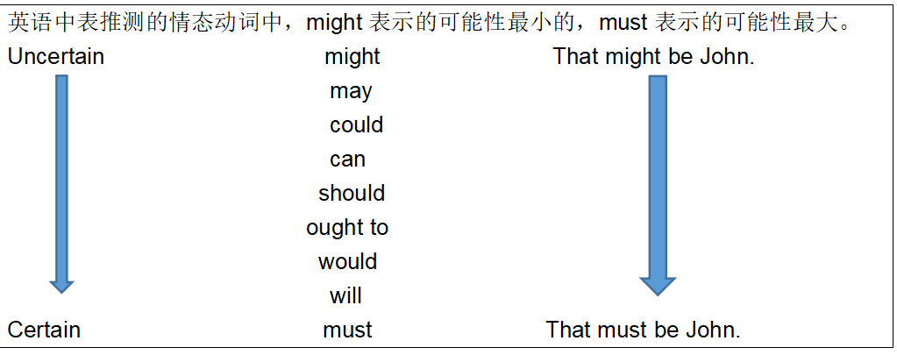

Slide 6
 | 虚拟 | 推测
may/might have done | 本可能 | 过去可能（不太确定）
could have done | 本能够 | 过去可能（比较确定）
should have done | 本应该
would have done | 本要，本会
否定 （略）
1.我本来要去你家，但我妈病了。
2.我本来能不在老师帮助下自己做出来这道数学题的。
3. 昨天如果我跑慢点，可能就要错过巴士了。
4. 你本应该告诉我事实真相，但你却撒谎了。
1. 他没接电话，他可能忘记充电了。
2. 街道是湿的，昨晚可能下过雨。

Slide 7
Subjunctive Mood
虚拟语气

Slide 8
虚拟语气的考点
if条件句中的虚拟语气及它们的变体；
虚拟语气在其他情况下的用法

Slide 9
主从句的谓语形式
时间
If 从句的谓语形式
主句的谓语形式
现在
would/could/should/might +v
did / were
would/could/should/might+have done
过去
had done
1. did / were
2. should do
3. were to do
would/could/should/might + v
将来

Slide 10
含蓄条件句（省略了If的条件句，主句不变）
与过去相反：
Without /But for your advice, I would not have made such rapid progress. 要不是...
Thanks to your advice, otherwise/ or (else) I would not have make such rapid progress. 否则...
与现在/将来相反：
Without your help, I wouldn’t be where I am today/ in the future.

Slide 11
if only, wish, would rather, as if/though引导的从句的虚拟
现在：If only I were a bird.
过去： If only I had listened to your advice years ago.
将来： If only he would/could go to Tsinghua University.
现在：I wish I knew what to do.
过去：I wish you had come to our party last night.
将来：I wish he would/could try again.
现在：He talks as if he knew everything.
过去：Why are you talking to me as if I had done it?
将来：Mr. Smith is so happy as if he would/could fly.
现在：I’d rather you took me away now.
过去：I’d rather you hadn’t done it.
将来：I’d rather Tom were here tomorrow.
不同于I’d rather do sth that do sth

Slide 12
2. 虚拟语气的其他情况 should
（各种从句中的用法）

Slide 13
一、表示要求,命令,建议的虚拟语气
宾语从句中，主句的谓语动词如果是以下词：
命令，要求，建议，坚持
1. order, command
2. demand , require, request, desire
3. advise, suggest（建议，非暗示）, propose
4. insist (坚持要求做..., 非坚持认为)
从句中的谓语动词用： (should )+ do

Slide 14
1.The guard at gate insisted that everybody
_______________(obey)the rules. ？从句
2. Your suggestion that she _______________
(wait) till next week is reasonable.
3. The orders are that nobody _____________ (leave) here.
4. It is proposed that overtime working ________________________(abolish).
命令要求建议的虚拟可见于 各种名从，宾从较为常见。
(should)obey
(should)wait
(should)leave
(should) be abolished

Slide 15
二、表达重要、必要、惊讶的主语从句
在句型 “It is important (necessary, natural， advisable, strange) that .... ” 中，that 后面的从句中的谓语动词用： (should) + 动词原形
[例句]
1) It’s necessary that we (should )have a walk now.
我们有必要出去散散步。
2) It’s natural that she (should) do so.
她这样做是很自然的。
3) It’s important that we (should) take good care of the patient.
重要的是我们要照顾好病人。

Slide 16
三、用在It is (about/high) time (that)…句型中，其中that-从句属于定语从句范畴。
五 定语从句
It is time that everyone should/ took action to make a change .
should此时不能省略

